Slide 1
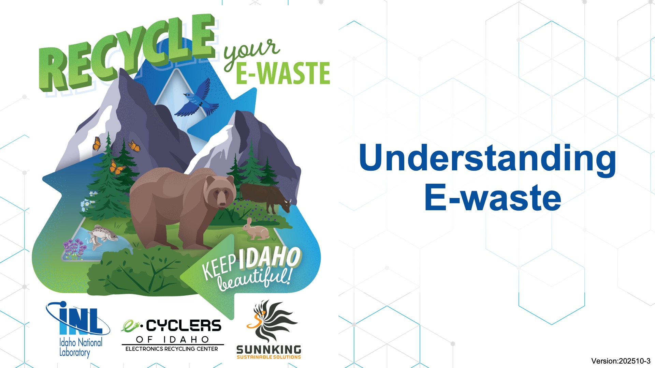
Notes:
Thank you for allowing us to present to you today!

Slide 2
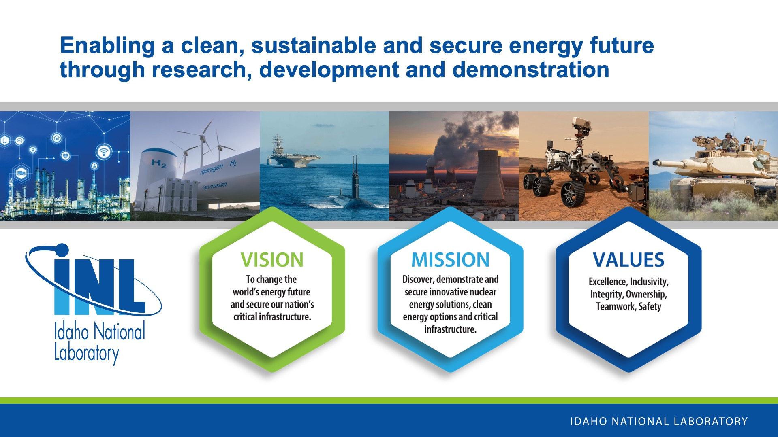
Notes:
INL is the nation’s center for nuclear energy research and development, celebrating 75 years of scientific innovations in 2024. The laboratory performs research in each of DOE’s strategic goal areas: energy, national security, science and the environment.

Slide 3




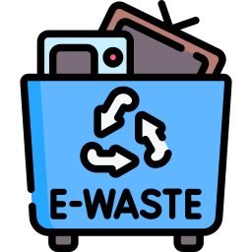



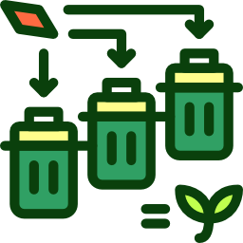
What are Electronics?
Battery Basics
E-waste
What’s Inside? Critical Materials
Agenda
Product Life Cycle
Benefits of Recycling E-waste
Start Recycling E-Waste

Slide 4

01
What are Electronics?
Devices that controls and directs electricity to perform tasks and/or process information.
Think of things that plug-in or require a battery!
Notes:
Ask: How would you define the term “Electronic”?
A device that controls and directs an electric current in order to work.
Picture source: https://www.redeweb.com/en/actualidad/que-son-los-aparatos-electronicos/
https://depositphotos.com/photos/electronic-devices.html
https://depositphotos.com/photos/electronic-devices.html

Slide 5
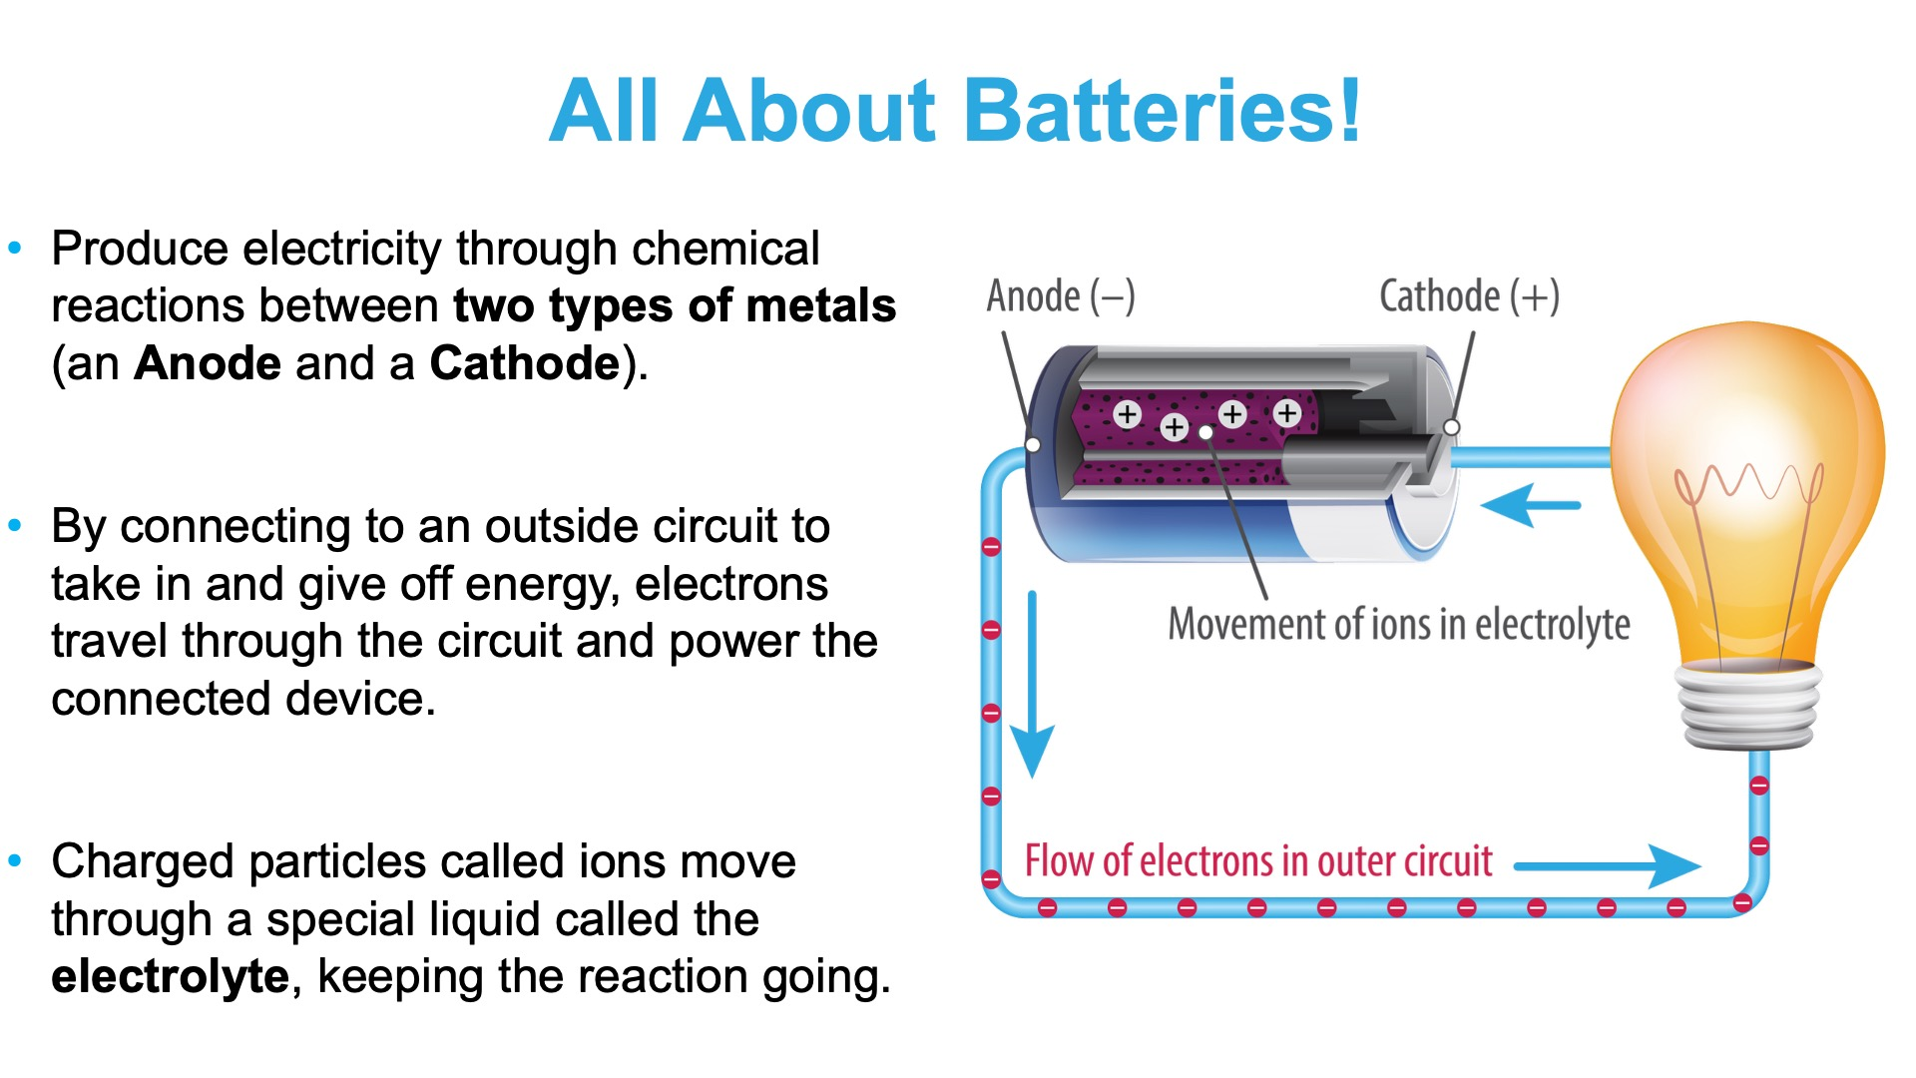
Notes:
A device that creates electricity through chemical reactions between an anode (–) and cathode (+), with ions moving through an electrolyte
It’s a chemical reaction between two types of metal that creates a flow of electrons.
Inside the battery, through a special liquid called an Electrolyte allows charged atoms to move between the two ends of the battery to keep the chemical reaction going.
By connecting to an outside circuit, electrons travel through the circuit. inside the battery, charged particles called ions move through a special liquid called the electrolyte.

Slide 6
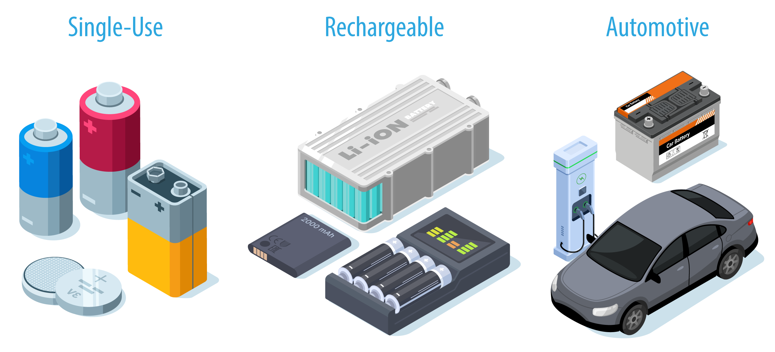
Types of Batteries​
Notes:
Single-use batteries = short lifespan. (AA, AAA, 9-volt, and D cells).
Common uses: alarm clocks, remote controls, flashlights, smoke detectors, and more.
Rechargeable batteries = charge them again and again.
Common uses: cordless phones, smartphones, and digital cameras, as well as in cordless power tools and similar gadgets.

Slide 7
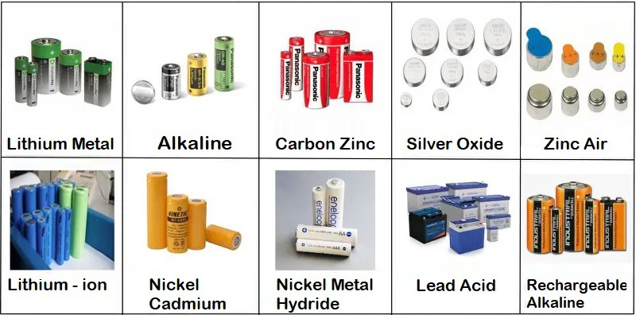
Why Batteries Matter
They contain critical materials like Lithium and Cobalt
Source: https://www.fairfaxcounty.gov/publicworks/recycling-trash/batteries
Notes:
There are many types of chemicals that can be used in batteries, and the choice depends on how the battery is designed and what it’s meant to power.
The batteries found in smartphones and electric cars are known as lithium-ion batteries.
You usually don’t see them because they are rechargeable and don’t need to be changed often; they are tucked away safely inside the devices (Roger Clarke,2019).

Slide 8
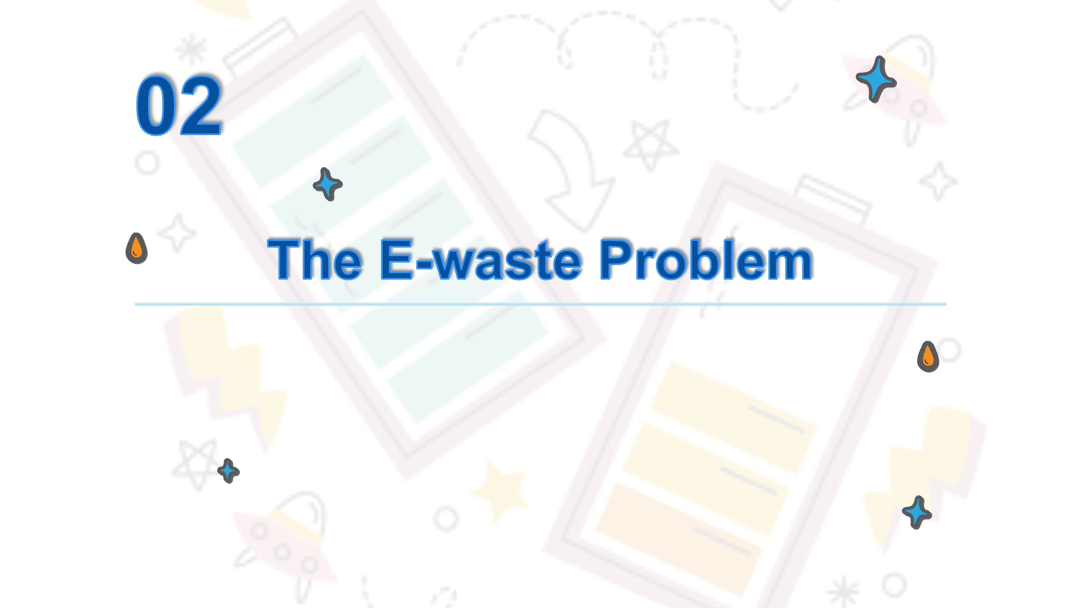
Notes:
In this section, you will learn:
How do you recycle?
What is E-Waste?
E-waste Categories
Batteries

Slide 9
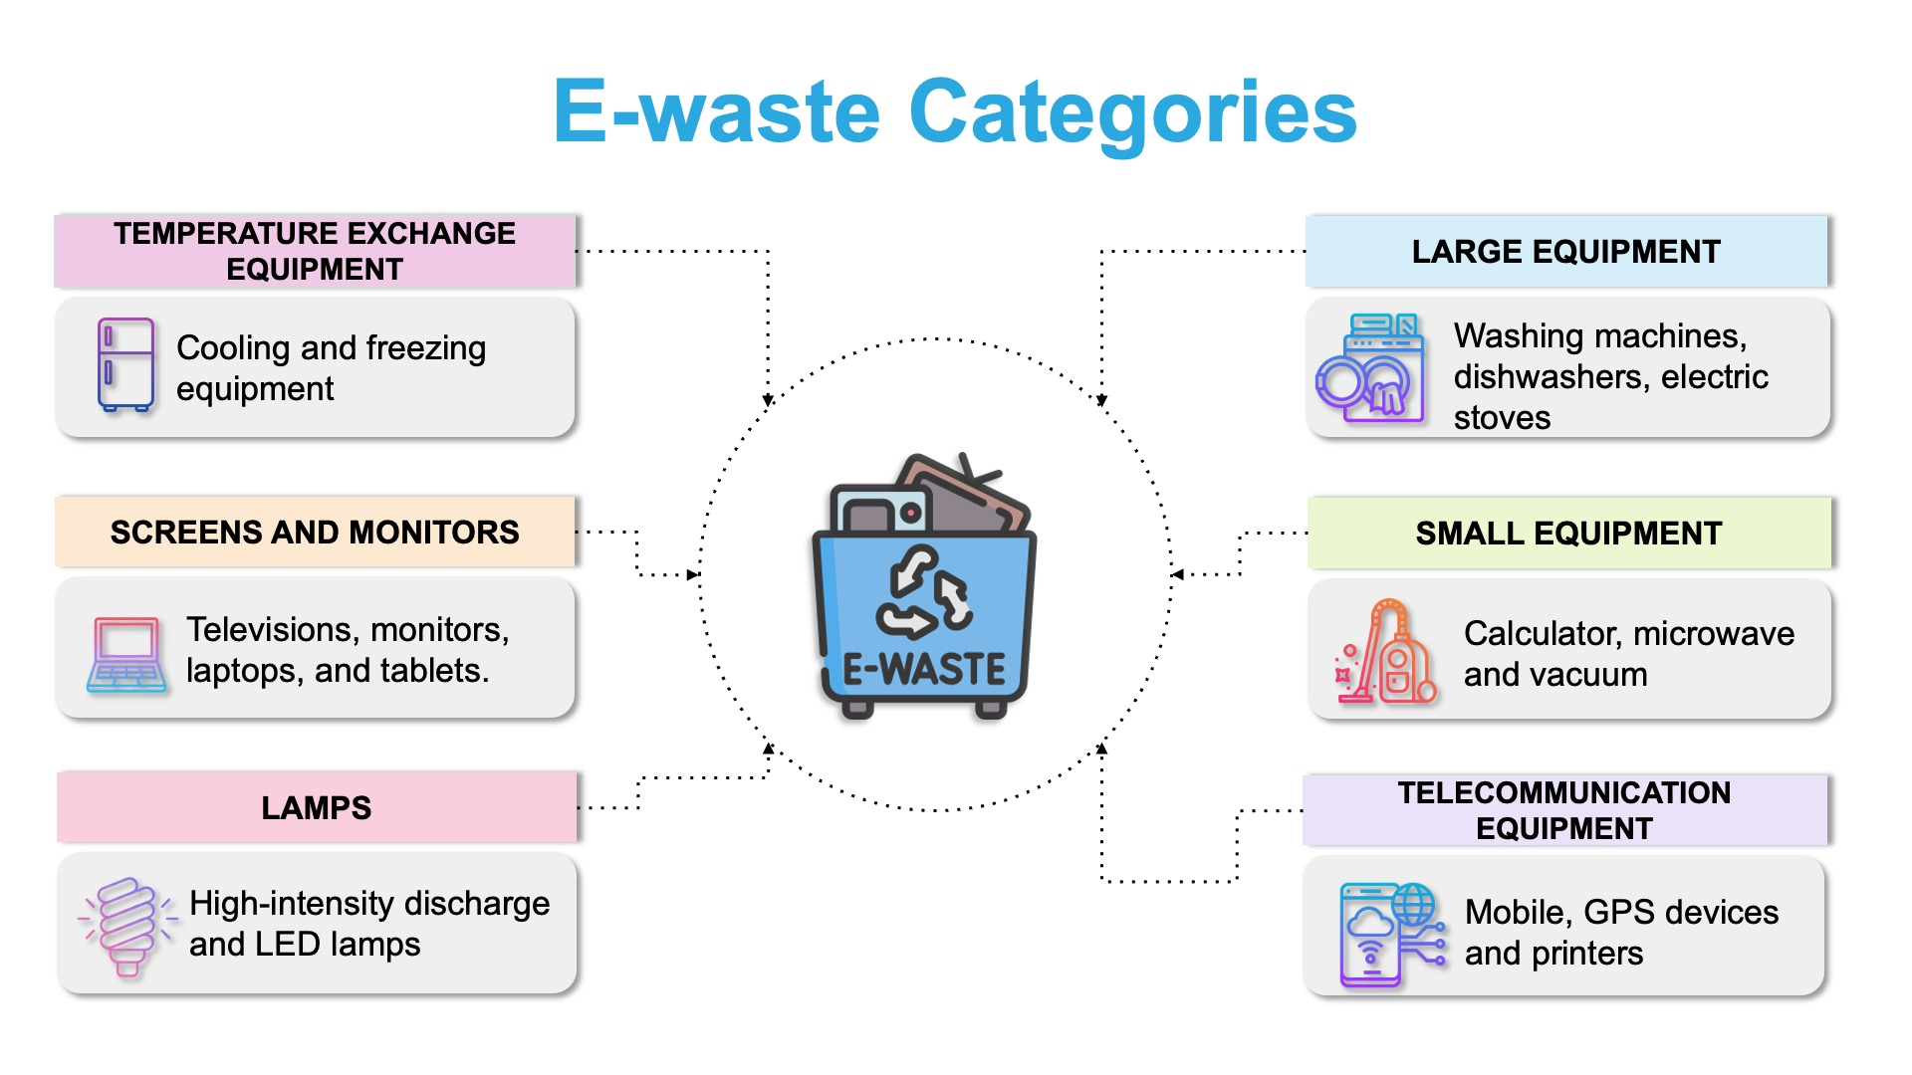
Notes:
As you all have heard, there are so many different kinds of electronics in all types of rooms! So it makes sense that not all of them are the same when it comes to recycling. A fridge is going to have a very different recycling process than a phone, for example. Can we think of maybe reasons why they would be different?
It is easier to recycle and repurpose electronics that are more similar. The people who recycle electronics have around 6 major categories to make it easier for them! They range from smaller things like lightbulbs to screens like laptops and phones, all the way to fridges and heaters.
[Source: Global E-Waste Monitor 2024, Page 21]

Slide 10
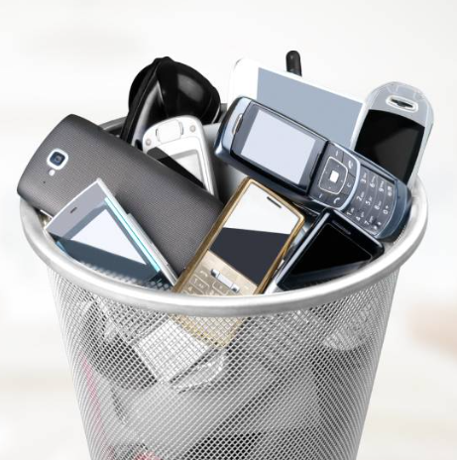
Growth of Technology
Do you know anyone that:
Got a new phone when their old phone still worked?
A new TV when their old tv still worked?
Got new appliances, power tools, toys, etc?
Notes:
There’s new tech being introduced every day.
New vocabulary alert: Obsolete - no longer in use or no longer useful
Technology growth and obsolescence (“becoming obsolete) are closely intertwined, with rapid advancements often leading to shorter product lifecycles. This cycle is worsened by planned obsolescence, where products are intentionally designed with a limited lifespan to encourage frequent replacements. As new technologies emerge, older devices quickly become outdated, contributing to increased E-Waste.

Slide 11
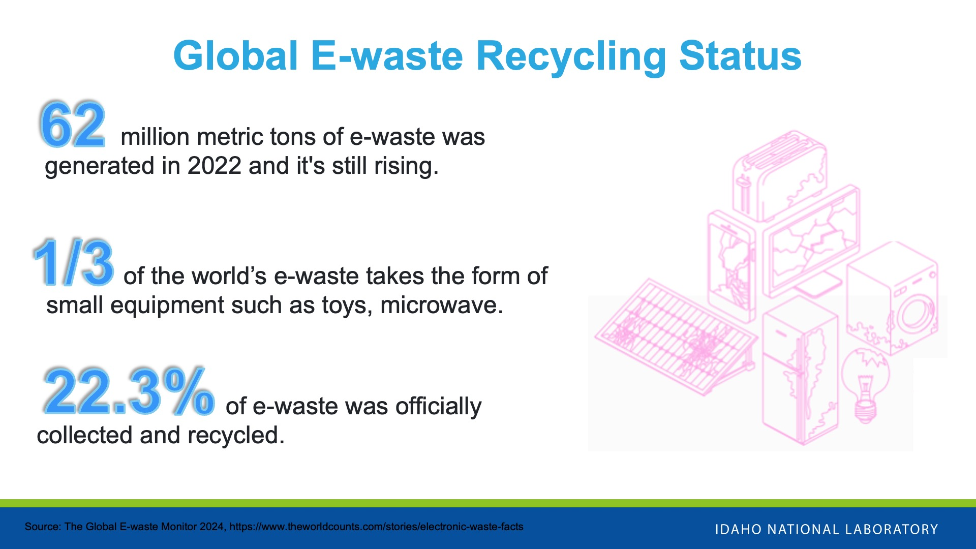
Notes:
https://ewastemonitor.info/the-global-e-waste-monitor-2024
The e-waste generated in 2022 contained 31 billion kg of metals, 17 billion kg of plastics, 14 billion kg of other materials (minerals, glass, composite materials, etc.)
36 countries have provisions on e-waste recycling rate targets.

Slide 12
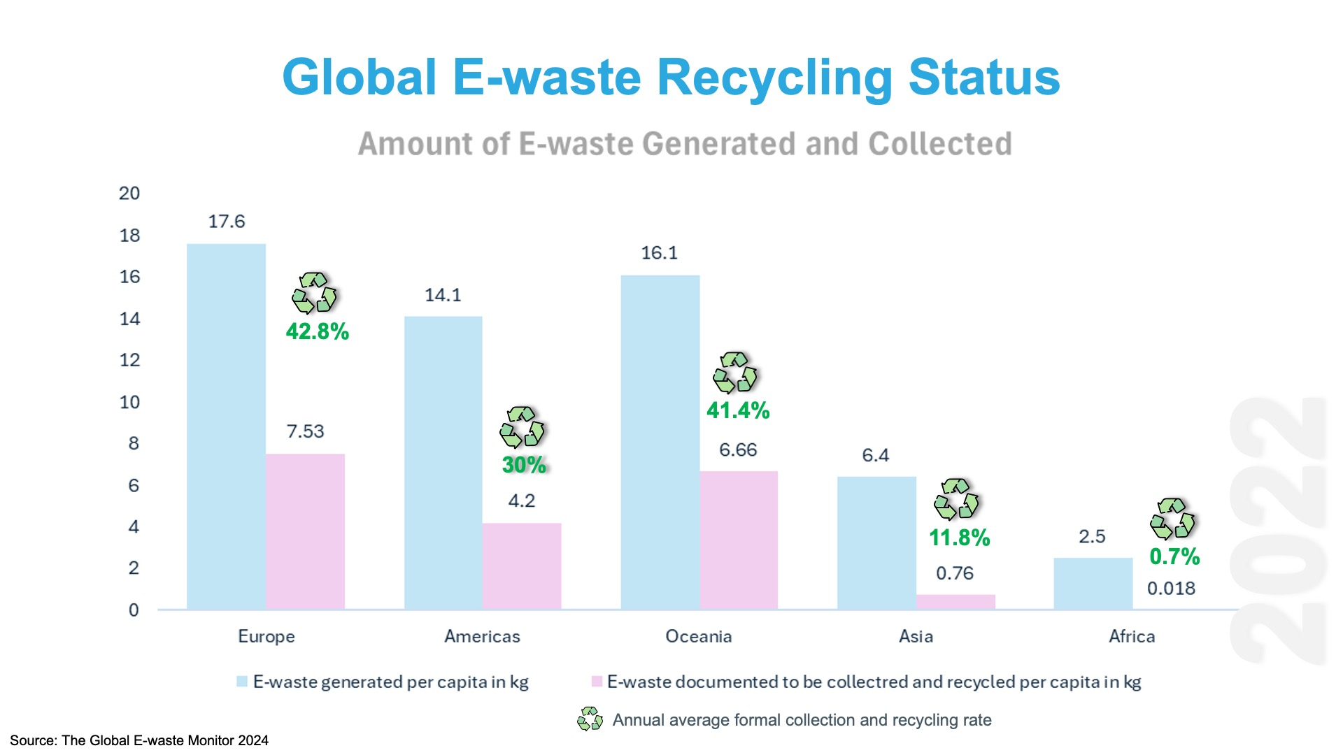
Notes:
An improperly disposed device can do harm to our local environment. Over time, these devices breakdown and leach out heavy metals like lead, mercury, cadmium and beryllium which can harm local wildlife and the environment. , E-waste heaps in landfills release toxic chemicals into the groundwater, and this finds its way to nearby wells and freshwater bodies. Harmful chemicals can make their way to our water sources and end up harming people, too!
In addition, critical materials like lithium and cobalt, can be extracted from e-waste and used again. This reduces the need to open new mines for these materials! Pollution overall can be reduced and less energy needs to be used for new product manufacturing.

Slide 13
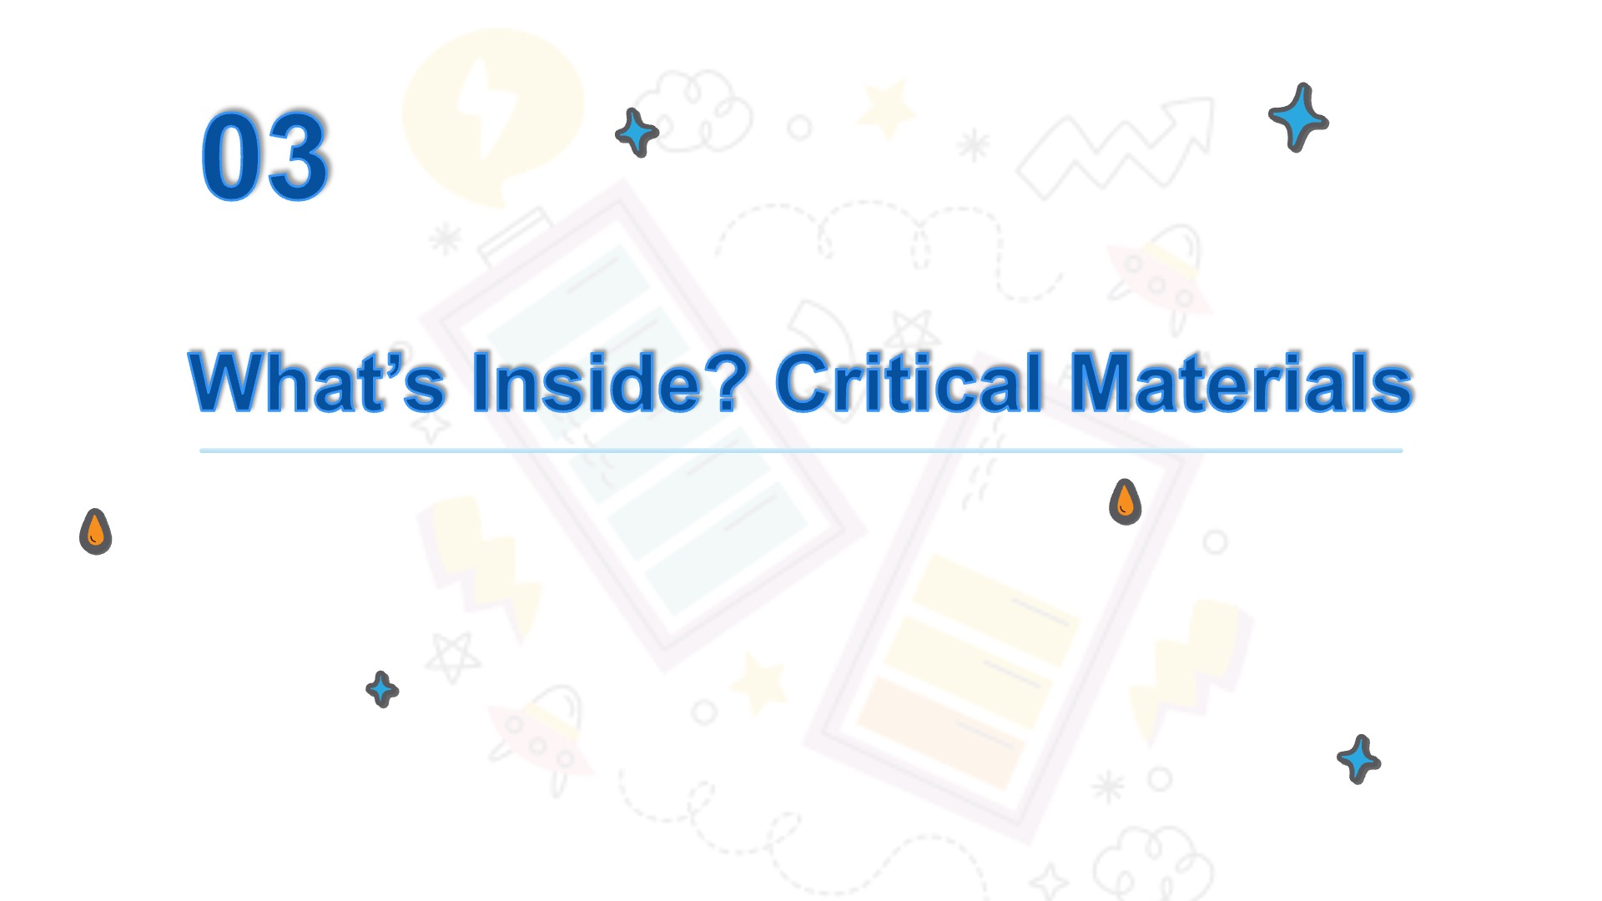

Slide 14

Electronics Demo
Notes:
Demonstration of E-Waste (examples from E Cyclers)

Slide 15
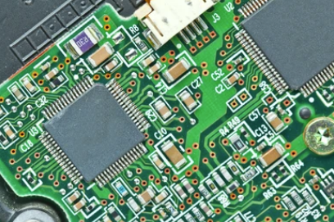
Based on what you saw inside the electronics demonstrated……
What do you think they are made of?
15/27
Notes:
Demonstration of E-Waste (examples from E Cyclers)

Slide 16
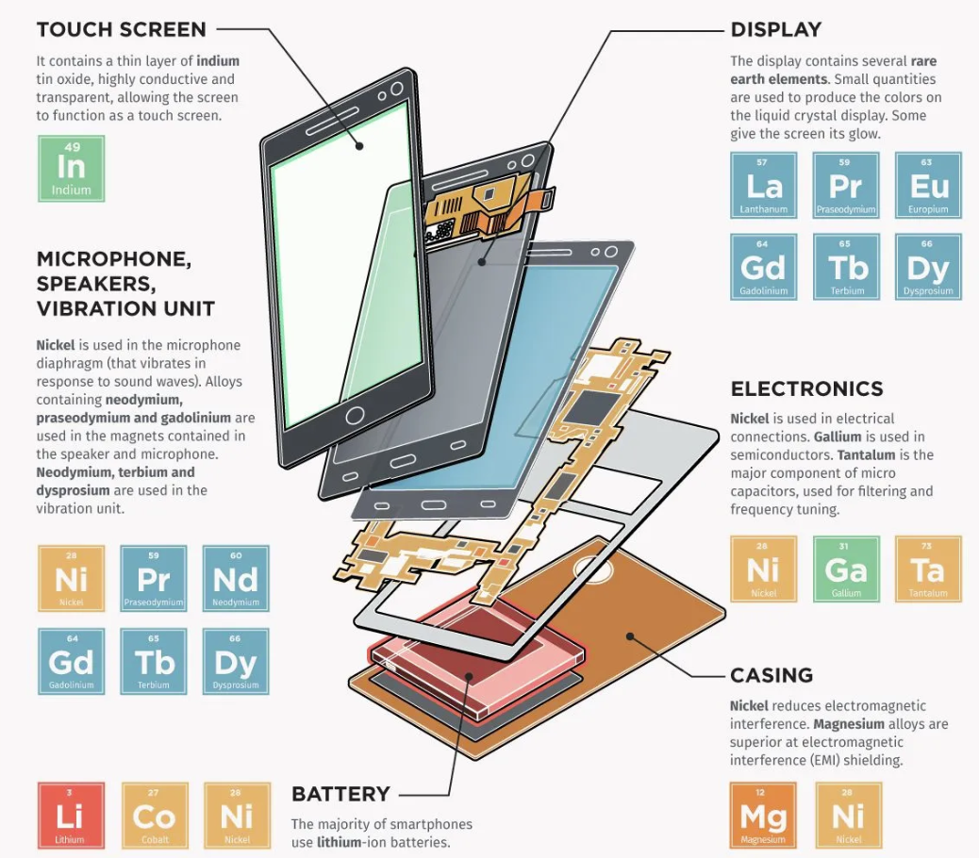
Smartphone Critical Metals
Some vital metals used to build these devices are at risk due to global scarcity, trade policy, and geopolitical issues.

Slide 17
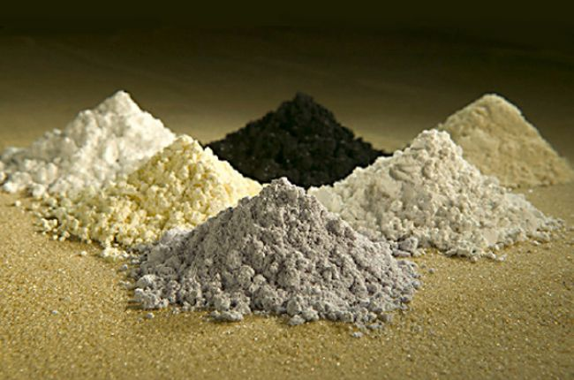
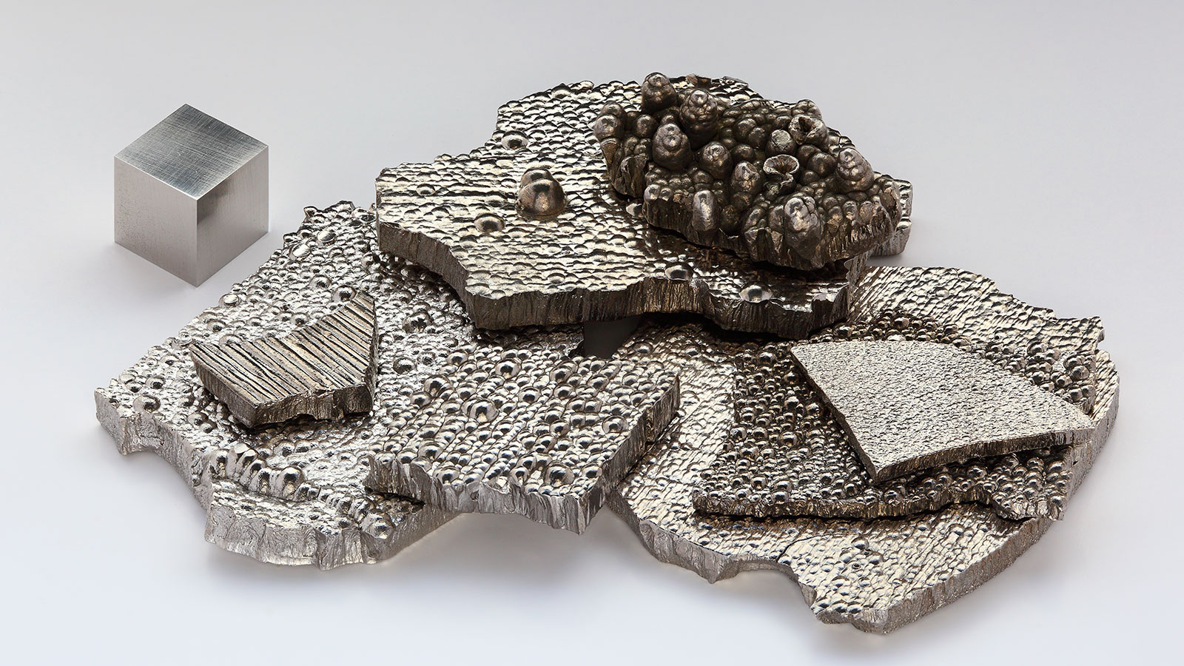
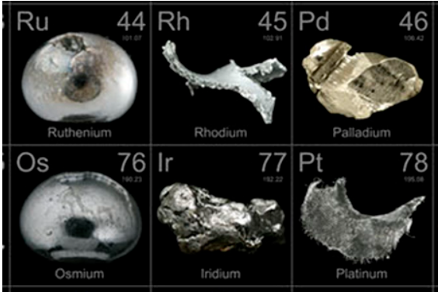
What are the Critical Materials?
Rare earth elements - used in offshore wind turbine generators and electric vehicle motors.
Lithium, cobalt, and high-purity nickel - used in energy storage technologies.
Platinum group metals - used in catalysts for automotive, chemical, fuel cell, and green hydrogen products.
Rare earth elements
Cobalt
Platinum group metals
Notes:
https://www.americangeosciences.org/critical-issues/faq/what-are-rare-earth-elements-and-why-are-they-important
https://science.howstuffworks.com/environmental/earth/geology/cobalt.htm

Slide 18
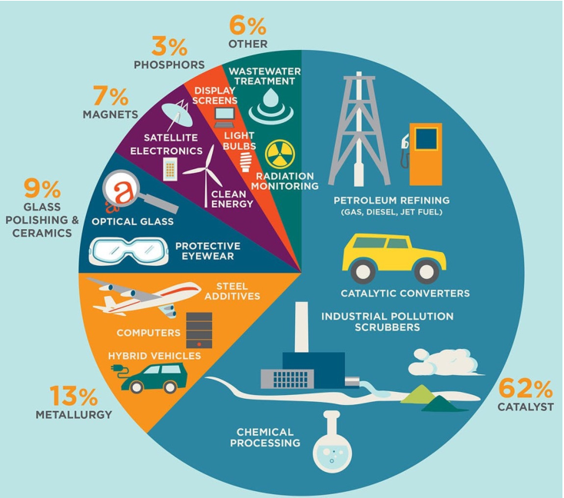
Why are Critical Materials so "Critical"?
  Have important and unique features to advanced products or systems.
  Crucial for the operation and reliability of many industrial environments.
  Have no easy substitutions.
  Significant risk in the supply chain.
Notes:
https://www.energy.gov/cmm/what-are-critical-materials-and-critical-minerals

Slide 19
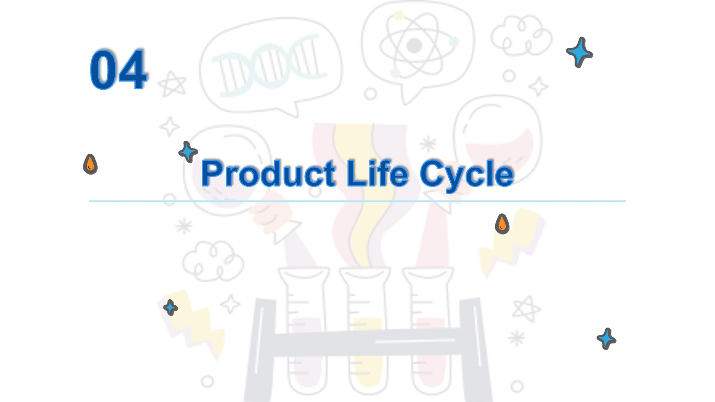

Slide 20










Product Life Cycle
Raw Materials
Materials Supply
Manufacture
Recycling
Product Sale
Landfill
Reuse/Refurbish
Electronic Use
E-waste Collection
Piling up at home
Notes:
https://www.electropages.com/blog/2024/09/understanding-global-e-waste-crisis(Electronics 2024)

Slide 21
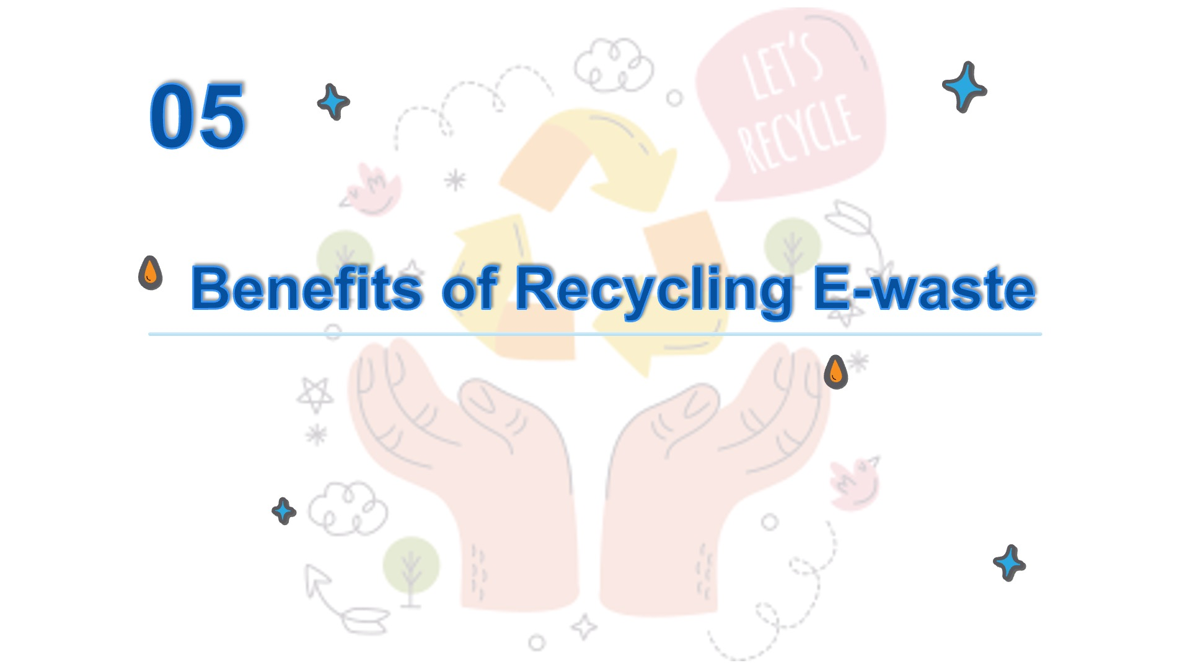
Notes:
Batteries are very important for a lot of electronic devices today. But, we have to be careful when those devices don’t work anymore! The materials in batteries and most e-waste can be extremely harmful if recycling isn’t happening.

Slide 22
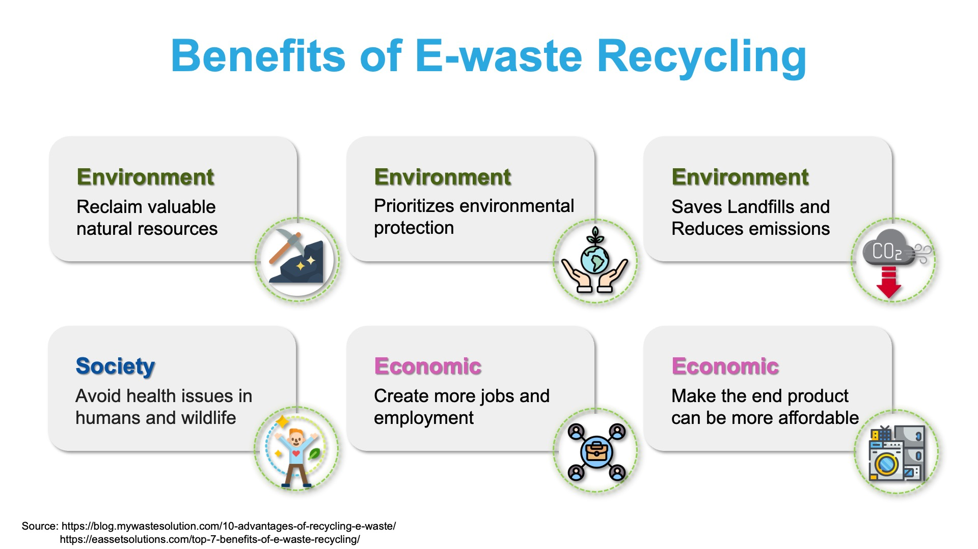
Notes:
It Prioritizes Environmental Protection
E-waste recycling prioritizes environmental protection. It includes proper handling, processing, and managing of electronic waste. As hazardous and toxic substances such as lead, mercury, and cadmium present in electronics can harm the environment. You may find many valuable resources or materials in an e-waste stream. Through E-waste recycling, we make most of these components instead of discarding them. This way, the hazards that these elements could have potentially caused to our environment are reduced.
Societal Benefits
E-waste recycling helps reduce the discharge of such hazardous toxins and maintains the balance in aquatic ecosystems. As a result, you help preserve the freshwater ecosystem for plants, animals, and even people who depend on them as livelihood sources.
E waste Recycling Helps to Conserve Available Natural Resources
Electronic waste recycling helps recover valuable materials from electronic products. This saves and conserves natural resources. This way, manufacturers do not need to mine the minerals; instead, they can just recycle and reuse the components of e-waste. So, yes, we can save copper or lead or valuable metals from mother nature. Thus, it promotes the utilization of resources wisely.
Creates Jobs
E-waste recycling is creating new jobs for people and local recyclers nearby. The more important thing is that, by doing so, it has created a secondary market. Where recycled materials are the primary commodity. The Environmental Protection Agency released findings that show the magnitude of economic benefits that come from e-waste recycling. In a year, the US’s recycling activities provided 757,000 jobs, $6.7 billion in tax revenues, and $36.6 billion in wages. By implication, for every thousand tons you recycle, there are 1.57 jobs created, $ 76,000 in wages paid, and $ 14,101 in tax revenues. So a lot of benefits come from trash, right? But there’s more. For a million laptops you recycle, you will have saved the equivalent of electric power capable of running 3657 households for one year. Guess what? For a million cell phones, you can recover gold weighing 75 pounds, silver of 772 pounds, copper of 35,274 pounds, and palladium of 33 pounds! There is also a significant social and economic impact. According to the EPA, recycling and reusing e-waste accounts for 681,000 jobs in a single year. Of course, e-waste is only a part of that, but as the fastest-growing waste stream, it is likely to become increasingly significant as we become more reliant on digital devices.
Increases Affordability
Using recycled components obtained from e-waste are cheaper than ones obtained from mining activities. This way, manufacturing costs can be reduced, and the end product can be more affordable. Copper found in e-waste can be reused multiple times. This has made the copper recycling business a lucrative industry today.

Slide 23
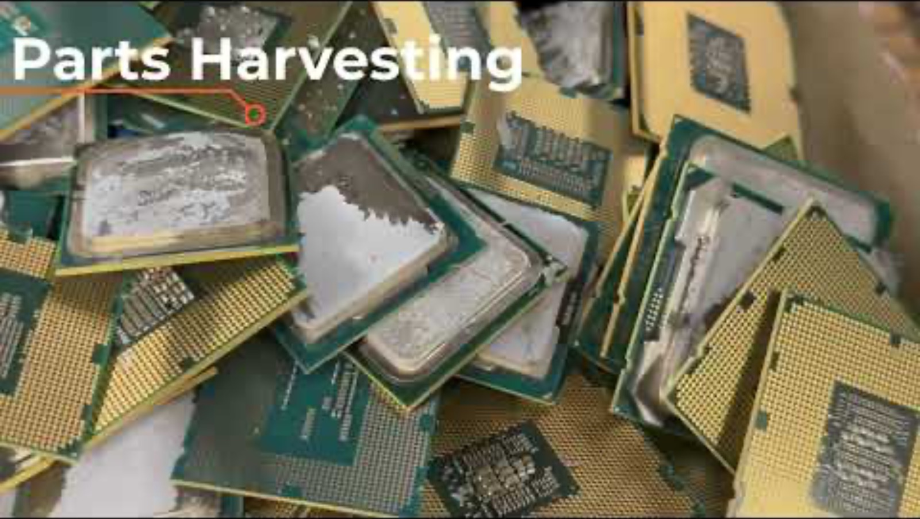
The E-waste Recycling Process
Notes:
Click to watch video on YouTube - https://www.youtube.com/watch?v=k7bHflfCtXw

Slide 24
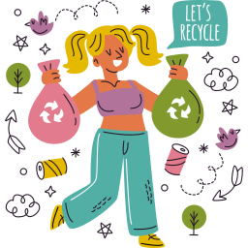
06
Start Recycling E-Waste
Notes:
I hope you’ve all learned the value of recycling old, broken, or unused electronics. But, you’re probably thinking:
Where do I go?
How do I get started?
How do I tell my friends and family?

Slide 25
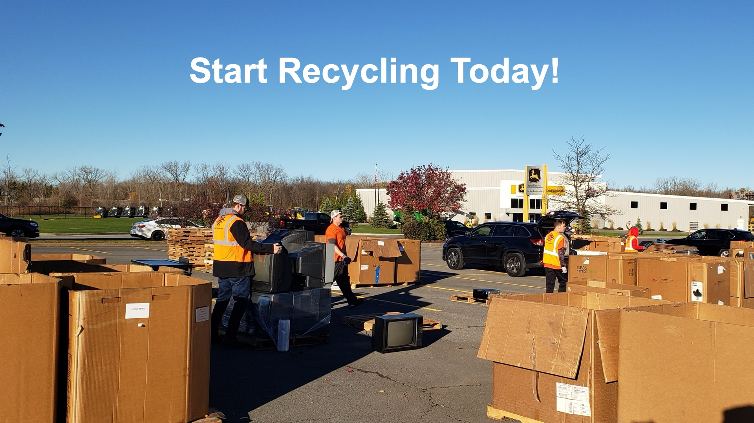
Start Recycling Today!
Notes:
We’ve placed recycling bins for e-waste at your school already! Talk to your parents first, but, if you have e-waste at home (Ask the kids for examples of e-waste).
We want to do a contest that involves the whole school! <School Name> is competing against other schools in your district. Who ever collects the most e-waste over the next 4 weeks is the winner.
You’re school will receive special recognition. Plus, E Cyclers will donate money to your PTO so that the PTO can continue offering awesome events and supporting your teachers.

Slide 26

Questions??

Slide 27
E-Waste Tic Tac Toe
Notes:
E-waste sorting game

Slide 28
Tic-Tac-Toe
1
2
3
1
2
3
4
5
6
4
5
6
7
8
9
7
8
9
choose

Slide 29



1
How does a battery work, and what are its three key parts?
BACK TO GAME

Slide 30
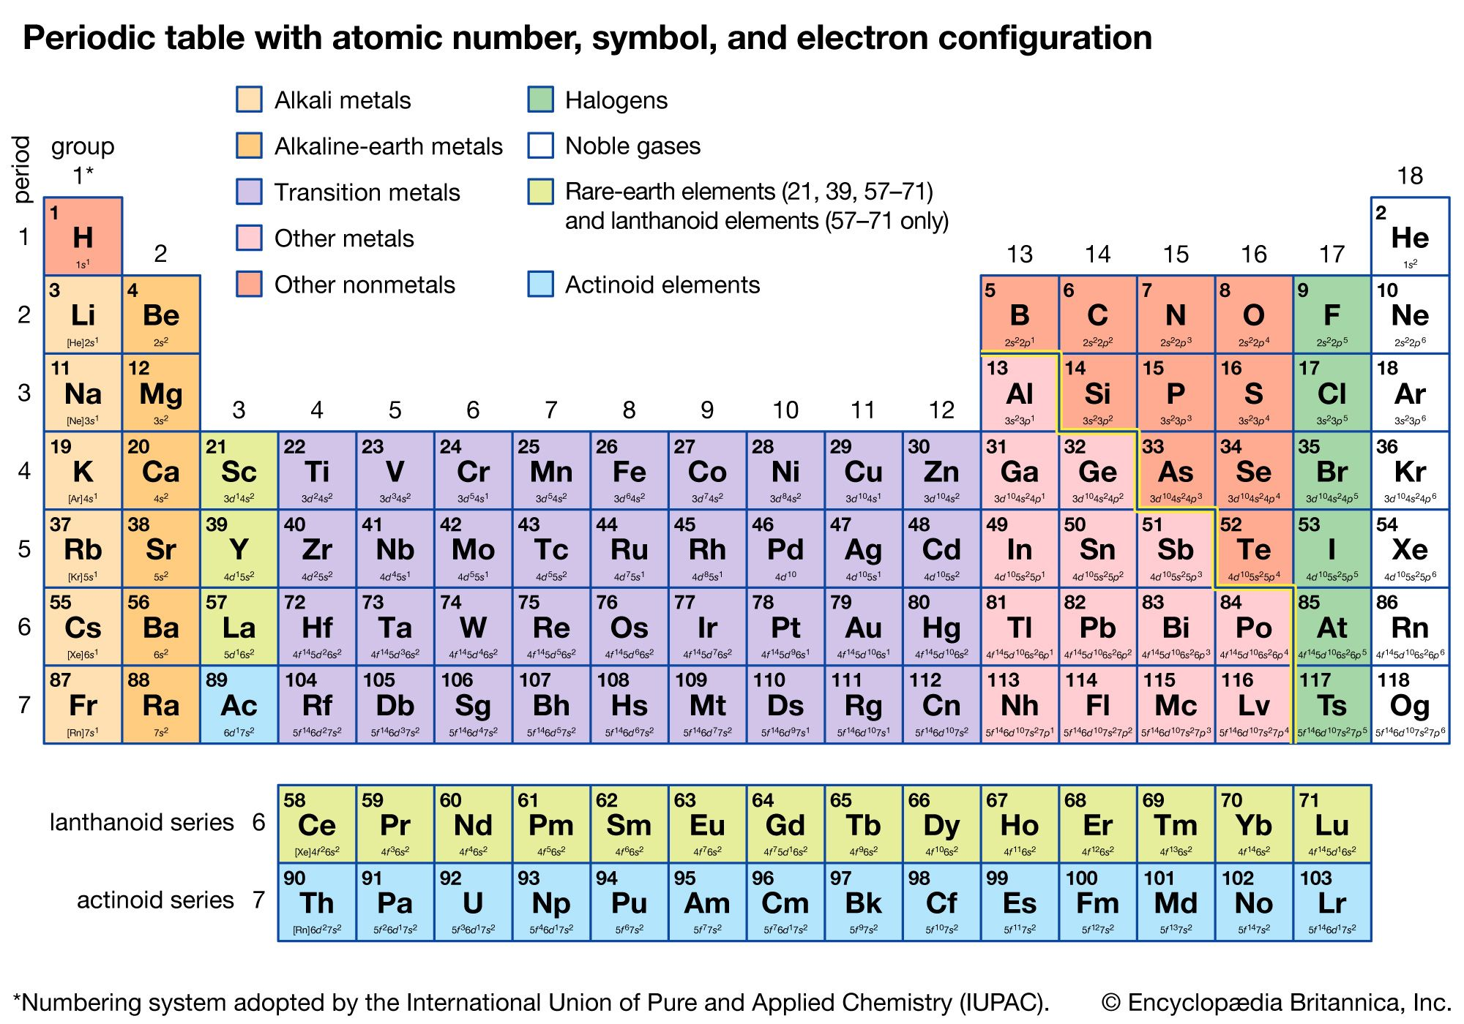
2
Please name three elements from the Periodic Table that are commonly used in electronics.
BACK TO GAME

Slide 31
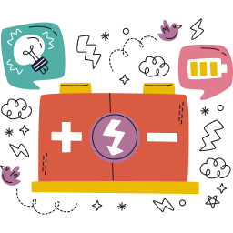
3
How many types of batteries are there? List 1 example for each type.
BACK TO GAME

Slide 32

4
How much total e-waste was generated in 2022?
A.10 metric tons
B.72 metric tons
C.62 metric tons
BACK TO GAME

Slide 33

5
Give 2 reasons why critical materials are considered "critical."
BACK TO GAME

Slide 34

6
How can e-waste recycling help the environment? Give 2 reasons.
BACK TO GAME

Slide 35

7
What are the steps in a product life cycle? Name or describe them simply.
BACK TO GAME

Slide 36

8
What are three potential pathways for end-of-life electronics?
BACK TO GAME

Slide 37

9
What are some examples of electronic waste? Provide at least 5.
BACK TO GAME

