Slide 1
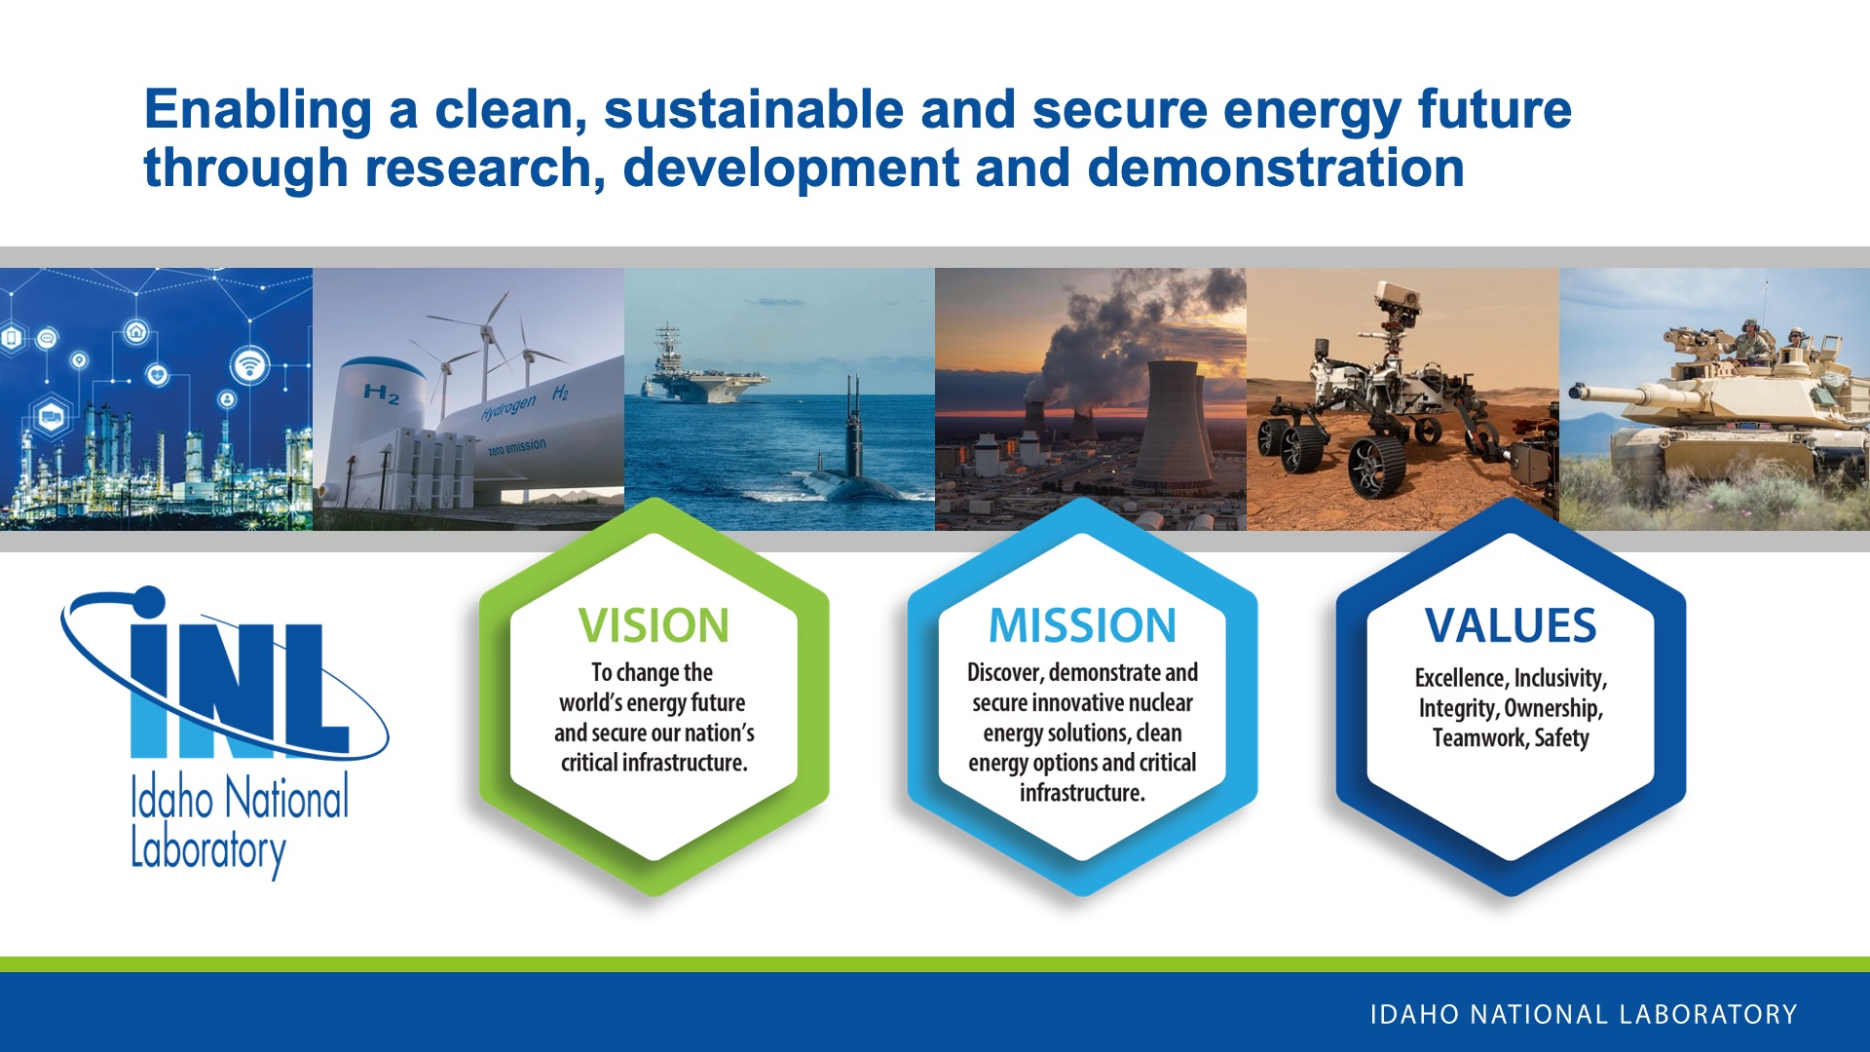
Notes:
INL is the nation’s center for nuclear energy research and development, celebrating 75 years of scientific innovations in 2024. The laboratory performs research in each of DOE’s strategic goal areas: energy, national security, science and the environment.

Slide 2
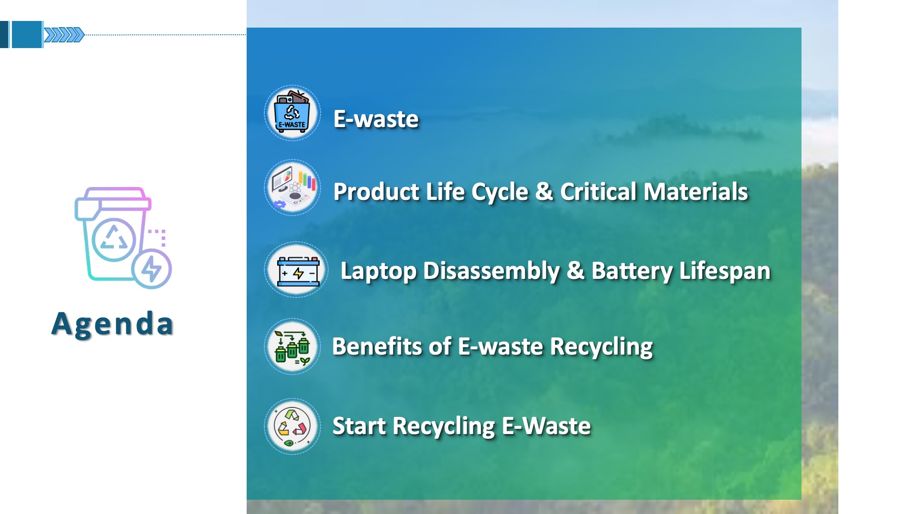

Slide 3
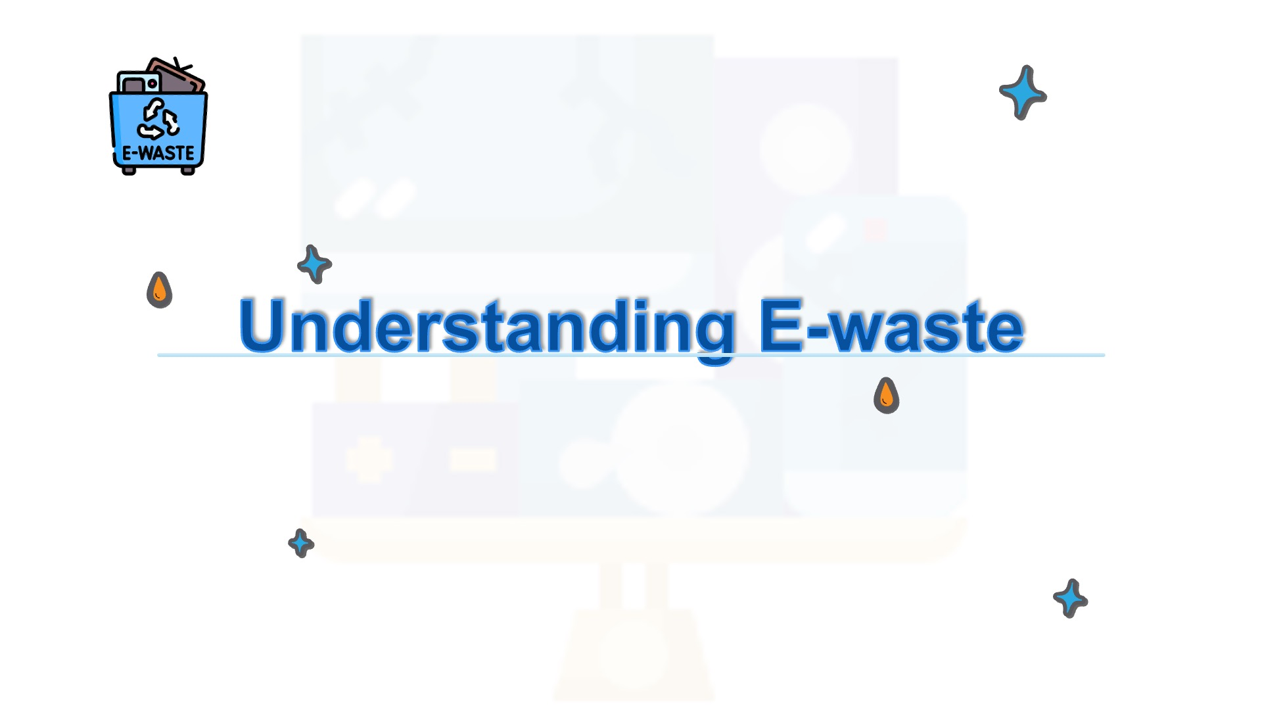
Notes:
(Ask the audience and engage with them)
Do you and your family recycle anything?
What are items in your home that you can recycle?
Let me ask you something: how many of you have an old phone or a broken gadget just lying around in a drawer at home? Now, picture if that little device could actually help save the planet. In 2022, the world produced a staggering 62 billion kilograms of e-waste—that’s about 7.8 kg for every person[1]. Surprisingly, only 22.3% of that was recycled properly. The rest? It ended up in landfills, incinerators, or was dumped in areas with little to no environmental protection1. And that’s a huge issue. E-waste contains harmful materials like lead, mercury, and cadmium, which can seep into our soil and water, endangering wildlife and even human health. There are many valuable raw materials in e-waste, such as gold, silver, copper, and iron. Recycling just one million used cell phones can recover up to 772 lbs of silver, 35,000 lbs of copper, 75 lbs of gold, and 33 lbs of palladium. It’s estimated that the 53.6 Mt of e-waste generated in 2019 held raw materials worth around $57 billion. Considering that 82.6% of electronic waste wasn’t recycled, that means nearly $47 billion worth of precious metals were never recovered[1].
Recycling e-waste isn’t only about cutting down pollution, it’s also about saving resources. For instance, recycling one million cell phones can yield about 75 pounds of gold, 772 pounds of silver, 33 pounds of palladium, and 35,000 pounds of copper[1]. Plus, recycling one million laptops can save enough energy to power 3,657 U.S. homes for a whole year[1].
So, the next time you upgrade your phone or throw away an old laptop, think again. By recycling your electronics, you’re not just cleaning up; you’re also protecting the planet, conserving resources, and helping to combat climate change. Let’s be the change, one device at a time.

Slide 4
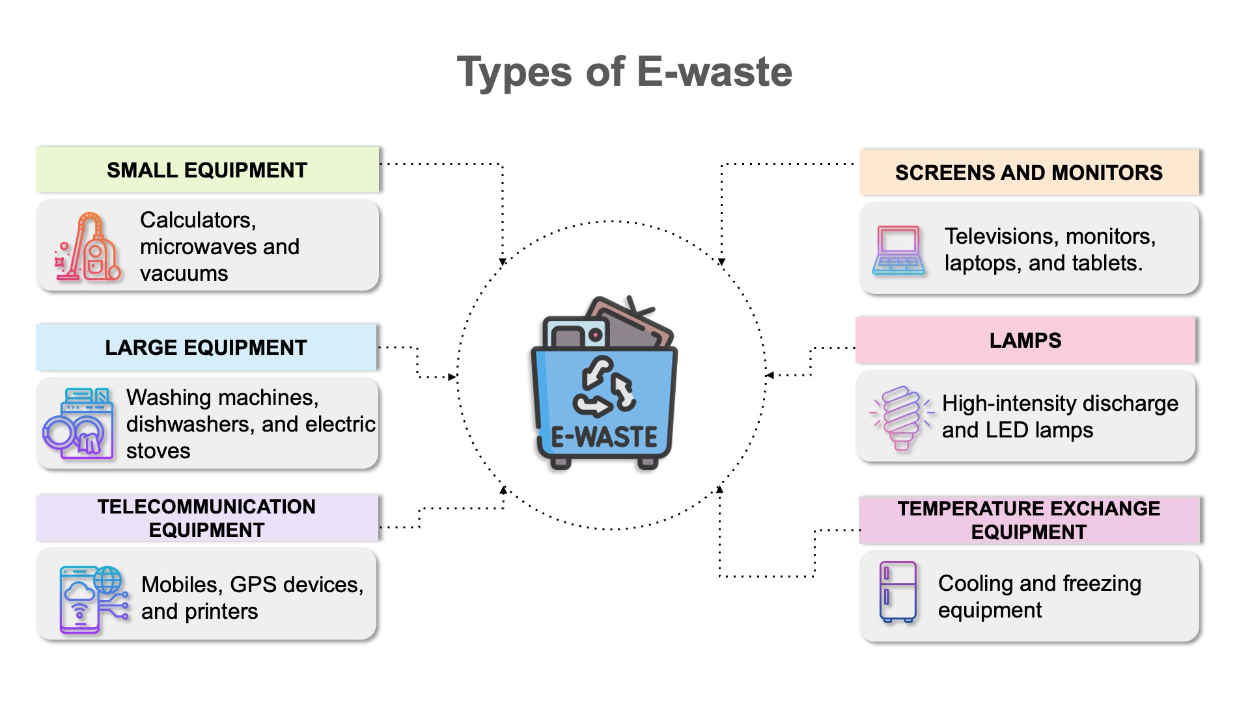
Notes:
There are a variety of different electronics and they all have different elements that make them unique. Size, material, etc. Some of these traits make it easier to recycle products, and other times it can be difficult. A fridge is going to have a very different recycling process than a phone, for example.
So to make it easier to identify different electronics with similar collection and recycling patterns, (like laptops and phones vs vacuums and microwaves), the people who track recycling have come up with around six major categories.
[Source: Global E-Waste Monitor 2024, Page 21]
Version 2 (Middle School Version)
As you all have heard, there are so many different kinds of electronics in all types of rooms! So it makes sense that not all of them are the same when it comes to recycling. A fridge is going to have a very different recycling process than a phone, for example. Can we think of maybe reasons why they would be different?
It is easier to recycle and repurpose electronics that are more similar. The people who recycle electronics have around 6 major categories to make it easier for them! They range from smaller things like lightbulbs to screens like laptops and phones, all the way to fridges and heaters.
[Source: Global E-Waste Monitor 2024, Page 21]

Slide 5
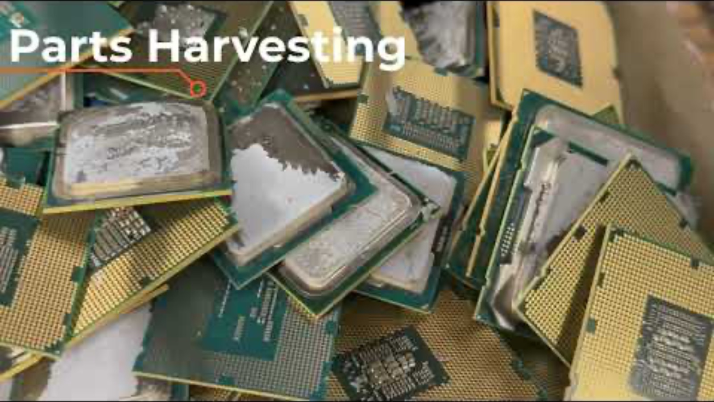
The E-waste Recycling Process
Notes:
Click to watch video on YouTube - https://www.youtube.com/watch?v=k7bHflfCtXw

Slide 6









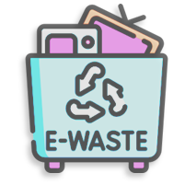
Product Life Cycle
Raw Materials
Materials Supply
Manufacture
Recycling
Battery Sale
Reuse/Refurbish
Electronic Use
Landfill
E-waste Collection
5/14
Notes:
https://www.electropages.com/blog/2024/09/understanding-global-e-waste-crisis(Electronics 2024)

Slide 7
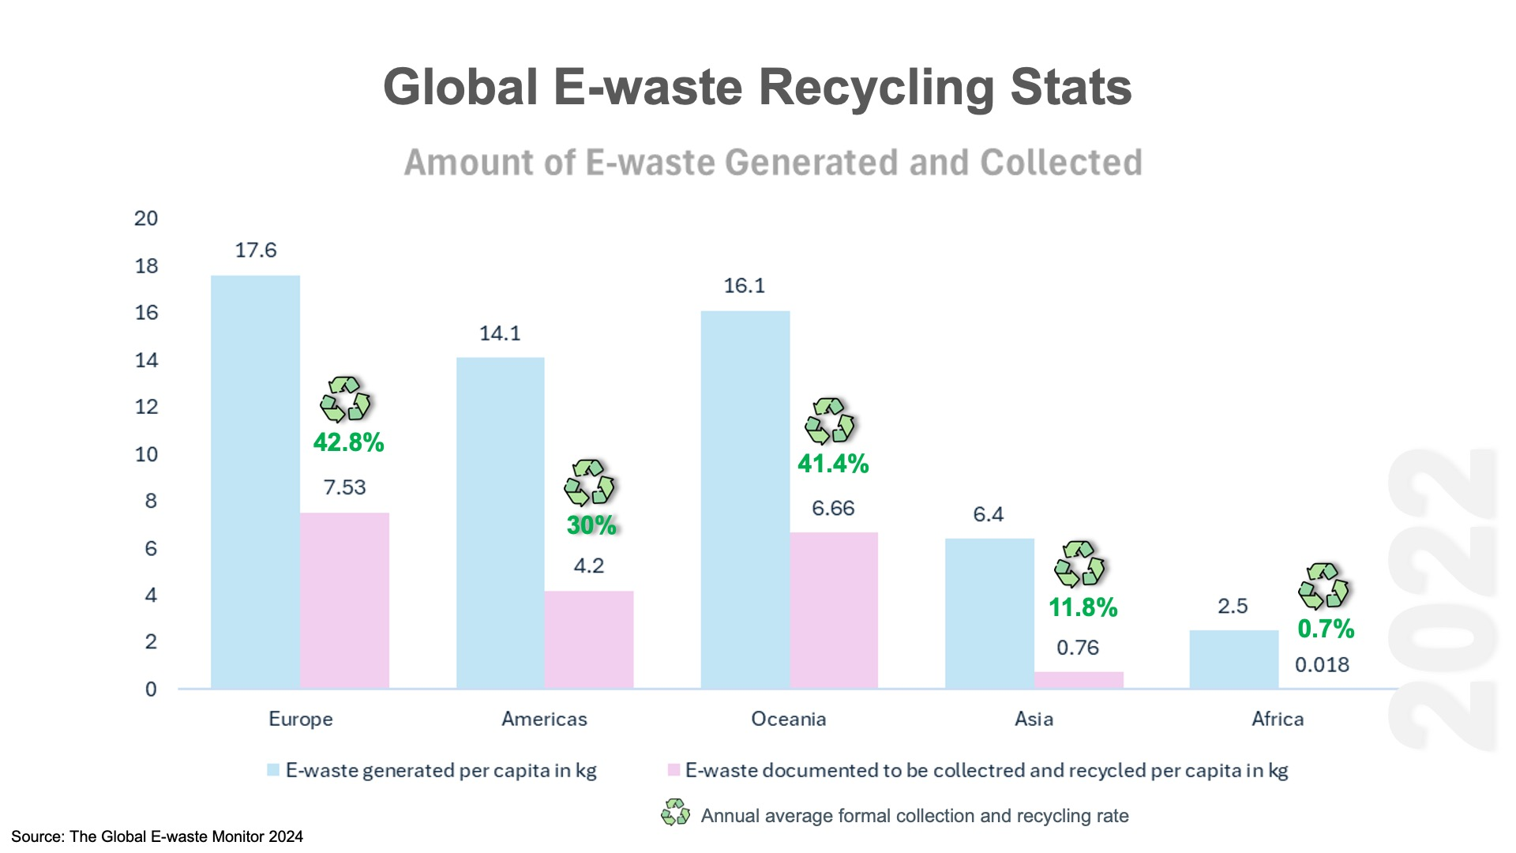
Notes:
An improperly disposed device can do harm to our local environment. Over time, these devices breakdown and leach out heavy metals like lead, mercury, cadmium and beryllium which can harm local wildlife and the environment. , E-waste heaps in landfills release toxic chemicals into the groundwater, and this finds its way to nearby wells and freshwater bodies. Harmful chemicals can make their way to our water sources and end up harming people, too!
In addition, critical materials like lithium and cobalt, can be extracted from e-waste and used again. This reduces the need to open new mines for these materials! Pollution overall can be reduced and less energy needs to be used for new product manufacturing.

Slide 8

Notes:
(Ask the audience and engage with them)
Do you and your family recycle anything?
What are items in your home that you can recycle?

Slide 9
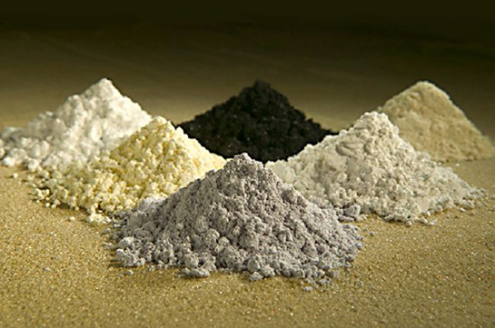
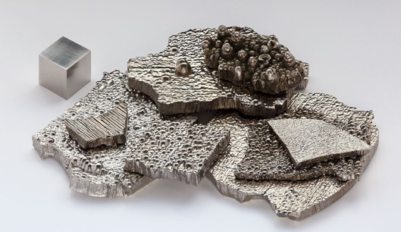
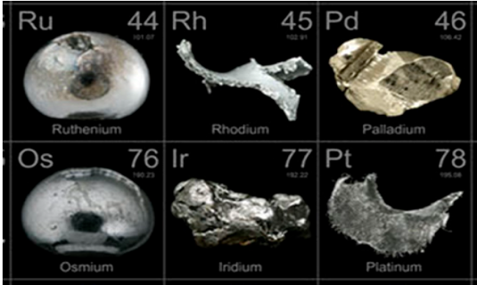
What are Critical Materials?
Rare Earth Elements
  Wind turbine generators
  Electric vehicle motors
Lithium, cobalt, and high-purity nickel
  Energy storage technologies
Platinum group metals
  Catalysts for automotive
  Chemical
  Fuel cells
  Green hydrogen products.
Rare earth elements
Cobalt
Platinum group metals
Notes:
https://www.americangeosciences.org/critical-issues/faq/what-are-rare-earth-elements-and-why-are-they-important
https://science.howstuffworks.com/environmental/earth/geology/cobalt.htm

Slide 10
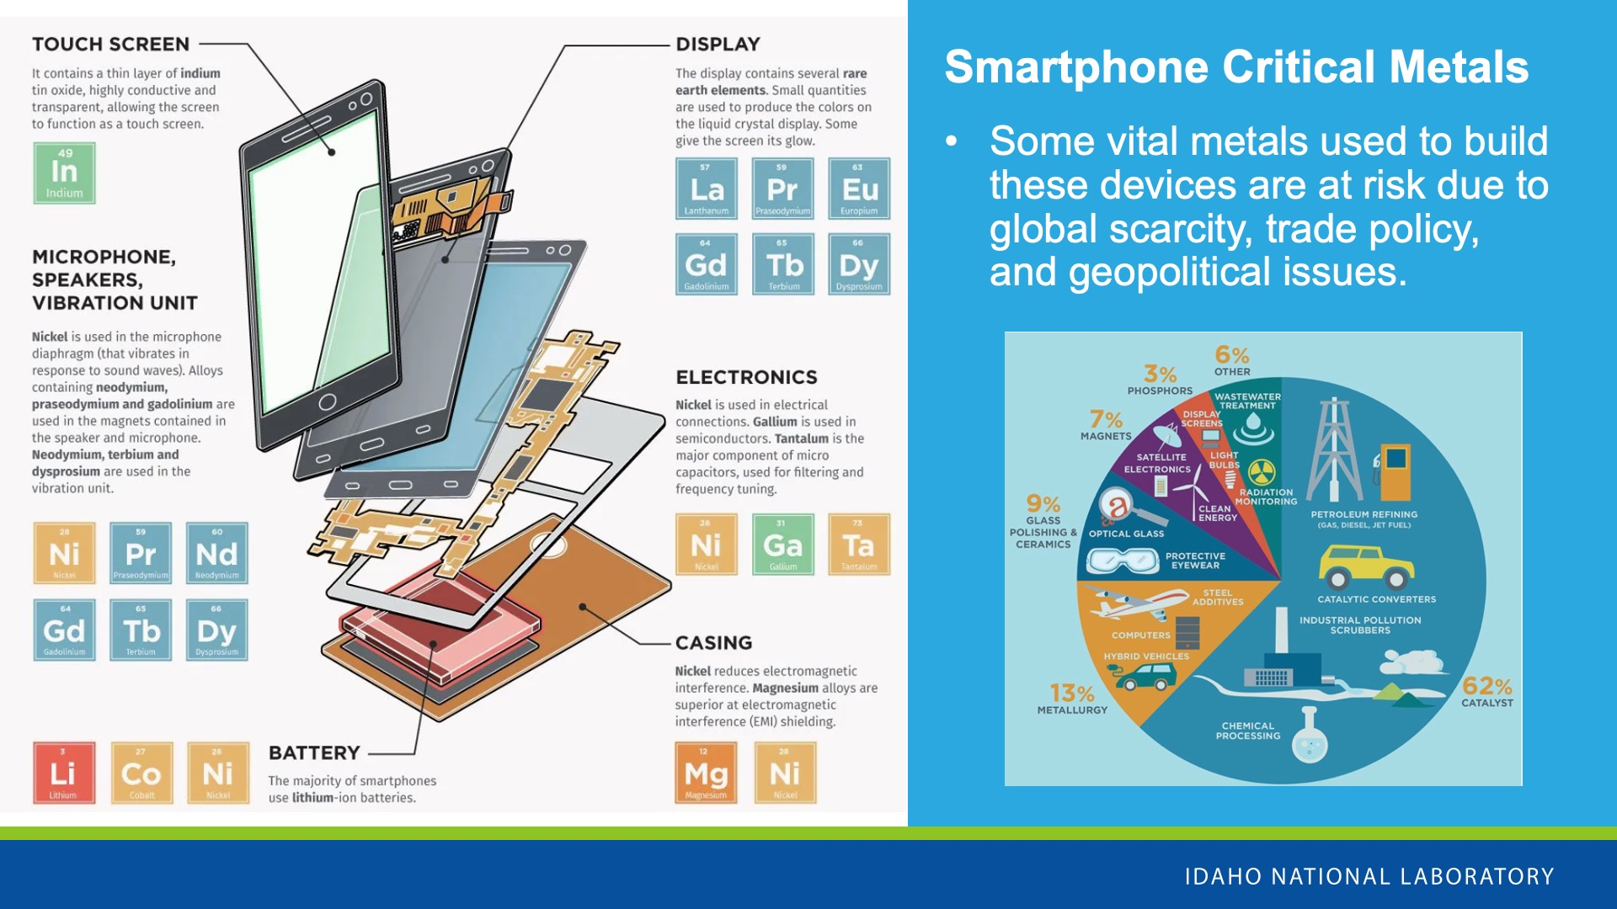

Slide 11
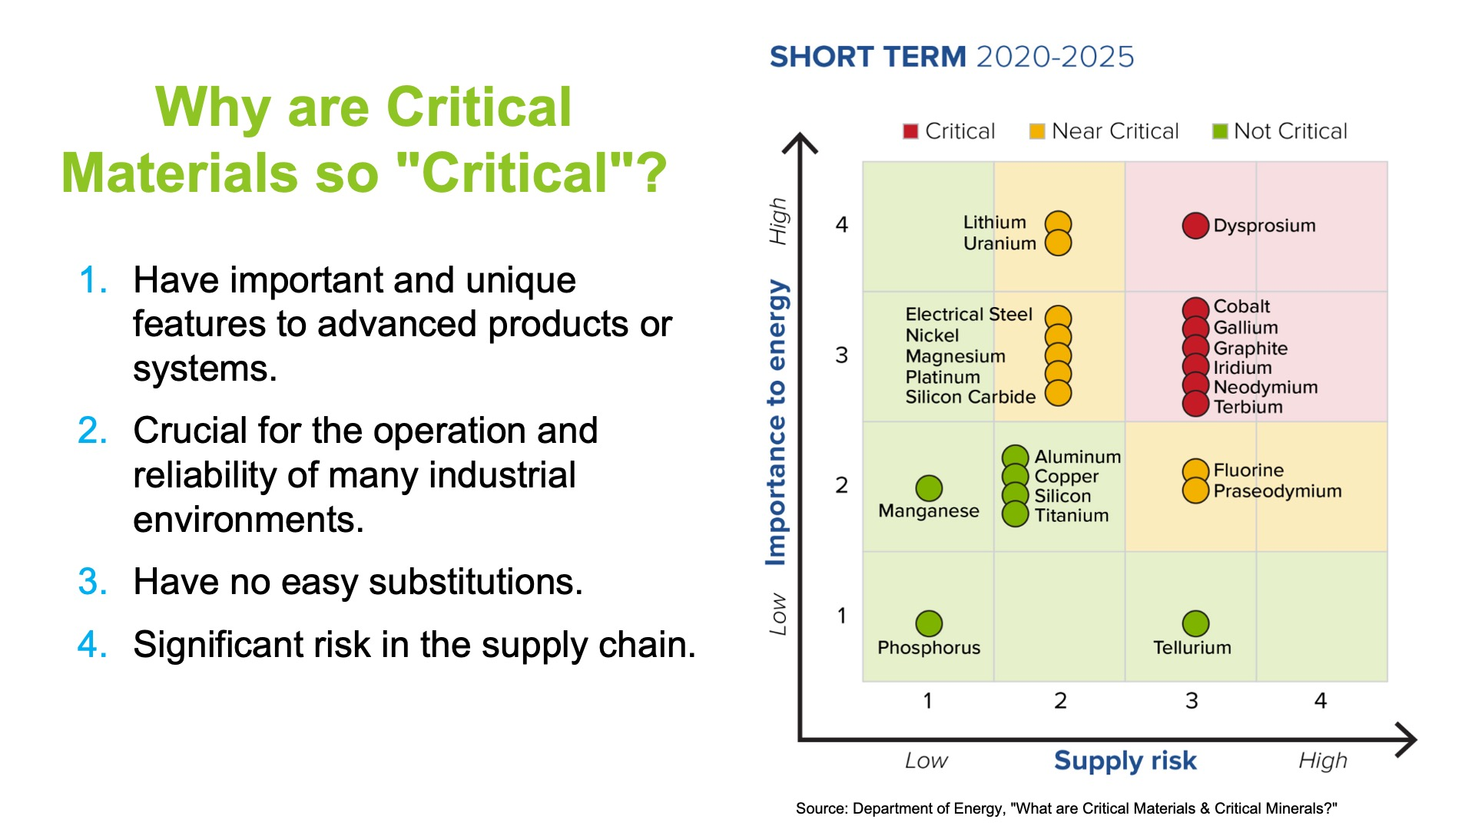
Notes:
https://www.energy.gov/cmm/what-are-critical-materials-and-critical-minerals

Slide 12
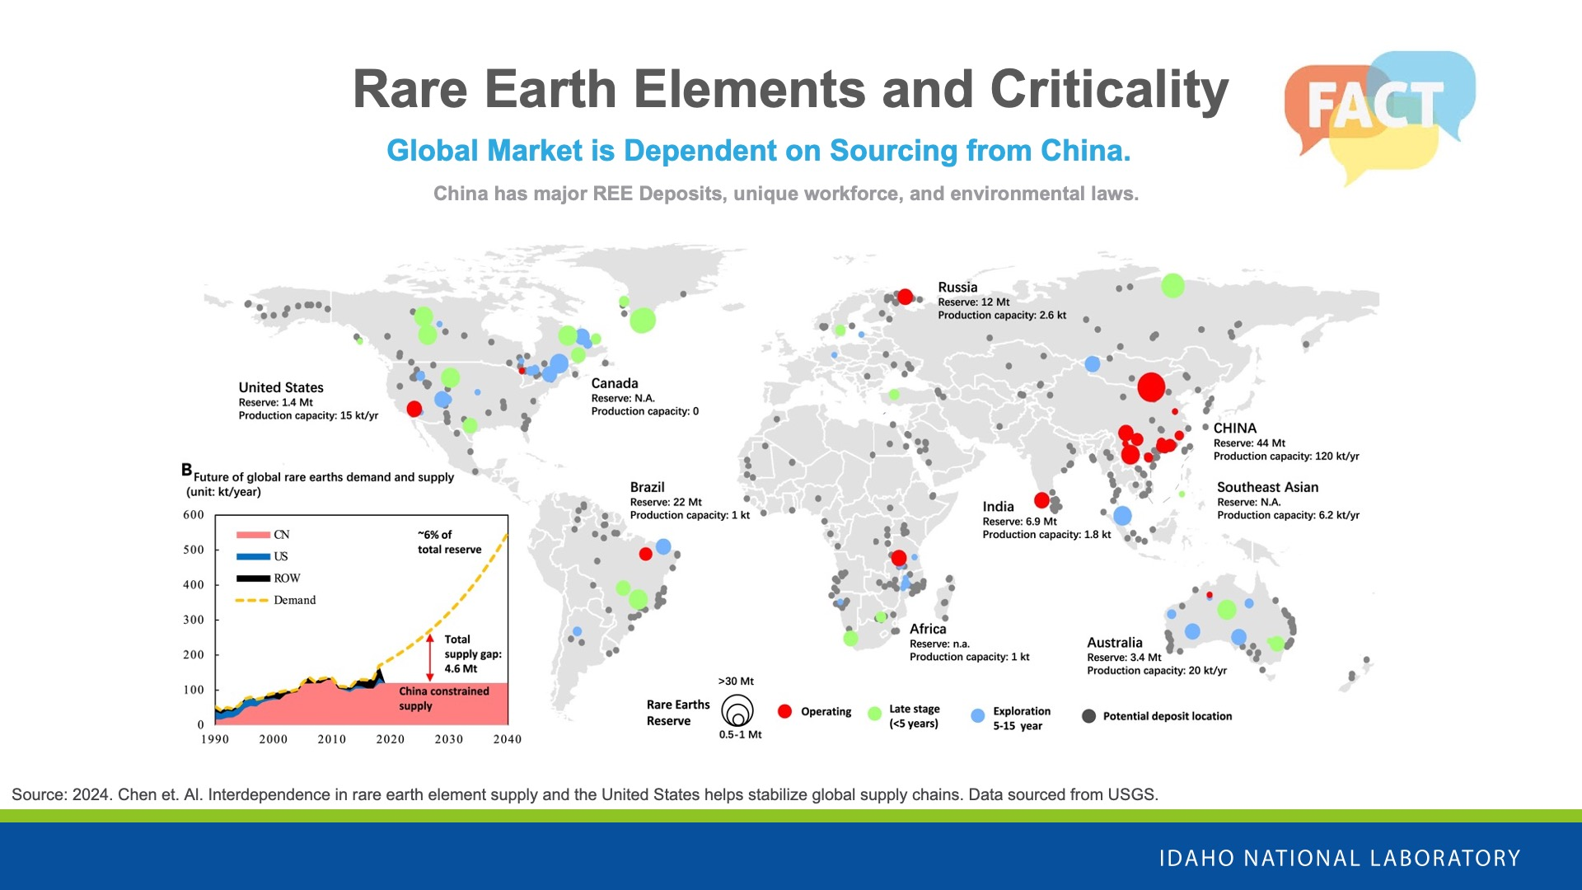

Slide 13
Laptop Disassembly Activity
In groups of 2-4, you will disassemble a recycled laptop to remove the battery.
Once the battery is safely removed, take note of the critical material and read the question on the back of the battery. We will go over them as a group.
After, replace the battery and the screws.
BE SAFE and keep any loose screws neatly organized.

Slide 14
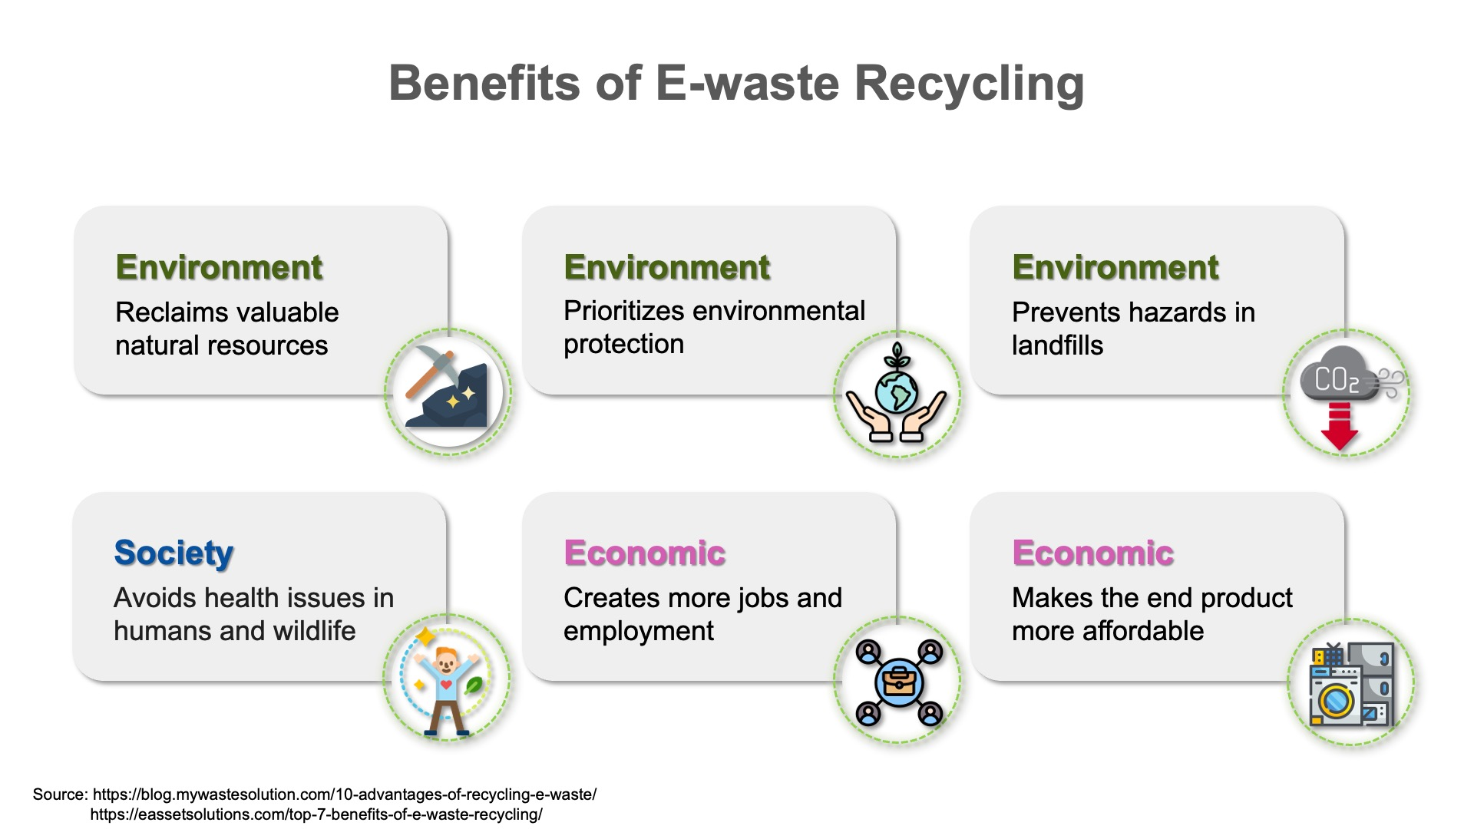
Notes:
It Prioritizes Environmental Protection
E-waste recycling prioritizes environmental protection. It includes proper handling, processing, and managing of electronic waste. As hazardous and toxic substances such as lead, mercury, and cadmium present in electronics can harm the environment. You may find many valuable resources or materials in an e-waste stream. Through E-waste recycling, we make most of these components instead of discarding them. This way, the hazards that these elements could have potentially caused to our environment are reduced.
Societal Benefits
E-waste recycling helps reduce the discharge of such hazardous toxins and maintains the balance in aquatic ecosystems. As a result, you help preserve the freshwater ecosystem for plants, animals, and even people who depend on them as livelihood sources.
E waste Recycling Helps to Conserve Available Natural Resources
Electronic waste recycling helps recover valuable materials from electronic products. This saves and conserves natural resources. This way, manufacturers do not need to mine the minerals; instead, they can just recycle and reuse the components of e-waste. So, yes, we can save copper or lead or valuable metals from mother nature. Thus, it promotes the utilization of resources wisely.
Creates Jobs
E-waste recycling is creating new jobs for people and local recyclers nearby. The more important thing is that, by doing so, it has created a secondary market. Where recycled materials are the primary commodity. The Environmental Protection Agency released findings that show the magnitude of economic benefits that come from e-waste recycling. In a year, the US’s recycling activities provided 757,000 jobs, $6.7 billion in tax revenues, and $36.6 billion in wages. By implication, for every thousand tons you recycle, there are 1.57 jobs created, $ 76,000 in wages paid, and $ 14,101 in tax revenues. So a lot of benefits come from trash, right? But there’s more. For a million laptops you recycle, you will have saved the equivalent of electric power capable of running 3657 households for one year. Guess what? For a million cell phones, you can recover gold weighing 75 pounds, silver of 772 pounds, copper of 35,274 pounds, and palladium of 33 pounds! There is also a significant social and economic impact. According to the EPA, recycling and reusing e-waste accounts for 681,000 jobs in a single year. Of course, e-waste is only a part of that, but as the fastest-growing waste stream, it is likely to become increasingly significant as we become more reliant on digital devices.
Increases Affordability
Using recycled components obtained from e-waste are cheaper than ones obtained from mining activities. This way, manufacturing costs can be reduced, and the end product can be more affordable. Copper found in e-waste can be reused multiple times. This has made the copper recycling business a lucrative industry today.

Slide 15
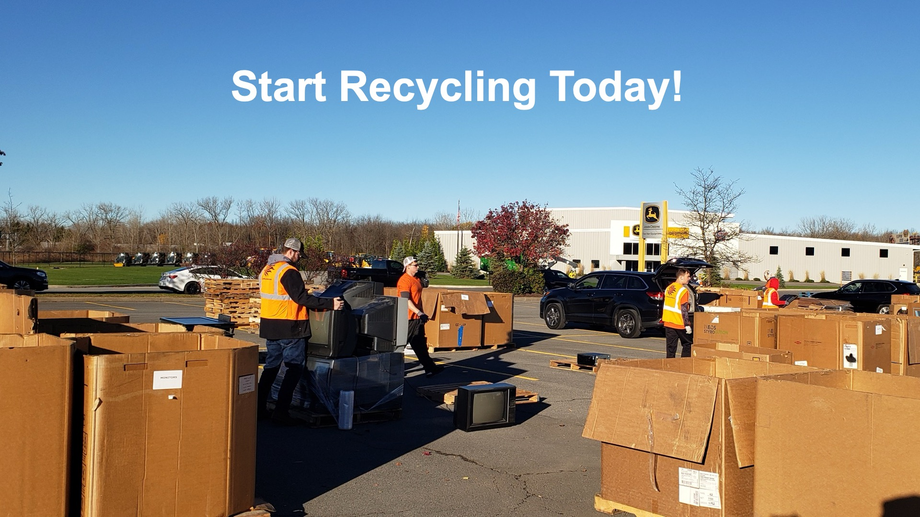
Start Recycling Today!
Notes:
We’ve placed recycling bins for e-waste at your school already! Talk to your parents first, but, if you have e-waste at home (Ask the kids for examples of e-waste).
We want to do a contest that involves the whole school! <School Name> is competing against other schools in your district. Who ever collects the most e-waste over the next 4 weeks is the winner.
You’re school will receive special recognition. Plus, E Cyclers will donate money to your PTO so that the PTO can continue offering awesome events and supporting your teachers.

Slide 16
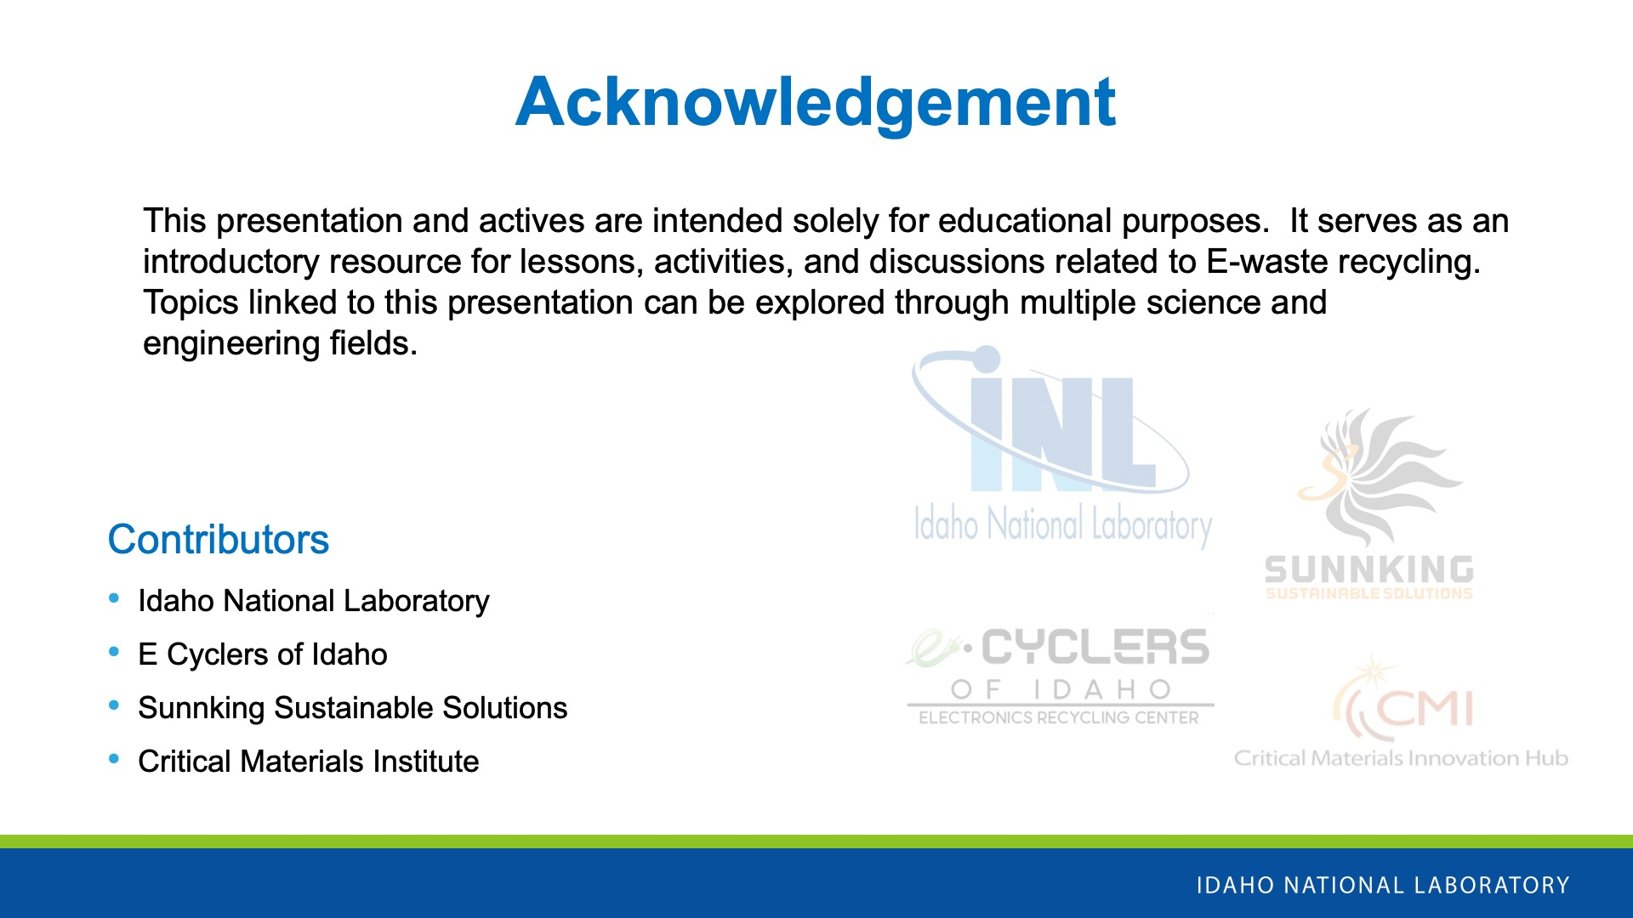

Slide 17

Questions??

Slide 18

E-waste Trivia!!
Notes:
E-waste sorting game
GAME PIECES: 20 Cards , 3 Sorting Bin posters
OBJECT: Reduce the amount of waste you must send to the landfill by accurately sorting items accepted by an E-Waste collector.
BIN
ITEM CATEGORY
1
E-Waste
2
Trash/Landfill
3
Recycling
PLAY:
STEP 1:
Shuffle the cards and place them face down.
Have participant stand next to cards
STEP 2: SORT!
Place the three “bins” in the activity area. They can be close together or spaced apart depending on preference.
Have the participant flip over a card and place the card in the appropriate bin.
Every correct card in the correct bin is worth 1 point. Incorrect cards are negative 1 point.
Repeat with other participants and have fun!
STEP 7: DISCUSSION
What percentage of the items you sorted don’t need to go in the trash?
Look in the trash and/or recycling bins in your classroom or in your school.
Are there any items in the trash that should go in the recycling? o Are there any items in the recycling that should go in the trash? ▪ Homework: Repeat this at home tonight.
What do you think the effect of putting items in the correct bins, instead of just putting them all in the trash bin, could have on the landfill? What do you think the effect of putting items in the wrong bins could have?

Slide 19
Question 1:
E-waste is defined as:
A
Everyday waste
B
Electronic waste
C
Electric waste
D
Environmental waste

Slide 20
Question 2:
In 2023, 22.3% of global e-waste was collected and recycled. What percentage of e-waste was recycled in the U.S.?
A
25%
B
33%
C
62%
D
17%

Slide 21
Question 3:
Over 50 million metric tons of e-waste were created in 2022.
A
True
B
False

Slide 22
Question 4:
Which region is responsible for generating the most e-waste?
A
Europe
B
Americas
C
Oceania
D
Asia

Slide 23
Question 5:
Which region is responsible for recycling the most e-waste?
A
Europe
B
Americas
C
Oceania
D
Asia

Slide 24
Question 6:
Which of the following elements is critical because of its use in batteries?
A
Copper
B
Silicon
C
Lithium
D
Uranium

Slide 25
Question 7:
Which of the following critical materials is used in wind turbine magnets?
A
Copper
B
Platinum
C
Tellurium
D
Neodymium

Slide 26
Question 8:
Critical materials are "critical" because they are uncommon and difficult to find.
A
True
B
False

Slide 27
Question 9:
Which country is the primary supplier of Rare Earth Elements?
A
India
B
China
C
The United States
D
Brazil

Slide 28
Question 10:
What is a benefit of recycling e-waste?
A
Environmental preservation
B
Recovery of critical materials
C
Job creation
D
All of the above

Slide 29
Question 11:
How many elements are used in the creation of an iPhone?
A
B
24
30
C
46
D
118

Slide 30
Question 12:
Which of the following is NOT one of the top 5 materials that make up an iPhone?
A
B
Lithium
Silicon
C
Gold
D
Aluminum

Slide 31
Question 13:
Which country is a primary producer of copper ore?
A
The United States
B
Brazil
C
China
D
Chile

Slide 32
Question 14:
Which U.S. state produces over 70% of the country's gold?
A
California
B
Idaho
C
Oregon
D
Nevada

Slide 33
Question 15:
What type of battery is in the iPhone?
A
Alkaline
B
Nickel-Cadmium
C
Lithium-ion
D
Zinc-Carbon

Slide 34
Overtime Questions
Notes:
E-waste sorting game
GAME PIECES: 20 Cards , 3 Sorting Bin posters
OBJECT: Reduce the amount of waste you must send to the landfill by accurately sorting items accepted by an E-Waste collector.
BIN
ITEM CATEGORY
1
E-Waste
2
Trash/Landfill
3
Recycling
PLAY:
STEP 1:
Shuffle the cards and place them face down.
Have participant stand next to cards
STEP 2: SORT!
Place the three “bins” in the activity area. They can be close together or spaced apart depending on preference.
Have the participant flip over a card and place the card in the appropriate bin.
Every correct card in the correct bin is worth 1 point. Incorrect cards are negative 1 point.
Repeat with other participants and have fun!
STEP 7: DISCUSSION
What percentage of the items you sorted don’t need to go in the trash?
Look in the trash and/or recycling bins in your classroom or in your school.
Are there any items in the trash that should go in the recycling? o Are there any items in the recycling that should go in the trash? ▪ Homework: Repeat this at home tonight.
What do you think the effect of putting items in the correct bins, instead of just putting them all in the trash bin, could have on the landfill? What do you think the effect of putting items in the wrong bins could have?

Slide 35
Question 16:
The primary material collected from E-waste recycling is plastic.
A
True
B
False
Notes:
Source: Global E-Waste Monitor, Page 46
Metal is the most collected because typically every electronic needs metals to function- that includes things we talked about like critical materials and precious metals.
Metal is the primary, with around 31 billion kg or 68 billion lbs.
Plastic is second, with around 19 billion kg or 41 billion lbs.
The rest are things like glass, alloys, etc.

Slide 36
Question 17:
Which category of E-waste is collected and recycled the most often (by percentage)?
A
Small Equipment
B
Screens & Monitors
C
Lamps
D
Large Equipment
Notes:
Global E-Waste Monitor, Page 34.
Large equipment is the highest category. Think washing machines, dishwashers, stoves, printers, and solar panels. Usually companies pick these items up to collect them, so they get recycled at a higher rate. It's also pretty inconvenient to store a broken stove in your house, versus a toaster or coffee machine you can just store away and not think about.
Large equipment (34%)
Temperature Exchange Equipment (27%)
Screens & Monitors (25%)

Slide 37
Question 18:
Only around 40% of all collected E-waste materials were recovered back into material circulation in 2022.
A
True
B
False
Notes:
Global E-Waste Monitor, Page 13
Unfortunately most e-waste is collected and recycled outside of formal recycling processes, where it is harder to ensure it has been recycled in an environmentally sound way. So, that 22% could be a much higher percentage if we better develop systems to recycle e-waste.

Slide 38
Question 19:
Which country is not among the top 3 E-waste producers (per person) in the Americas?
A
Puerto Rico
B
United States
C
Canada
D
Aruba
Notes:
Source: Global E-Waste Monitor, page 70.
Aruba is an island in the Caribbean sea with a developed tourism industry, meaning they have a more robust middle class. They also have gold production and manufacture some electronics.

Slide 39
Question 20:
Which critical material is recovered from E-waste recycling at the highest rate?
A
Copper
B
Iron
C
Nickel
D
Aluminum
Notes:
Source: Global E-Waste Monitor, Page 46
While Iron is the most recycled metal, it is not a critical material.

