Slide 1
Technical Assistance for Securing Digital Energy Infrastructure Webinar
Cyber-Informed Engineering and How to Apply It To Your GRIP Project

Slide 2
Navigating Supply Chain Challenges
Building Resilient Systems for Electric Grid Modernization
The main concern revolves around the availability of US-manufactured products for electric grid modernization and navigating the challenges presented by the geopolitical supply chain landscape.
How do we drive modernization – while appropriately mitigating risk and consequence
Project design optimization – secure supply chain and criticality of the application to your operation is a primary consideration
Focus areas:
  Electric Vehicles (EVs) + EV Supply Infrastructure
  Battery Energy Storage Systems (BESS) + management systems
  Inverters
  Orchestration software (Distributed Energy Resources Management Systems [DERMS]/Advanced Distribution Management Systems [ADMS])
  Critical-and-Emerging-Technologies-List-2024-Update.pdf (whitehouse.gov)
See the following sections of the FOA for information on disclosure requirements, domestic content, and related information: IV.D.xxi; IV.I; VI.B; Appendix B; Appendix C.

Slide 3
Launch Plan: How to Evaluate and Protect
(Operate large scale storage and other infrastructure with known higher risk items)
Mitigation menu/strategic training and workshops for consequence based/CIE approach, template & training
Key Injects: Procurement, Contracting, Design, Operations & maintenance
Operate through, maintain the investment, resilience and reliability
Notes:
Standards & other items aren’t moving fast enough
We need approaches we can test, and use to eventually push into state planning for interconnect and monitoring
Launch Program:
A) Commence program with a series of webinars - Today!
B) Conduct training webinars covering Cyber Informed Engineering, Supply Chain Assessment, and Threat Modeling for all participants.
C) Applicants apply through the INL portal; the team will provide assessments on a tiered/scaled basis over the next 12 months - Phase 1.

Slide 4
Grid Deployment Office (GDO) Technical Assistance Program and INL Team
GDO Technical Assistance
INL Securing Digital Energy Infrastructure Program
Digital Assurance TA

Slide 5
Digital Assurance Technical Assistance
Goals
  Improve resilience and supply chain sustainability in the grid modernization space with enhanced security programs for digital equipment
  Secure digital energy infrastructure by guiding organizations through a tailored analysis, design support and mitigation program
  Respond to rapidly changing regulatory landscape and cutting-edge equipment
  Evaluate supply chain and protection choices against the consequences
  Help entities develop a future sustainable assessment and procurement planning system

Slide 6






Center for Securing the Digital Energy Transition
Emma Stewart
Director
Tracy Briggs
Program Manager
Megan Culler
Technical Director for Clean Energy Cybersecurity
Jake Gentle
Staffing Coordination & Cross Division Manager
Virginia Wright
Strategic Advisor & Operations
Wayne Austad
Strategic Advisor
https://inl.gov/national-security/csdet/

Slide 7
Types of Technical Assistance we provide
Short Advisory
Quick questions
Consultations with SMEs
Expert Match
Workshops and webinars
Personalized discussion of application of available resources
Deep Dive
Address inquiries with length development processes
Threat hunting
Equipment evaluation
Overview of available resources
Notes:
INL will assign applicant to one of the three areas based on the initial request.
Applicant does not have to participate in all of the activity options for each level
Items from lower-level TA options may be included on request
Email coordination will determine scope of TA activates
Coordination calls will be scheduled as necessary

Slide 8
Short Advisory Technical Assistance
Virtual SME
Quick virtual consultations to answer specific questions
Resource Overview
Call to provide overview of the resources available to support cybersecure BESS deployments
Assessment templates
Resources provided for do-it-yourself risk mitigation
Who is this for?
  Organizations with higher cybersecurity maturity
  Individuals with specific questions
What is the time commitment?
  <5 hours of SME time
  Expected to be performed virtually
  Setup, execution, and follow up can be completed within 1-2 weeks
“I have a question”
Match questions to an INL subject matter expert (SME)
Schedule a call to discuss.
After the call, INL will follow up to verify questions have been answered satisfactorily

Slide 9
Expert Match Technical Assistance
CIE workshops
Cyber-informed engineering workshop or webinar
SME Consulting
Dedicated time from an SME to discuss specific implementation challenges
Design Guidance
Procurement Guidance
Individual sessions to review BESS design cybersecurity guidance and discuss personalized application
Individual sessions to review procurement guidance and discuss personalized application
Who is this for?
  Teams looking for training to enhance cyber maturity
  Projects in design or contracting phase with a need for dedicated cyber support
  Organizations with inquiries that require increased resources
What is the time commitment?
  5-10 hours of SME time
  Participating organization may want to involve engineering, operations, and cybersecurity personnel
  Full activity can be completed within 2-6 weeks of initial contact

Slide 10
Deep Dive Technical Assistance
Cybersecurity Assessments
Cyber Security Evaluation Tool
Equipment Physical/Forensic Assessment
Assessment of field devices
Threat Hunt
Short-term monitoring for anomalous network behaviors
Measure alignment to standards and best practices
Requires devices to be shipped to lab
Malcolm AIA
Asset Interaction Analysis
Site Visit for In-Depth Analysis
OT Security Training
Tailored to participant needs
OT equipment, processes, procedures
Automated generation of network diagram based on passive monitoring
Who is this for?
  Organizations just starting to implement cyber policies, practices, and procedures
  Inquiries that require substation resources or lengthy development process
  Applications requiring assistance such as sourcing, assessment of equipment being installed
  Applicants requesting site visits
What is the time commitment?
  15-40 hours expected, could be split across different roles
  Multiple personnel will be involved (operations, cybersecurity, engineering, networking/IT)
  Full activity may take 4-8 weeks to plan and execute

Slide 11
Cybersecurity and Operational Technology

Slide 12
What is Cybersecurity?
Cybersecurity is the art of protecting networks, devices, and data from unauthorized access or criminal use and the practice of ensuring confidentiality, integrity, and availability of information.
-- Cybersecurity and Infrastructure Security Agency (CISA))

Slide 13
What is Cybersecurity?
Cybersecurity is the art of protecting networks, devices, and data from unauthorized access or criminal use and the practice of ensuring confidentiality, integrity, and availability of information.
-- Cybersecurity and Infrastructure Security Agency (CISA)
What’s missing in this picture?

Slide 14
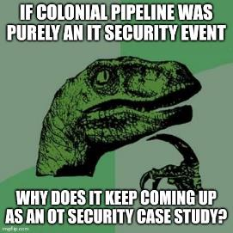
Cybersecurity is not just about data
Ransomware attacked business data on an IT network
However, pipeline operations were curtailed.
Why?
Joe Slowick, MITRE

Slide 15
Cybersecurity in Operational Technology
Cyber Attack Impacts
Cybersecurity Protections
Information Technology
Physical Processes
Operational Technology
Control Systems
Engineering

Slide 16
Cyber-Informed Engineering
Cyber Attack Impacts
Cybersecurity Protections
Engineering Controls
Information Technology
Physical Processes
Operational Technology
Control Systems
Engineering

Slide 17
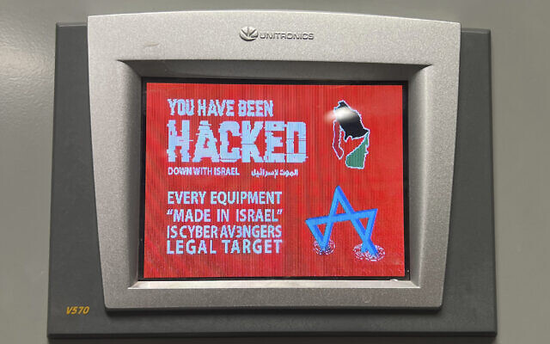
How are Cyber Attacks affecting Physical Infrastructure?
Ransomware accounts for 80% of attacks where threat actor is known
Multiple nation-state attacks on OT open to the internet
  Weak or default passwords
  Vulnerable system
Nation States using commodity tools, tactics and techniques
50% of identified incidents impacted process and discrete manufacturing
  Production shutdowns, work stoppages and shipping delays
Financial impacts are public record:
  $27-450M
The largest impacts to operations are indirect, including IT dependencies and “abundance of caution shutdowns”
OT-related Supply Chain Attacks are increasing
Volt Typhoon
Zyxel Firewalls
Water sector
Predictions:
Ransomware attacks with OT consequences will increase
Politically motivated attacks will increase in number and impact alongside criminal ransomware
The success of “indirect” attacks will drive more attempts
Data from Waterfall 2024 Threat Report on OT Cyberattacks with Physical Consequences - https://waterfall-security.com/ot-insights-center/ot-cybersecurity-insights-center/2024-threat-report-blog/

Slide 18
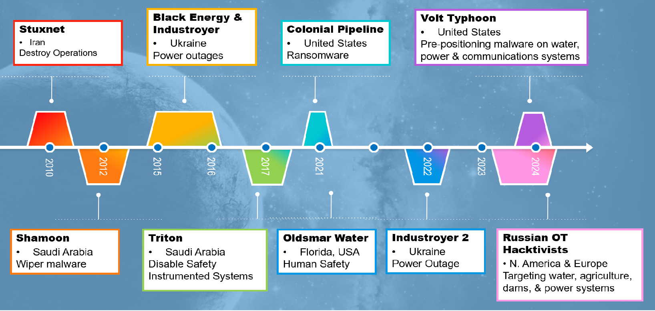
Cyber Attacks on Control Systems are Real – and Growing

Slide 19
Cyber-Informed Engineering

Slide 20
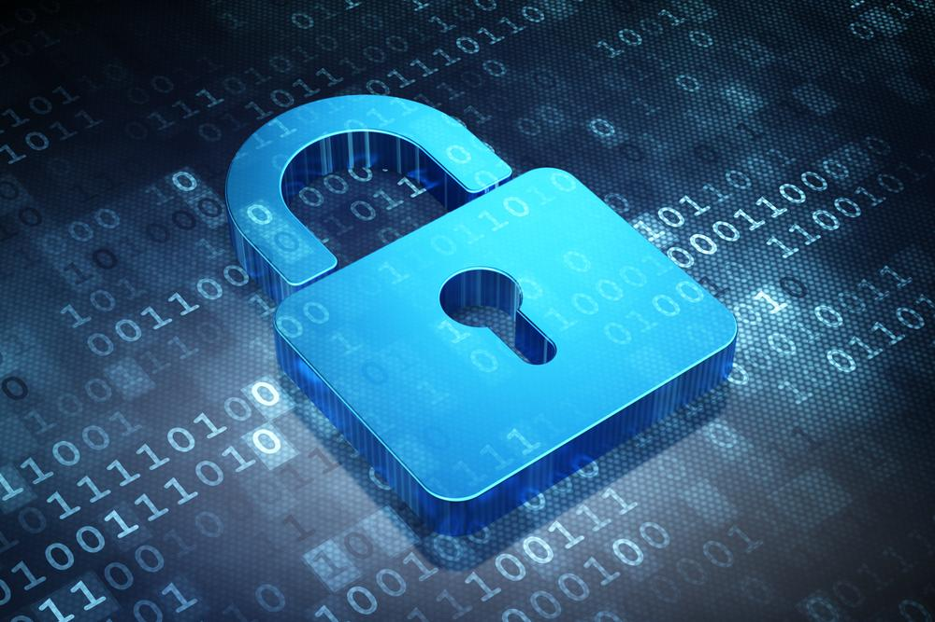

Cyber-Informed Engineering (CIE)
CIE uses design decisions and engineering controls to eliminate or mitigate avenues for cyber-enabled attack.
CIE offers the opportunity to use engineering to eliminate specific harmful consequences throughout the design and operation lifecycle, rather than add cybersecurity controls after the fact.
Focused on engineers and technicians, CIE provides a framework for cyber education, awareness, and accountability.
CIE aims to create a culture of security aligned with the existing industry safety culture.

Slide 21
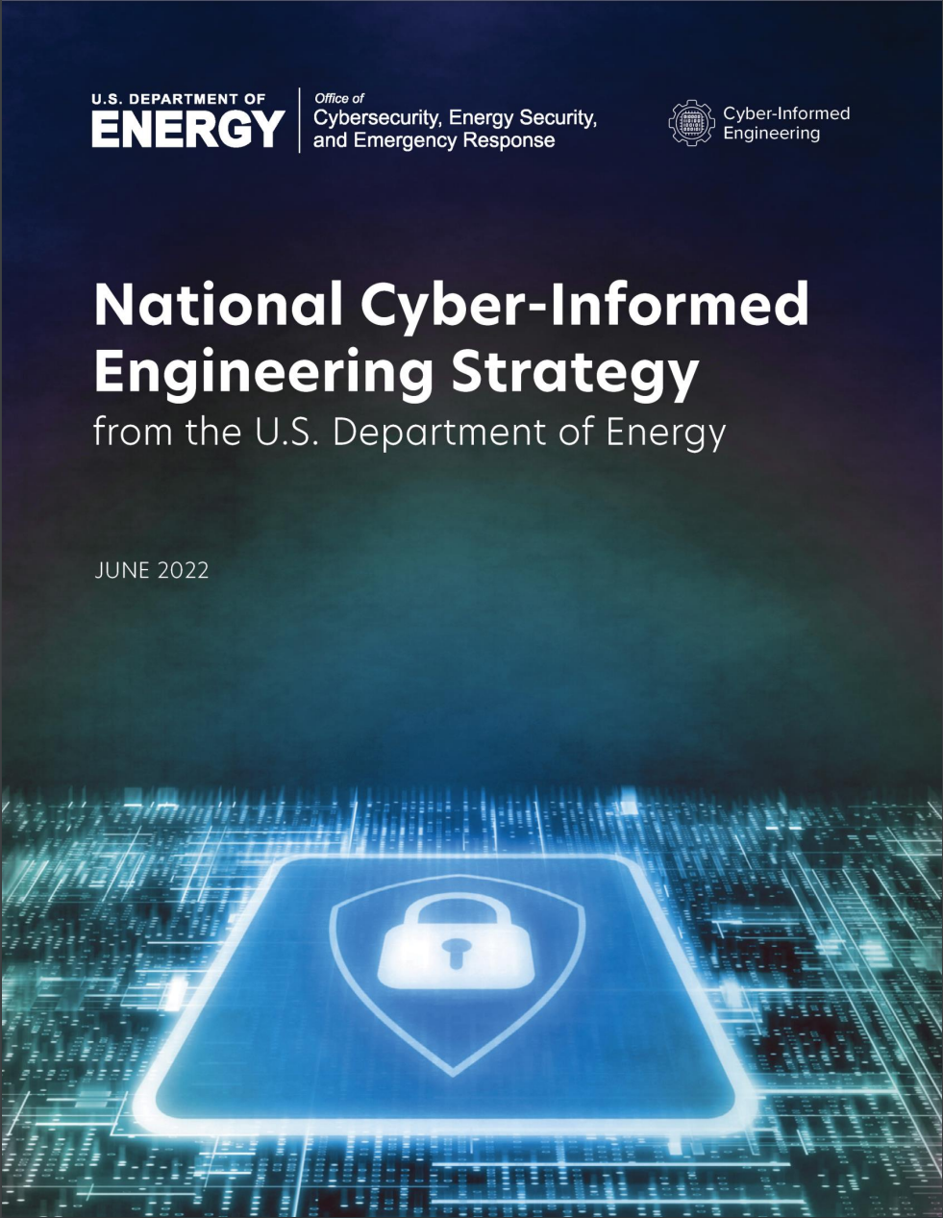
National CIE Strategy
Directed by the U.S. Congress in the Fiscal Year 2020 National Defense Authorization Act
Outlines core CIE concepts
  Defined by a set of design, operational, and organizational principles
  Placed cybersecurity considerations at the foundation of control systems design and engineering
Five integrated pillars offer recommendations to incorporate CIE as a common practice for control systems engineers
  Intended to drive action across the industrial base stakeholders—government, owners and operators, manufacturers, researchers, academia, and training and standards organizations
DOE issued the National CIE Strategy June 15, 2022
CIE has been named in the National Cyber Strategy and the National Cyber Strategy Implementation Plan and in the report on cyber-physical systems by the President’s Council of Advisors on Science and Technology
https://www.energy.gov/sites/default/files/2022-06/FINAL%20DOE%20National%20CIE%20Strategy%20-%20June%202022_0.pdf

Slide 22
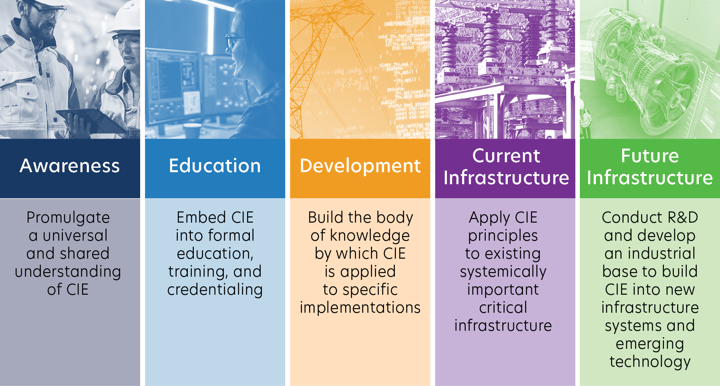
Pillars of the National CIE Strategy

Slide 23
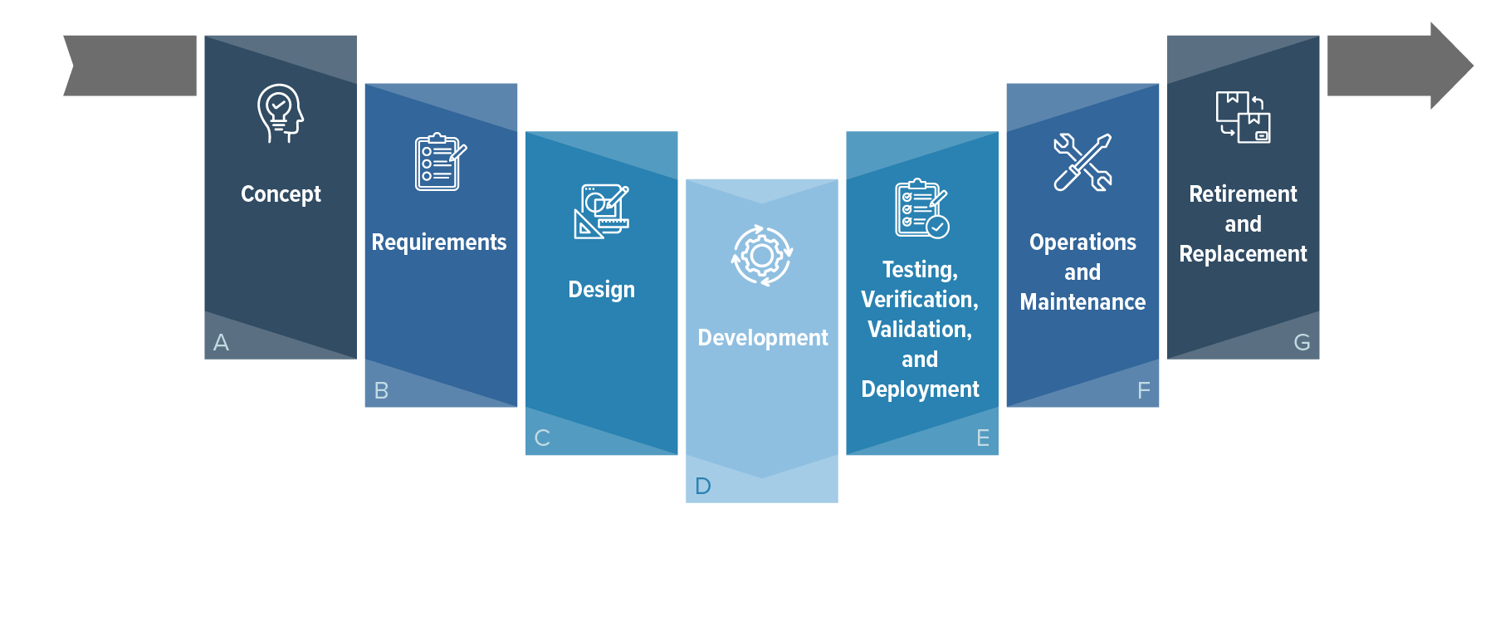
CIE and the Systems Engineering Lifecycle

Slide 24
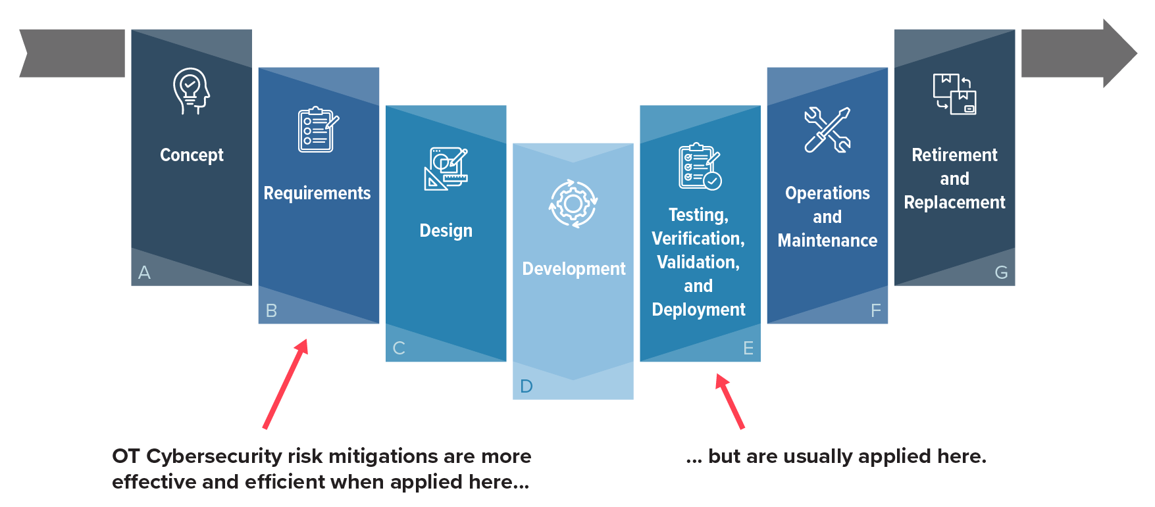
CIE and the Systems Engineering Lifecycle
OT Cybersecurity risk mitigations are usually applied here…

Slide 25
CIE and the Systems Engineering Lifecycle
…but they are more effective and efficient when applied here.
OT Cybersecurity risk mitigations are usually applied here…

Slide 26
CIE Principles
Principle​ | Key Question​
Consequence-Focused Design​ | How do I understand what critical functions my system must ensure and the undesired consequences it must prevent? ​
Engineered Controls​ | How do I select and implement controls to minimize avenues for attack or the damage that could result?​
Secure Information Architecture​ | How do I prevent undesired manipulation of important data? ​
Design Simplification​ | How do I determine what features of my system are not absolutely necessary to achieve the critical functions?​
Layered Defenses​ | How do I create the best compilation of system defenses?​
Active Defense​ | How do I proactively prepare to defend my system from any threat?​
Interdependency Evaluation​ | How do I understand where my system can impact others or be impacted by others?​
Digital Asset Awareness​ | How do I understand where digital assets are used, what functions they are capable of, and what our assumptions are about how they work?​
Cyber-Secure Supply Chain Controls​ | How do I ensure my providers deliver the security the system needs?​
Planned Resilience​ | How do I turn “what ifs” into “even ifs”?​
Engineering Information Control​ | How do I manage knowledge about my system? How do I keep it out of the wrong hands?​
Organizational Culture​ | How do I ensure that everyone’s behaviors and decisions align with our security goals?​
Notes:
12 elements of CIE
We examined the systems engineering process across the entire lifecycle and identified those areas where key engineering decisions could radically impact the cybersecurity of the operational technology.

Slide 27
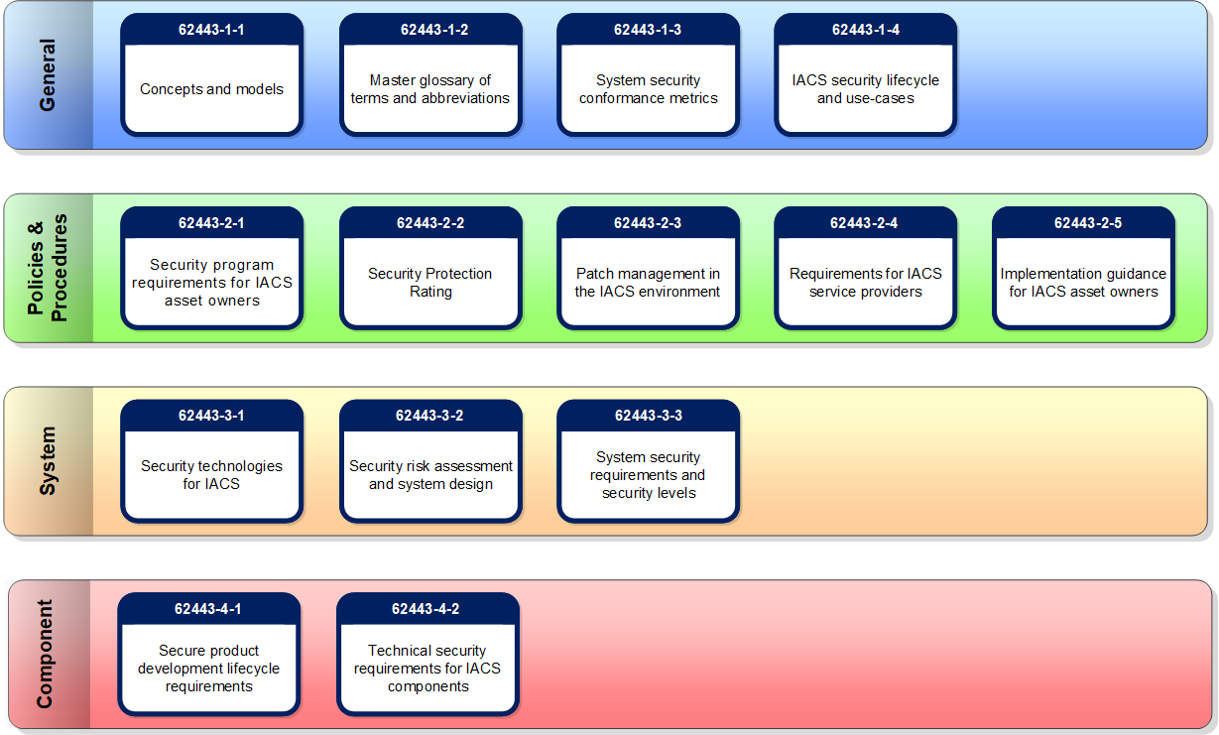

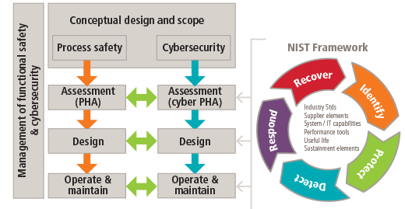
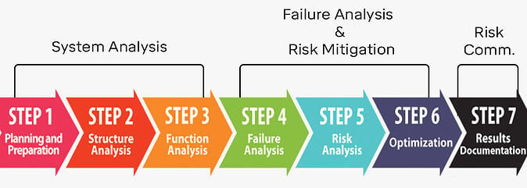
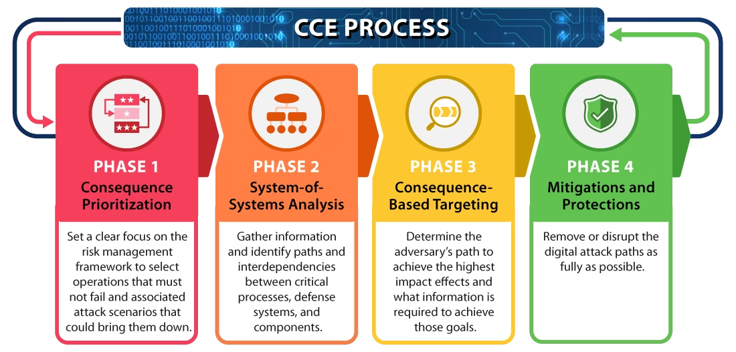
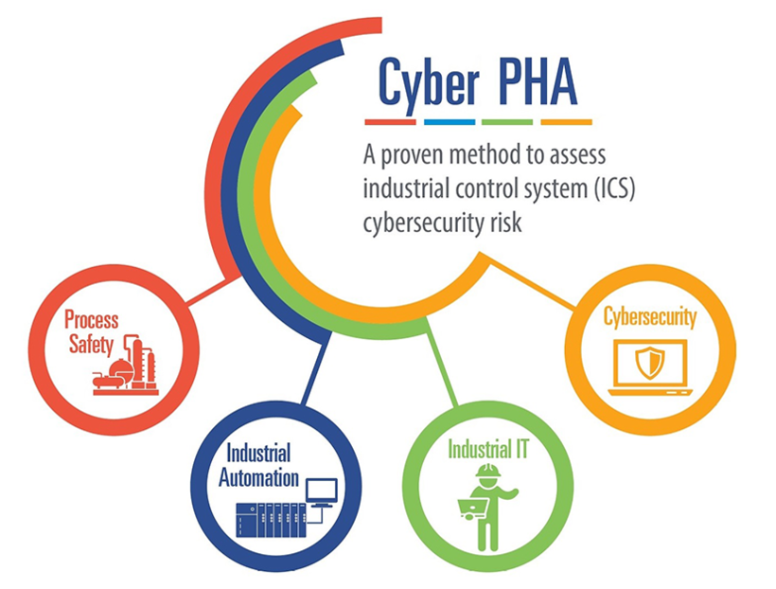
OK, But How Do You CIE?

Slide 28
How does this work in practice?
Water Booster Pump Station

Slide 29
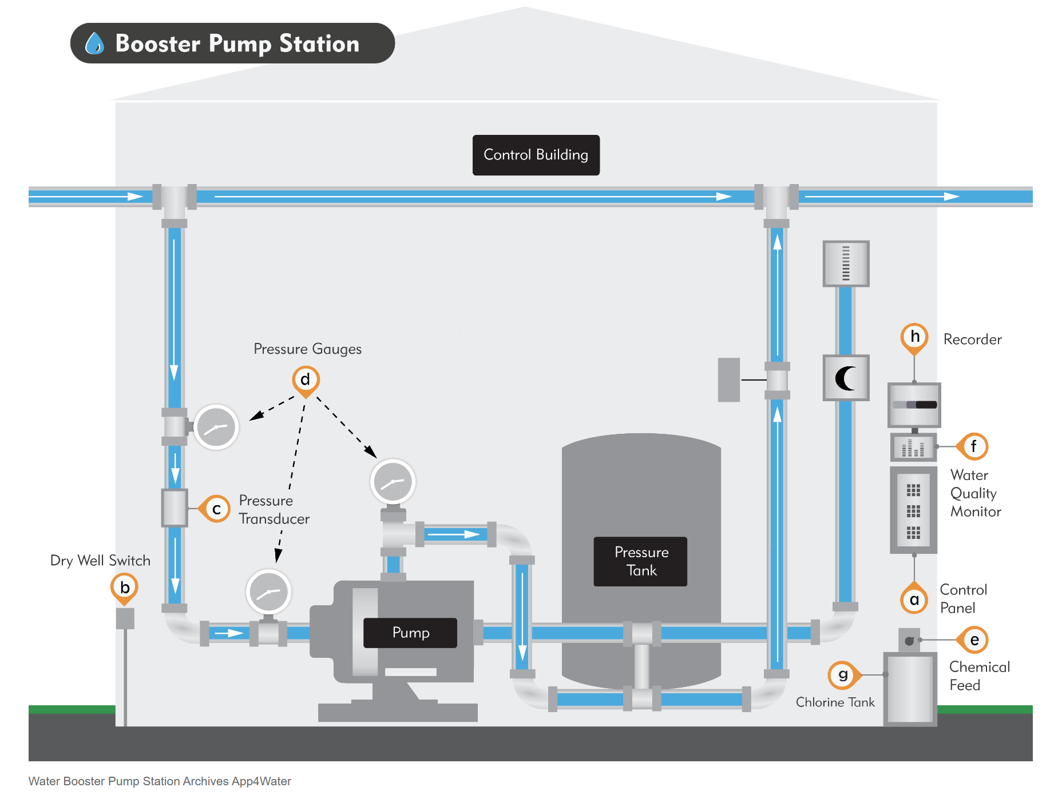
Water Booster Pump Station
https://bmxlovesk.xyz/product_details/13200675.html

Slide 30
Water Booster Pump Station
Cloud-based monitoring and control
https://bmxlovesk.xyz/product_details/13200675.html

Slide 31
Cyber Solution Review
Control System Software has a qualifying secure development lifecycle.
  Very mature demonstrated processes
  Provided SBOM
  Component infrastructure is up to date
  Mature vulnerability release process – with regular patches
  24/7 Support availability
Cloud provider is reputable and qualified
  SOC Type 2 and Fedramp (if needed), great physical security
  Very mature, experienced in hosting critical infrastructure services
  Demonstrated response and restoration capabilities

Slide 32
IT Installation Review
Network entry point has standard security package
Monitoring and logging traffic on this interface according to standard practice
  Logging interfaces with organizational logging system
Traffic in and out is encrypted between the cloud provider and the internal network boundary

Slide 33

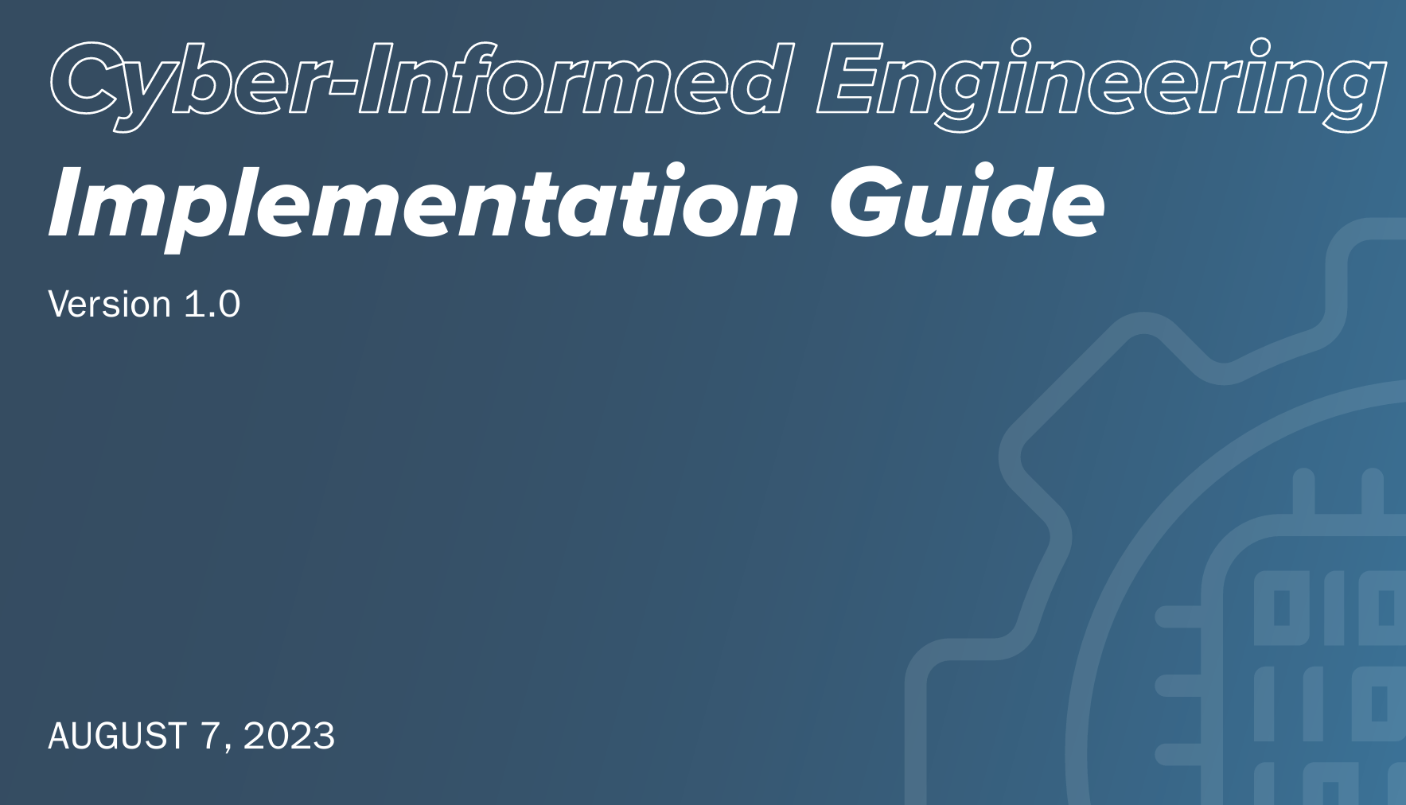

Organizational Review Board Votes
Finance / Accounting –
Information Technology –
Cybersecurity –
Engineering Operations –

Slide 34
Water Booster Pump Station
Cloud-based monitoring and control
https://bmxlovesk.xyz/product_details/13200675.html

Slide 35
Water Booster Pump Station
Cloud-based monitoring and control
https://bmxlovesk.xyz/product_details/13200675.html
Mechanical Time Delay Relay

Slide 36
Organizational Review Board Votes
Finance / Accounting –
Information Technology –
Cybersecurity –
Engineering Operations –

Slide 37
CIE Principles Deeper Dive

Slide 38
Consequence-Focused Design
How do I understand what critical functions my system must ensure and the undesired consequences it must prevent?
Impact
Area Impacted
Attack Breadth
Cost
Safety
Duration
System Integrity
What is normal operation?
What is the worst consequence of this operation?
What are the system’s critical functions?
What is my risk appetite?

Slide 39
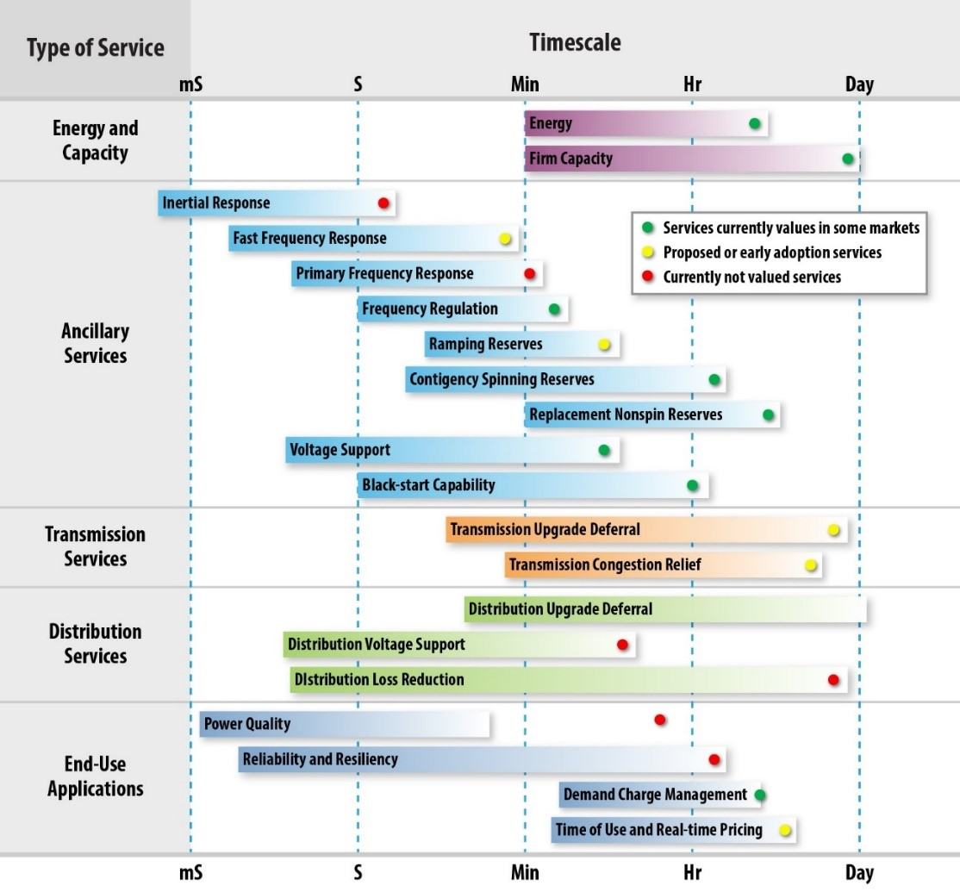
Consequence-Focused Design in Practice
A critical function could be the grid service(s) that your installation is designed, or contracted, to provide.
Consequence of losing that grid service is determined by each installation and its magnitude.

Slide 40
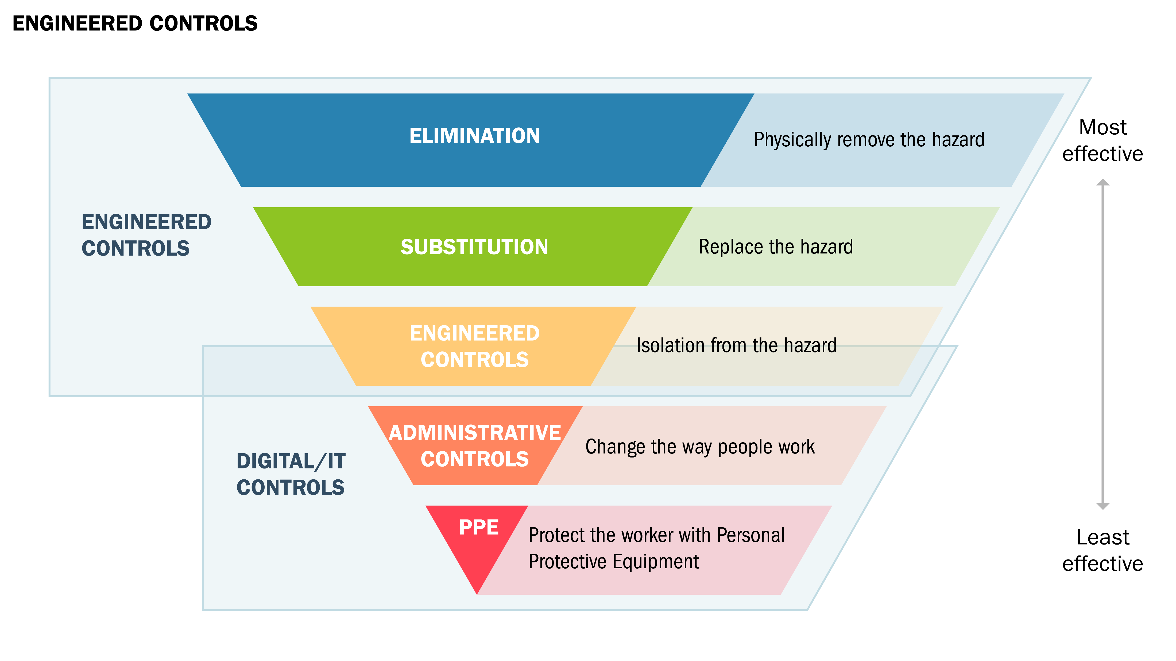
Engineered Controls
How do I select and implement controls to reduce avenues for attack or the damage that could result?
Hierarchy of Controls
Graphic adapted from: CDC NIOSH - https://www.cdc.gov/niosh/topics/hierarchy/default.html

Slide 41
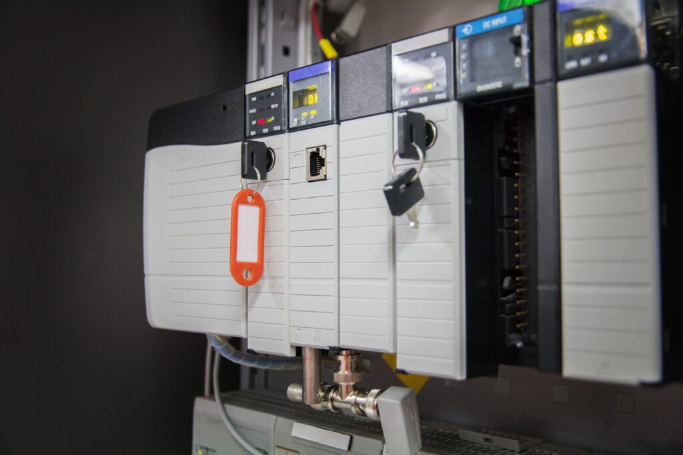
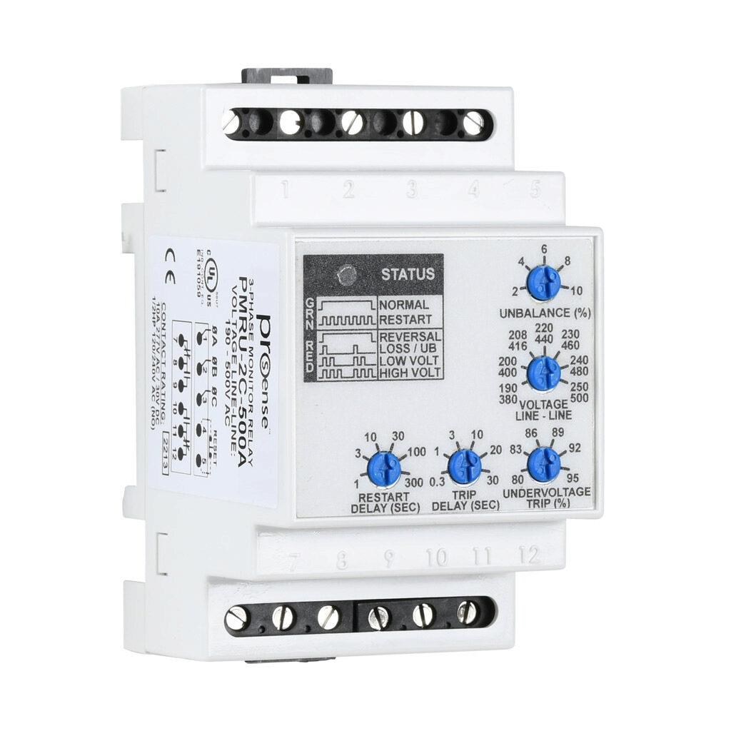
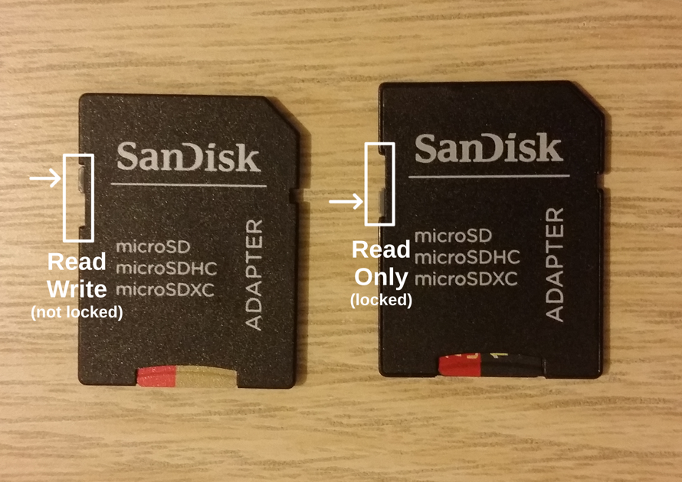
Engineered Controls in Practice
Use of a mode key prevents updating of a PLC controller (BESS controller, site controller, etc.) unless you are physically at the unit.
Phase monitoring relay can be used to provide a non-digital control decision when a cyber attack creates a phase reversal, phase loss, phase unbalance, overvoltage and undervoltage scenario in 3-phase systems (AC Inverter Side)
Image Source: https://www.automationdirect.com/adc/shopping/catalog/relays_-z-_timers/phase_monitoring_relays
Image Source: https://www.dragos.com/blog/industry-news/value-of-plc-key-switch-monitoring/
SD Card has a toggle switch to change from Read-Write to Read Only to prevent manipulation (firmware updates, code files, etc.)
Image Source: https://9to5answer.com/unable-to-open-dev-sdb-read-write-read-only-file-system

Slide 42
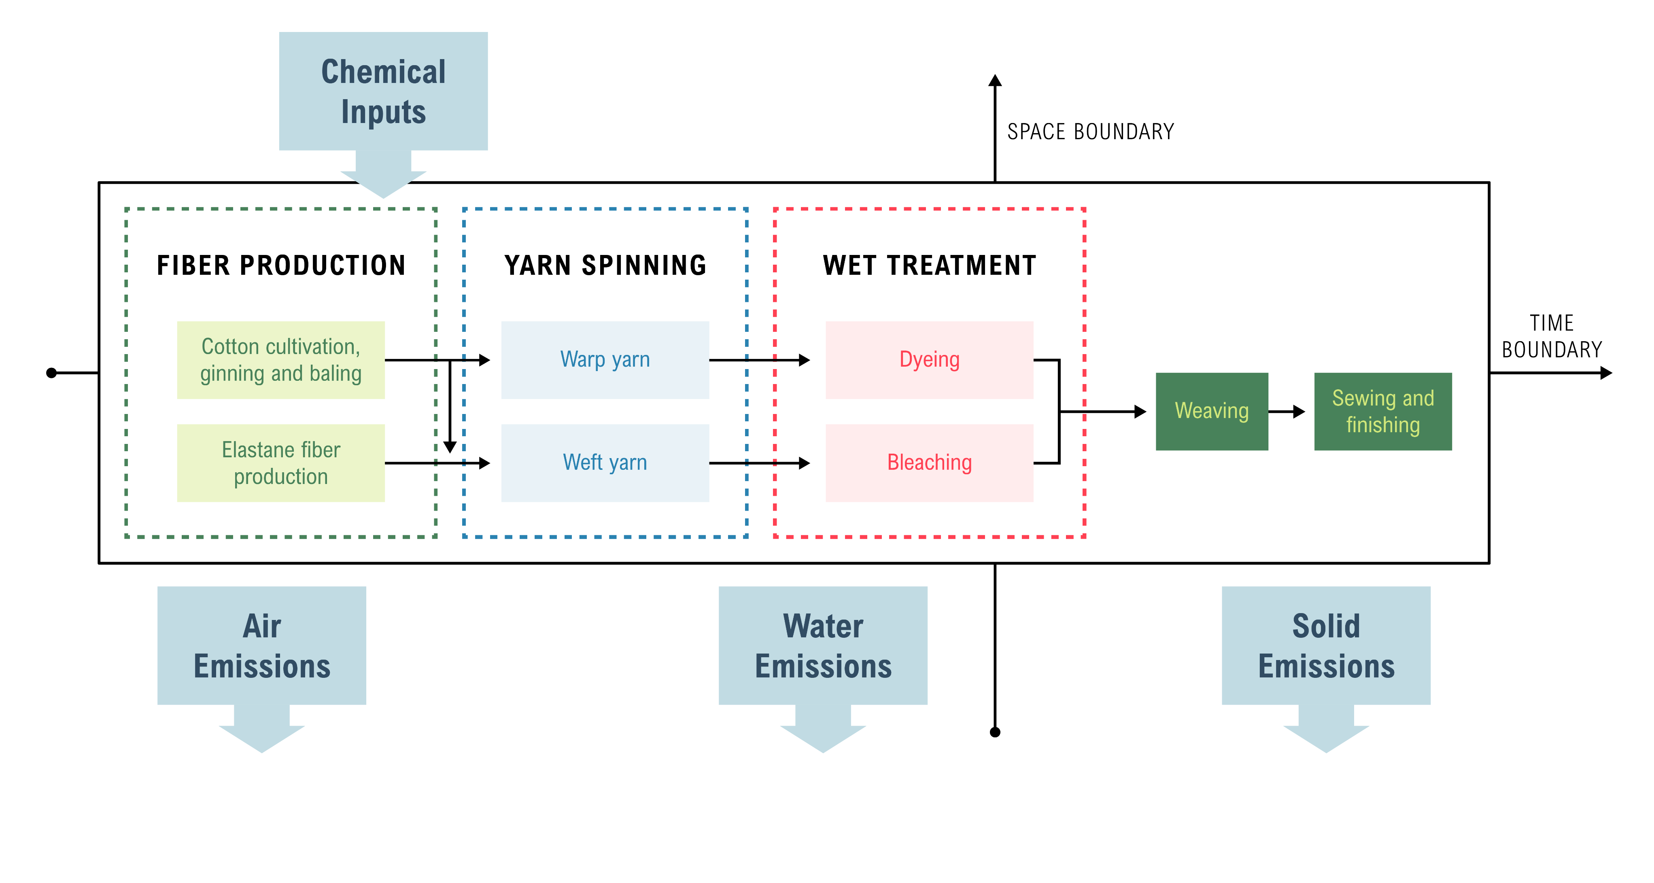
Secure Information Architecture
How do I prevent undesired manipulation of important data?
For our critical functions:
  What is the critical data?
  What systems originate, change, and validate?
  How will data flow?
  How should we group the data flows and data?
  How can we create monitorable boundaries?
  Where are areas of implicit trust?

Slide 43
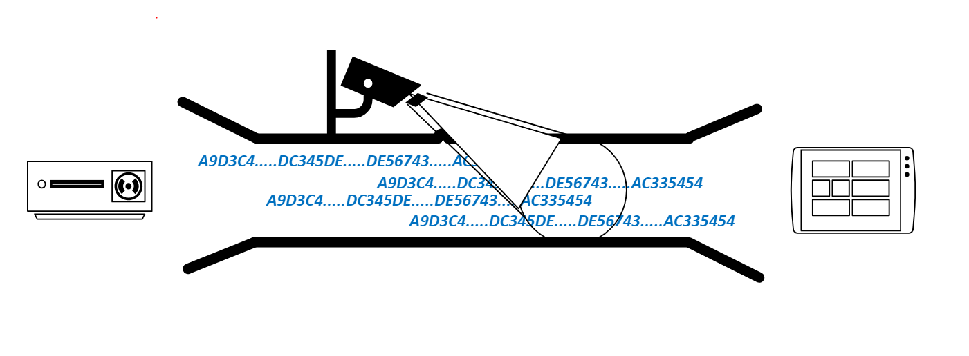
Secure Information Architecture in Practice
Key data is used between communicating equipment when sensing and commanding a critical function in the system. This information is best understood by the engineering staff, who should help inform:
Monitoring Policy and Rules
Firewall Policy and Rules
Network Segmentation
For example, the heartbeat signal that is often used in microgrid installations between the energy management system (EMS) and the BESS Controller to allow for power mode commands to be accepted could be seen as a key piece of data that should be protected and monitored for.

Slide 44
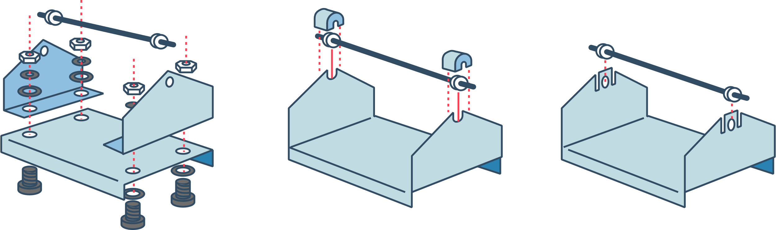
Design Simplification
How do I determine what features of my system are not absolutely necessary to achieve the critical functions?
Are all of the elements of my design actually required?
How do I reduce complication?
What do I lose by simplifying?
Graphic adapted from: http://www.slideshare.net/BabasabPatil/product-design-ppt-doms

Slide 45
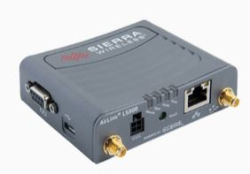
Design Simplification in Practice
Cell modems are often installed in systems to provide a digital communication between a vendor and their equipment such as a BESS installation.
This path is often redundant to a physical communication path through a site firewall and site router to an EMS service. Design Simplification would suggest removing this “alternate” path and require communication only through the firewall.
Image source: https://www.radwell.com/Shop?source=GoogleShopping&IgnoreRedirect=true&ItemSingleId=195062231

Slide 46
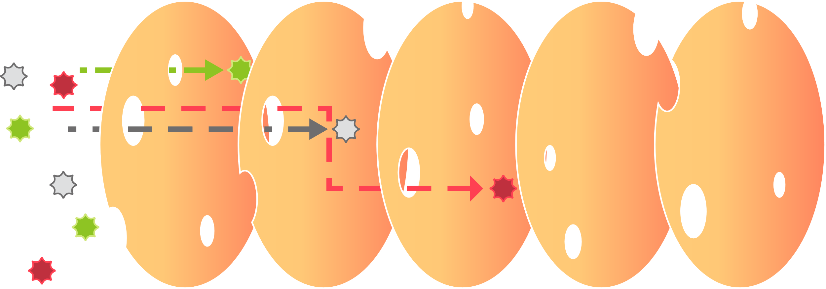
Layered Defenses
How do I create the best compilation of system defenses?
Reason’s Swiss Cheese Model adapted from: https://skybrary.aero/articles/james-reason-hf-model

Slide 47
Layered Defenses in Practice
Cybersecurity Controls
Engineering Controls
Network Segmentation
Access Control (i.e. passwords, RBAC, etc.)
Monitoring
Backups
Updates
Physical Access Control
Etc.
PLC Mode Keys
Analog Circuitry
Manual Modes of Operation
Feasibility Checks in Process Logic
Etc.
Reduce Impacts
Reduce Likelihood

Slide 48
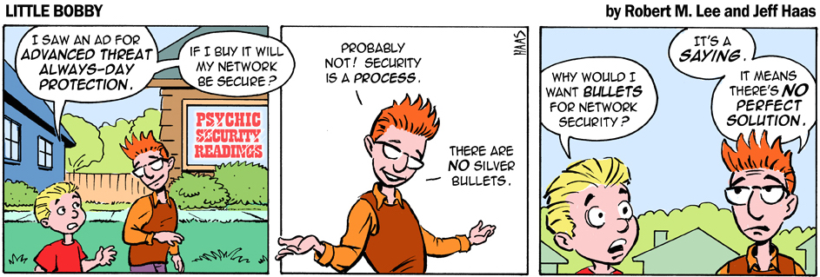
Active Defense
How do I proactively prepare to defend my system from any threat?
How do I protect what I designed?
How can engineers and IT collaborate in defense?
How do we exercise/practice defense?
Have we developed policies and procedures?
Used with permission from: https://www.recordedfuture.com/active-cyber-defense-part-2/

Slide 49

Active Defense in Practice
Operator training includes recognizing indicators, events, or controls available when determining or responding to cyber threats.
When the mouse moves without your control, do you have a procedure to help an operator respond correctly?
At what point does the IT security team call the OT engineering teams when the IT team detects cyber anomalies?
When is the last time we exercised one of our resilience strategies?
Image Source: https://www.saskwind.ca/power-and-renewables/system-operators/

Slide 50
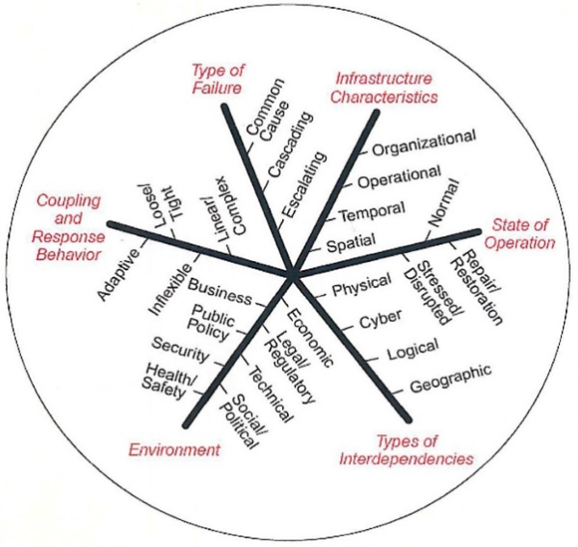
Interdependency Evaluation
How do I understand where my system can impact others or be impacted by others?
Image adapted from: http://witandwisdomofanengineer.blogspot.com/2010/11/infrastructure-interdependencies.html

Slide 51
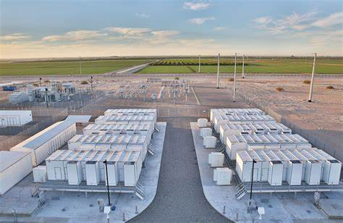
Interdependency Evaluation in Practice
Microgrid installations often have multiple energy sources (BESS, PV, Wind, Synchronous Generators like Propane, etc.).
Given a digital manipulation, could certain energy sources be used against others to create an unacceptable consequence?
Image Source: https://powersecure.com/customer-solutions/our-solutions/basic-microgrid/

Slide 52
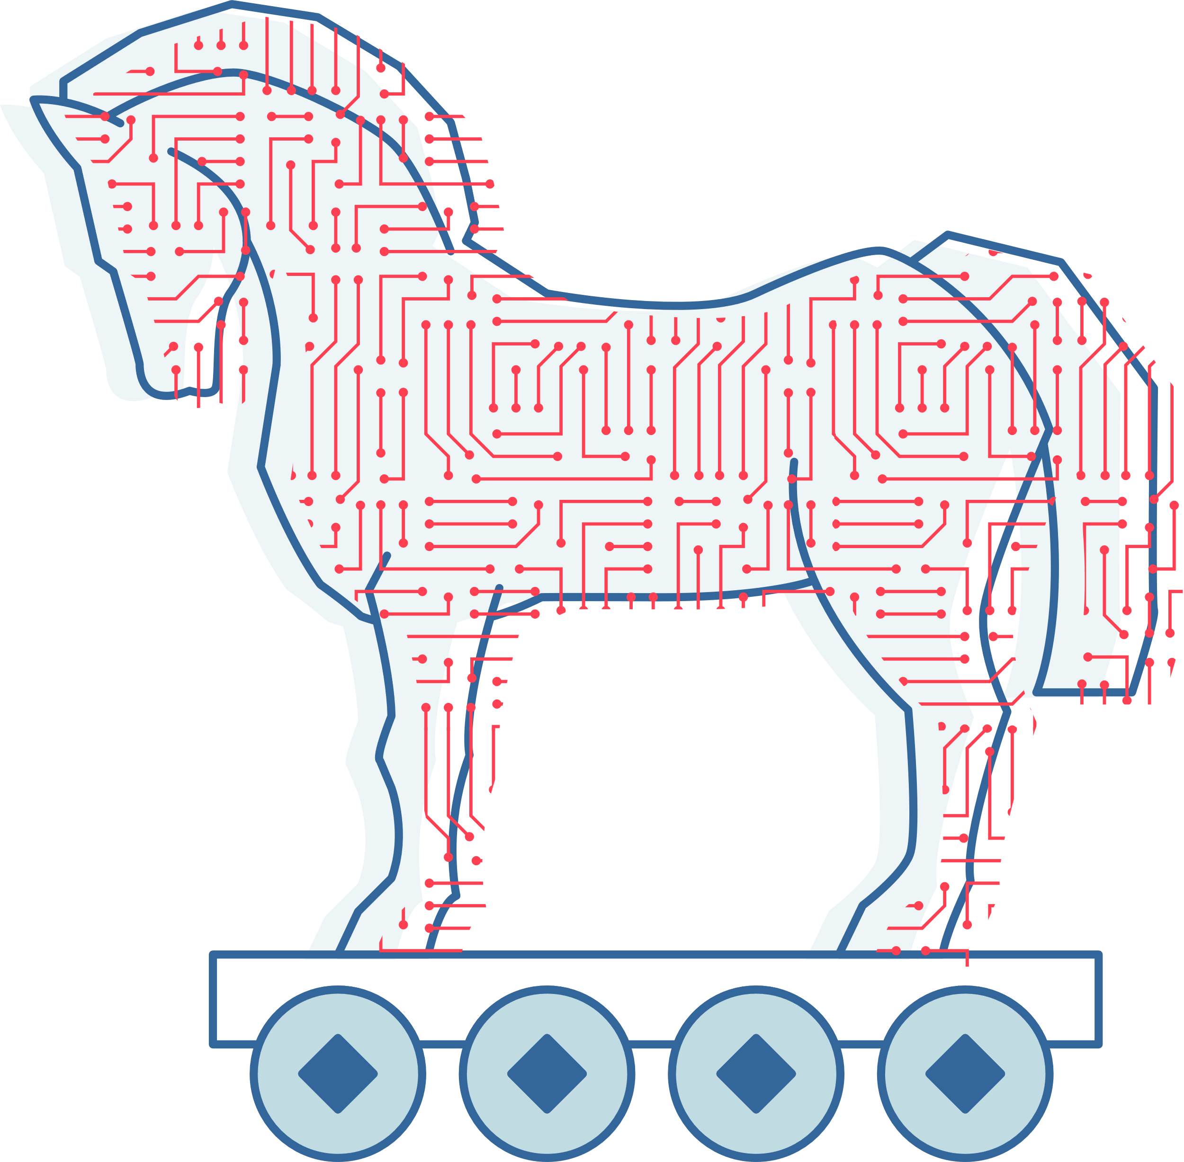
Digital Asset Awareness
How do I understand where digital assets are used, what functions they are capable of, and our assumptions about how they work?
Digital systems are different from their analog counterparts
  Turning off features doesn’t remove them
  Digital features area a source of different risks
One way of tracking risk is keeping an inventory of digital assets
  Simple? Maintaining accuracy is not simple
How do you protect this information?

Slide 53
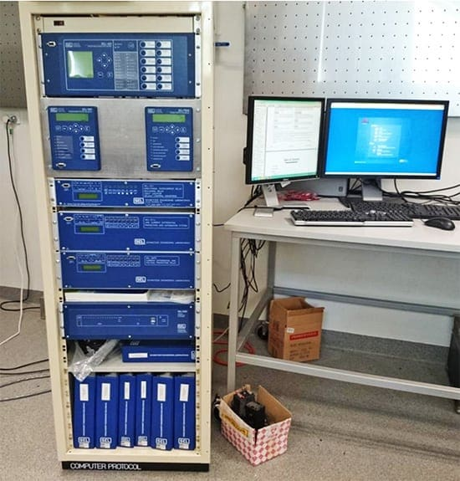
Digital Asset Awareness in Practice
Given the push to modernization, most control and protection devices are providing digitally-delivered functionality.
How could a cyber attack impact critical controls and protections?
Image Source: https://electrical-engineering-portal.com/download-center/books-and-guides/relays/overcurrent-differential-protection

Slide 54
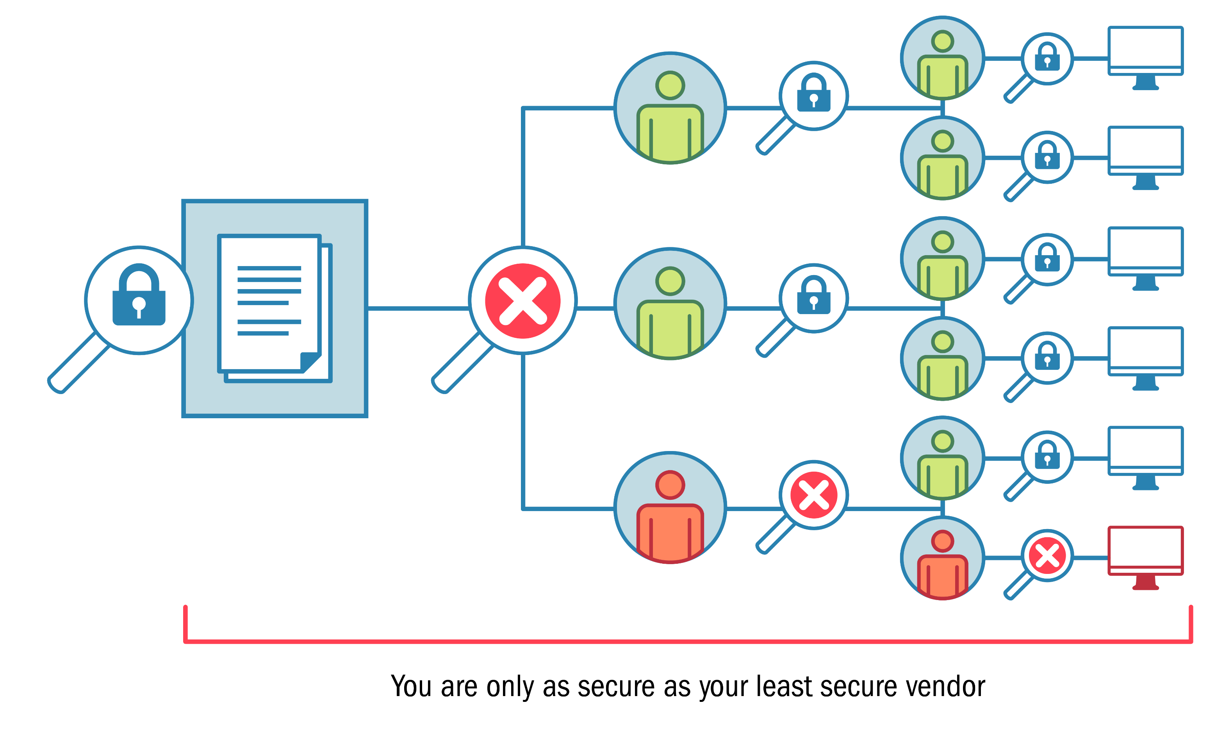
Cyber-Secure Supply Chain Controls
How do I ensure my providers deliver the security the system needs?
How do cyber security requirements flow to vendors, integrators, and third-party contractors?
  What assumptions are we making?
Does procurement language must specify the exact requirements a vendor must comply with as part of the system design, build, integration, or support?
How do we verify compliance?

Slide 55
Cyber-Secure Supply Chain Controls in Practice
Adapted from https://www.sciencedirect.com/science/article/pii/S1364032117312844#f0010

Slide 56
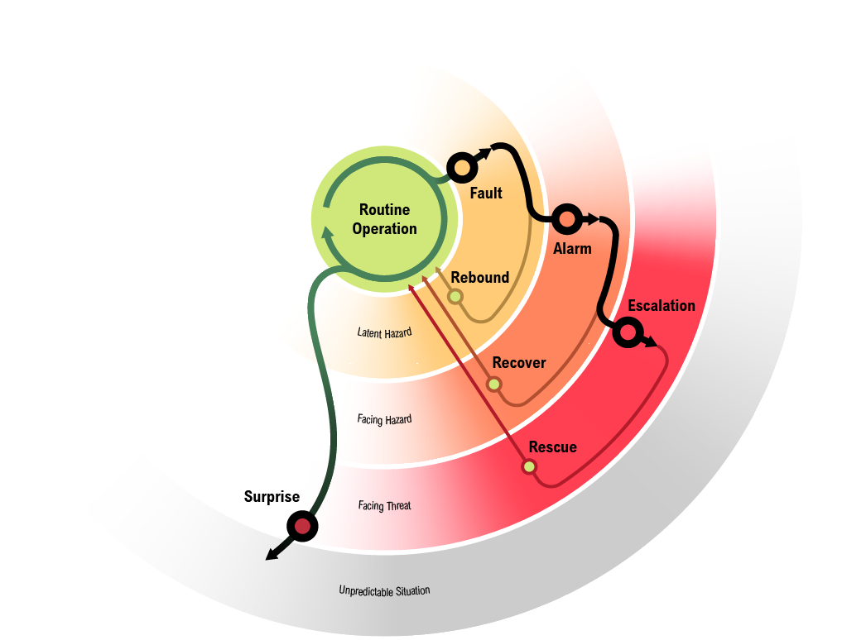
Planned Resilience
How do I turn “what ifs” into “even ifs”?
What are the limits of acceptable degradation for critical system functions and what alternate operating modes would protect and maintain those critical system functions within acceptable limits?
How does the organization maintain business continuity and critical function delivery through incident response and recovery?
How will resilience measures be validated?

Slide 57
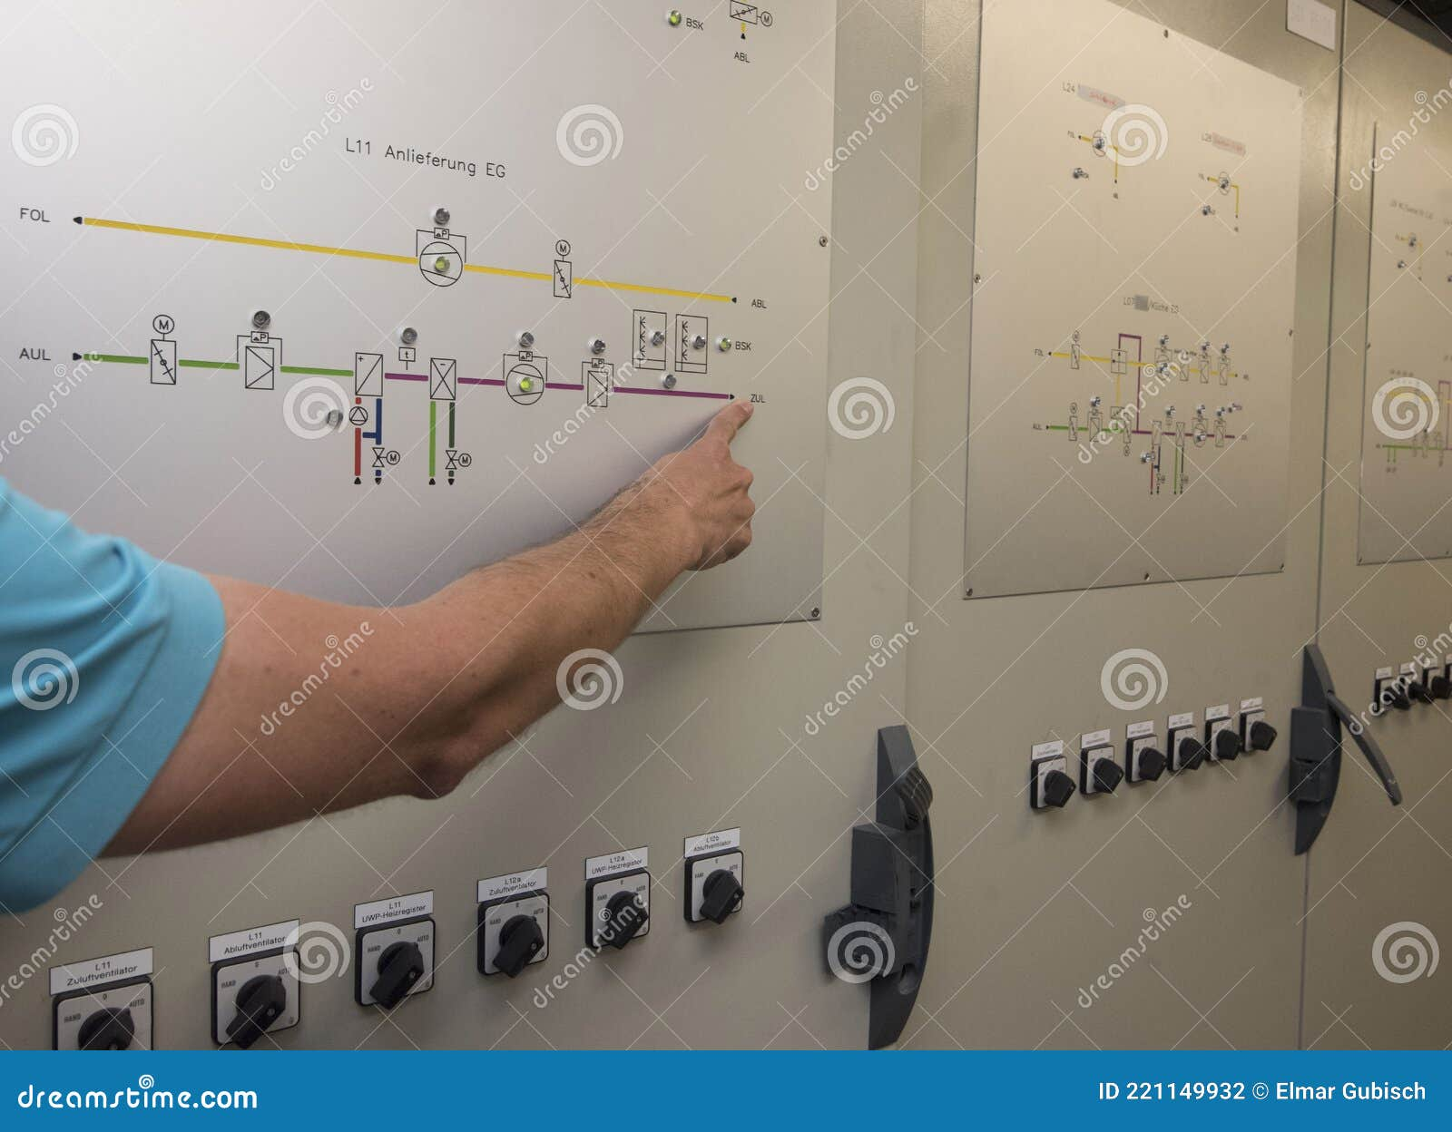
Planned Resilience in Practice
Day Without Automation (DWOA) Tabletop Exercise & System Design
People
Process
Technology
Image Source: https://www.dreamstime.com/analog-control-room-controlling-machines-working-processes-image221149932

Slide 58
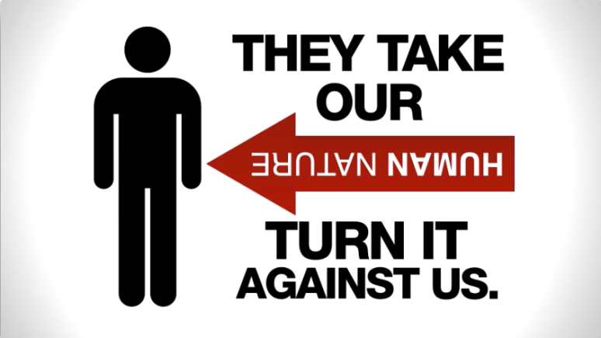
Engineering Information Control
How do I manage knowledge about my system? How do I keep it out of the wrong hands?
What information should we protect?
Who has and should have it?
How do we protect it?
Image from: https://www.uscomputer.com/2016/02/16/employee-education-thwarts-social-engineering-threat/

Slide 59

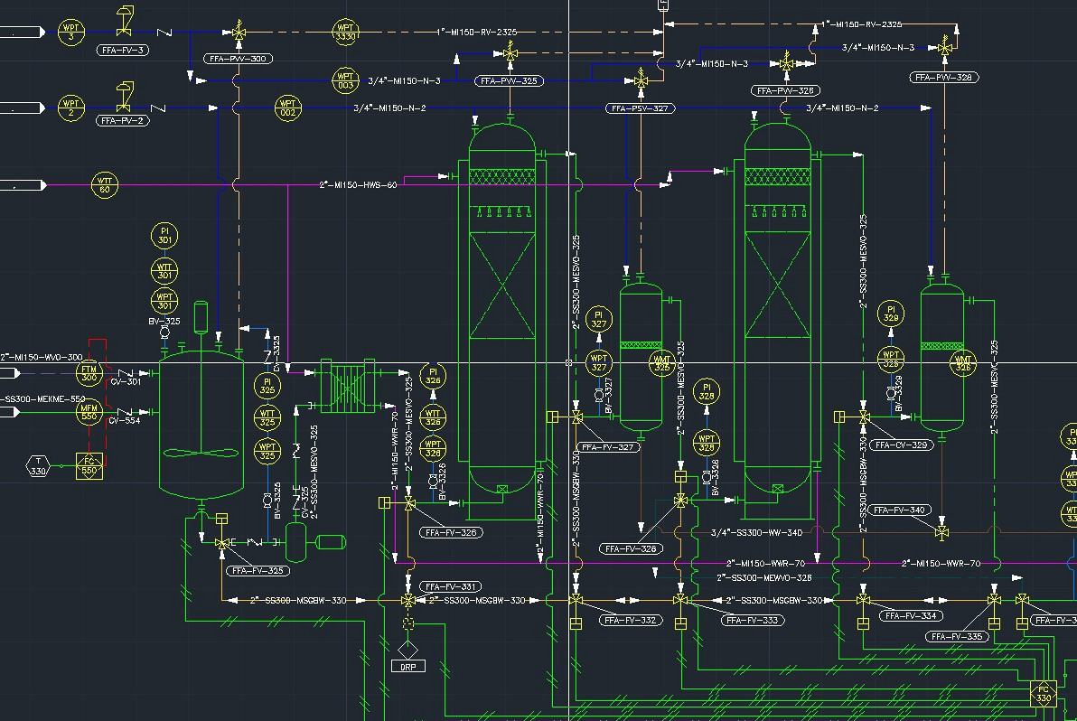
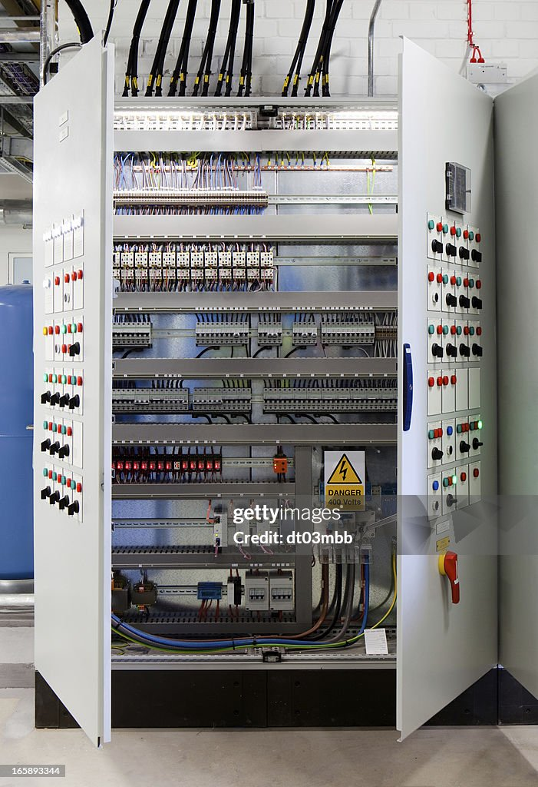
Engineering Information Control in Practice
https://jefersoncosta.com/what-is-pid-piping-and-instrumentation-diagram-or-process-and-instrumentation-diagram/
Image Source: https://www.gettyimages.com/detail/photo/systems-control-cabinet-royalty-free-image/165893344
Image Source:
https://www.recruit.net/job/plc-technician-spf--jobs/E193F6688698F576?utm_campaign=google_jobs_apply&utm_source=google_jobs_apply&utm_medium=organic

Slide 60
Organizational Culture
How do I ensure that everyone’s behavior and decisions align with our security goals?
Conversations
Explicit Assumptions
Collaboration on Projects
Include cyber security into engineering and engineering into cyber security
Ensure entire staff is enlisted and endorses cyber security
Ensure staff understand and follow processes and procedures
  All it takes is one user to lower security posture
How do we encourage a questioning attitude?
How can we provide the same rigor for cybersecurity as physical protection security and safety?
Assessments
Scenarios
Exercises

Slide 61

Organizational Culture in Practice
For example, are employees rewarded for speaking up about cybersecurity?
Do all people and stakeholders involved in the project have the same worldview when it comes to system security?
Image Source: https://www.trustntm.com/how-to-create-a-culture-of-cybersecurity-in-your-organization/

Slide 62
So Where from here with CIE?

Slide 63
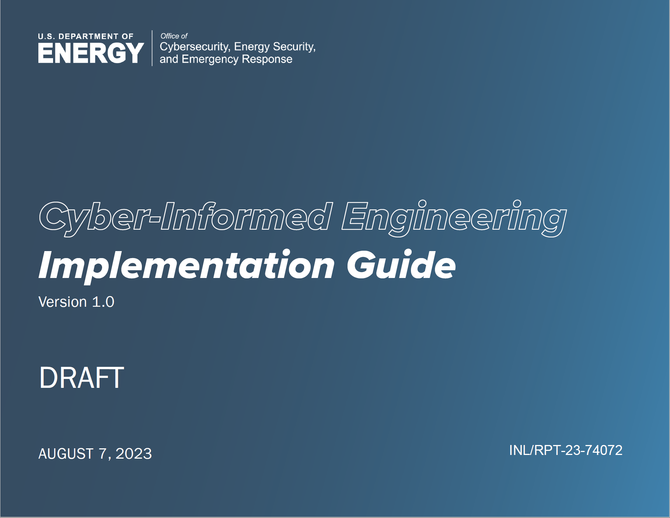
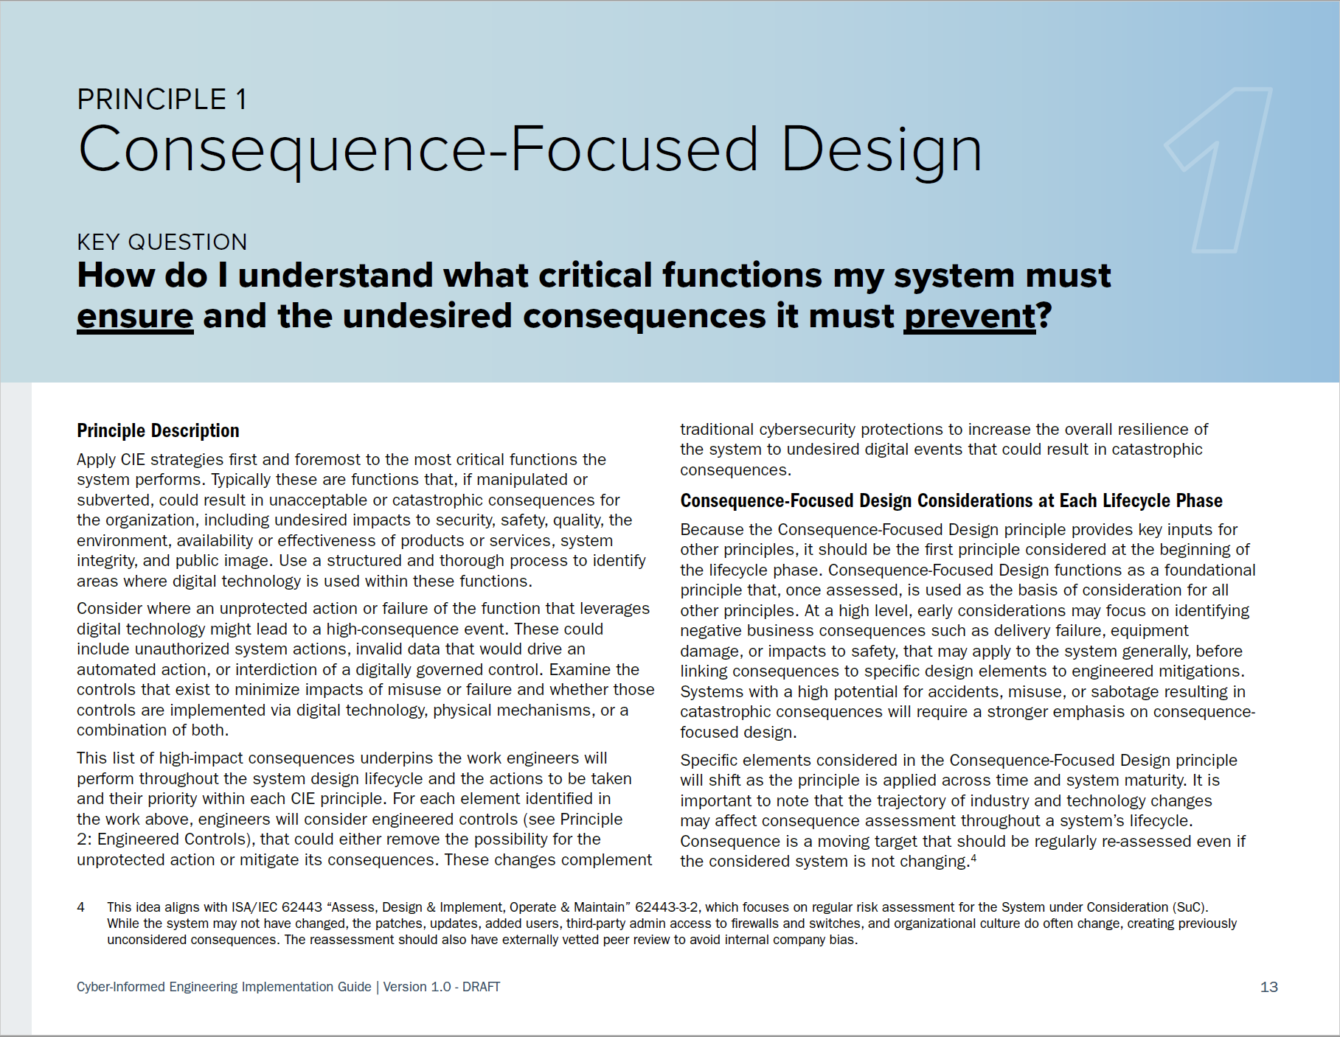
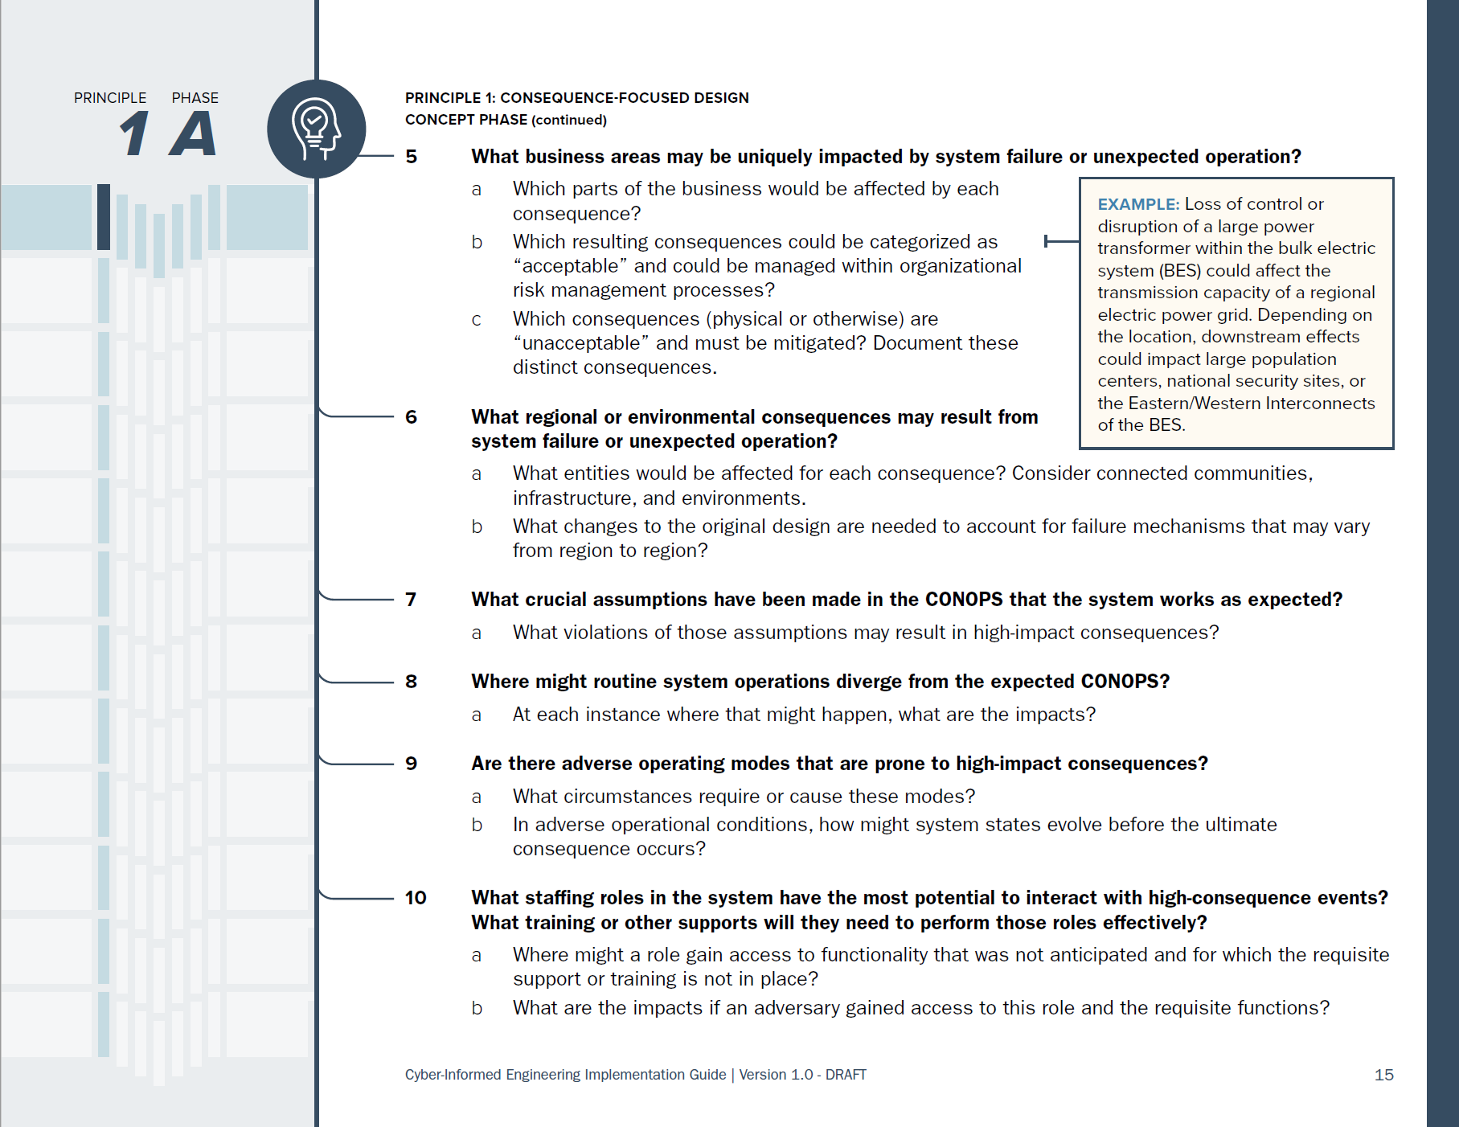
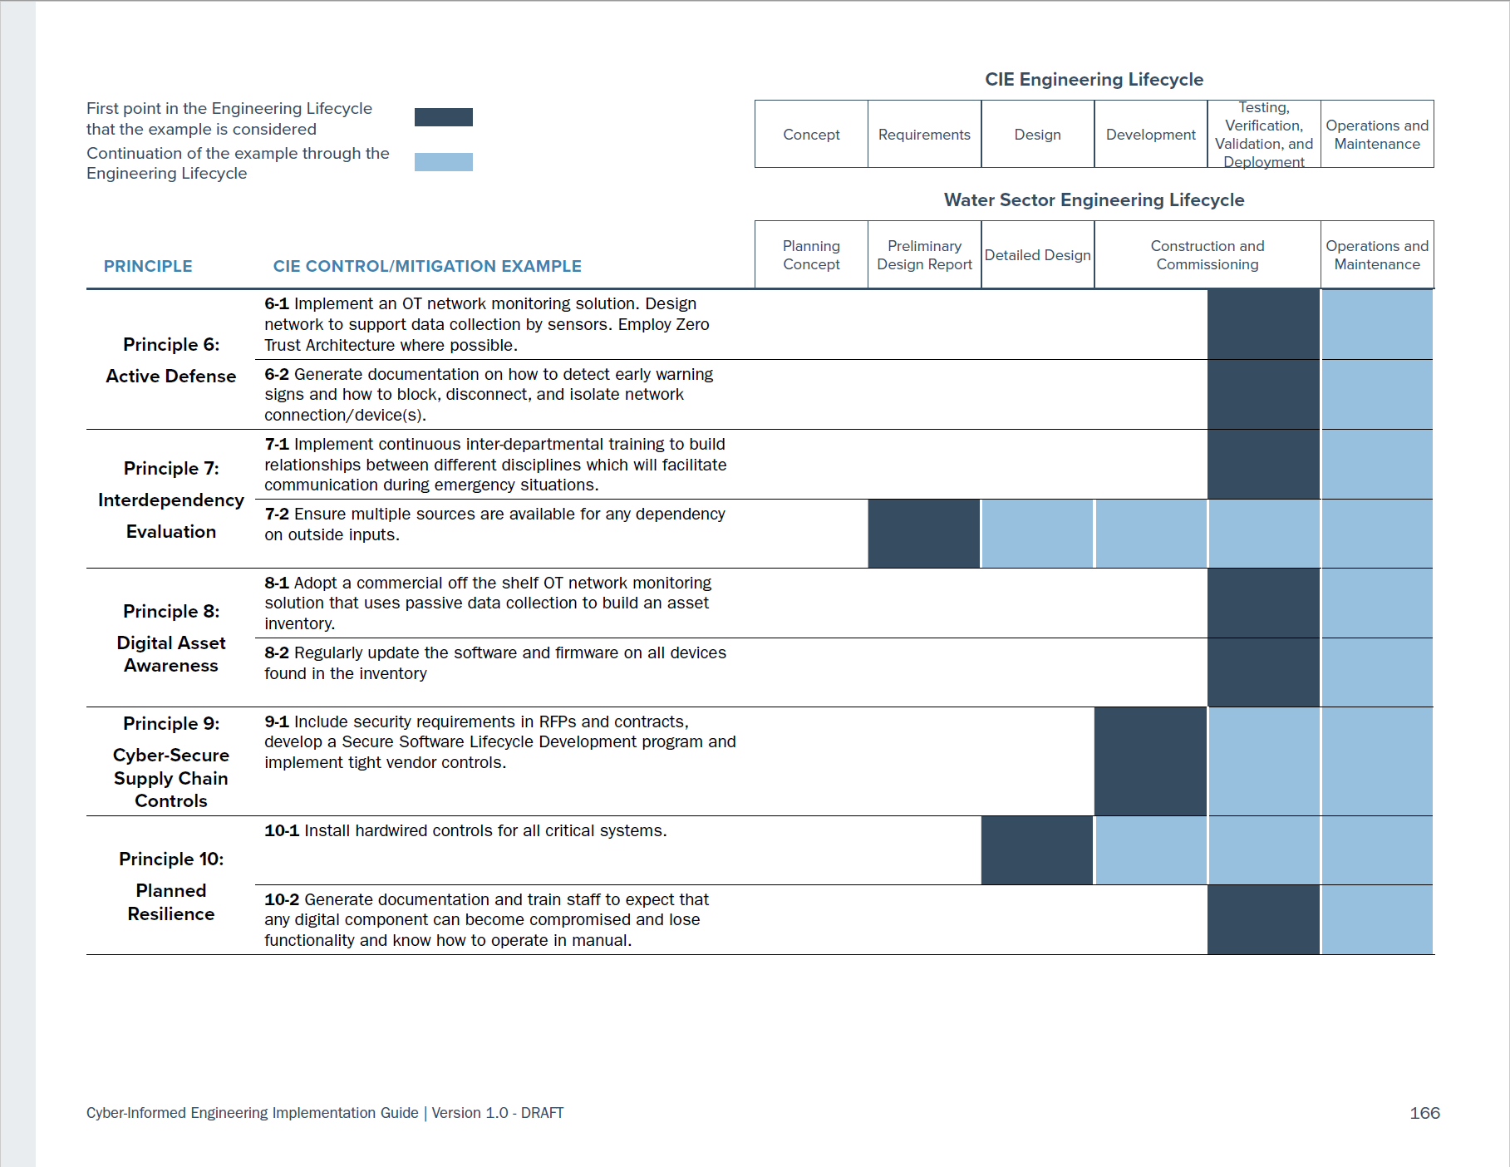
CIE Implementation Guide
https://www.osti.gov/servlets/purl/1995796
Notes:
In the appendix of the implementation guide is an example of CIE applied to a water-sector project. In that case study, a specific system is examined, with specific system consequences and the engineered solutions to mitigate them that the team creates. This example allows teams to explore what implementation of CIE on their systems engineering projects might look like.

Slide 64
CIE COP and Working Group Purpose
Cyber-Informed Engineering COP
Quarterly
11 AM ET on the 2nd Wednesday of January, April, July, and October
CIE Standards WG
Monthly
1st Wednesday, 9 AM MT / 11 AM ET
CIE Education WG
Monthly
3rd Wednesday, 9 AM MT / 11 AM ET
CIE Implementation WG
Monthly
4th Wednesday, 9 AM MT / 11 AM ET
Support integration of CIE into engineering and cybersecurity standards
Develop curricula and materials that integrate CIE principles into engineering degree programs
Multi-stakeholder team to aid the translation of CIE into technical requirements that can inform guidance, practices, and standards development
Develop CIE implementation guidance and an open-source library of resources
64
Notes:
In 2023, CESER through the national labs initiated a CIE community of practice and multiple working groups in response to the strategic recommendations to 1) lead a CIE awareness campaign to support a shift in the culture of energy infrastructure engineering and operations, and 2) Develop policy initiative and build partnerships to incentivize the broad adoption of CIE in the energy industry. The COP’s aid CESER and the labs to understand the needs of universities, standards organizations, asset owners, engineering design organizations and vendors and tool providers for the energy sector.

Slide 65
Recent CIE Publications
Websites
  DOE CESER CIE Website -- https://www.energy.gov/ceser/cyber-informed-engineering
  INL CIE Website - https://inl.gov/cie/
  NREL CIE Website - https://www.nrel.gov/security-resilience/cyber-informed-engineering.html
Publications
  CIE Implementation Guide: https://www.osti.gov/biblio/1995796
  CIE Workbook for ADMS: https://www.osti.gov/biblio/1986517
  CIE Workbook for Microgrids: https://www.osti.gov/biblio/2315001
  CIE Workbook for Water Systems: https://www.osti.gov/biblio/2371031
  CIE Assessment Tool: https://github.com/inlguy/CIE/releases/tag/v12.2.4.0
Articles and Briefings
  SANS ICS Concepts Video: https://youtu.be/o_vIxW6UTeg
  Industrial Cyber: CIE and CCE Methodologies Can Deliver Engineered Industrial Systems for Holistic System Cybersecurity (June 11, 2023) with interviews from INL, 1898, and West Yost
  Harvard Business Review: Engineering Cybersecurity into U.S. Critical Infrastructure (April 17, 2023) by Ginger Wright, Andrew Ohrt, and Andy Bochman
  Shift Left video podcast on GrammaTech blog: Shifting Left for Energy Security (April 4, 2023) with Ginger Wright, Idaho National Lab and Marc Sachs, Auburn University
  For more CIE articles and publications, visit: inl.gov/cie
Under Development
  CIRRUS - Tool for leveraging CIE for consideration of OT in the Cloud
  CIE Microgrid Tool - Tool for leveraging CIE in the design of microgrids
  CIE BESS Tool - Tool for leveraging CIE in the design of BESS installations
  Discussions with CISA Secure by Design
Just Released!

Slide 66
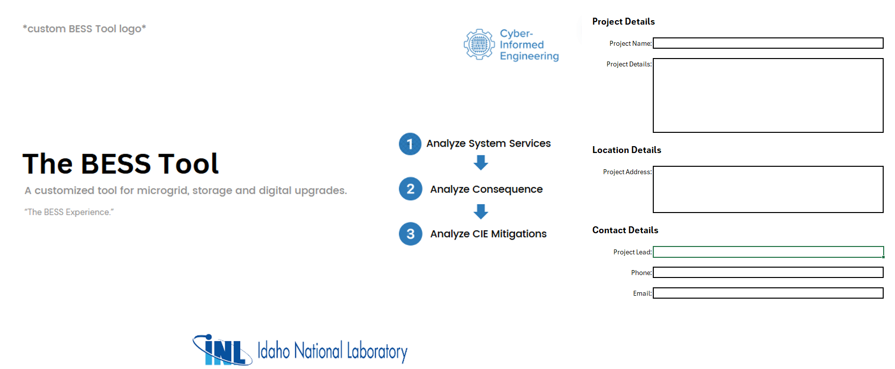
CIE BESS Analysis Tool (CIEBAT)

Slide 67
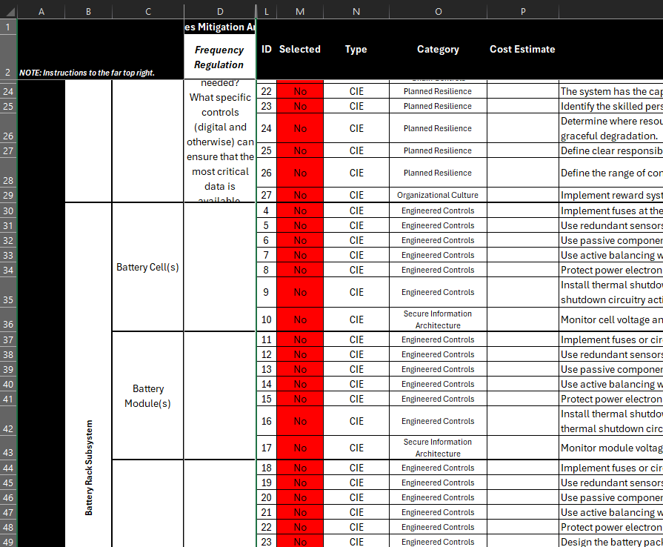
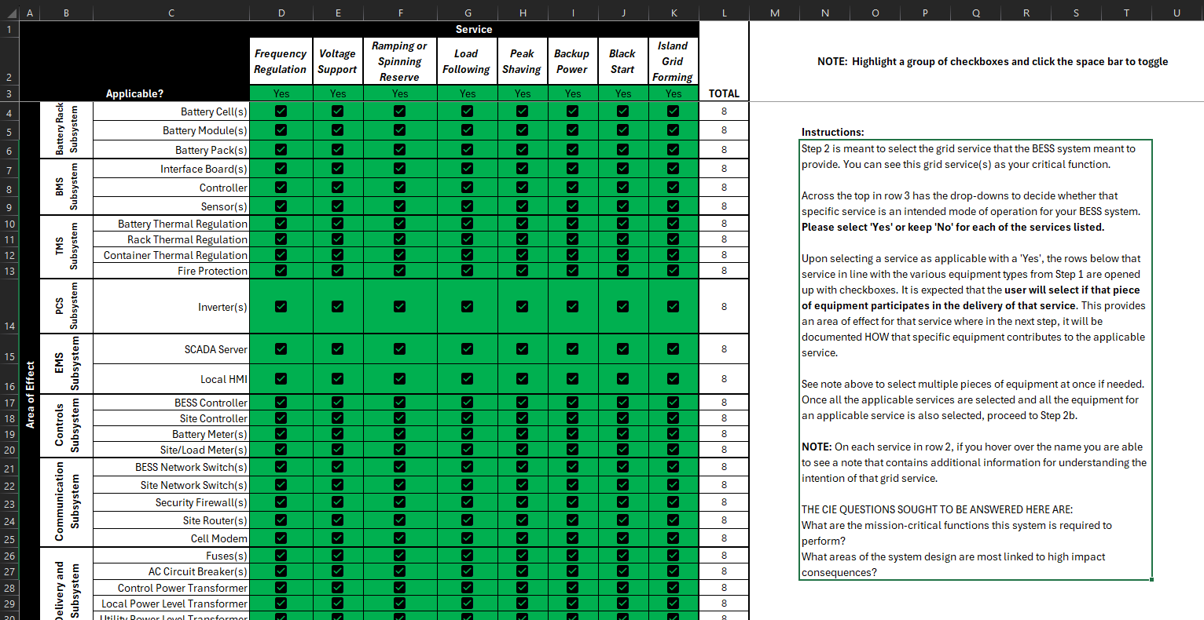
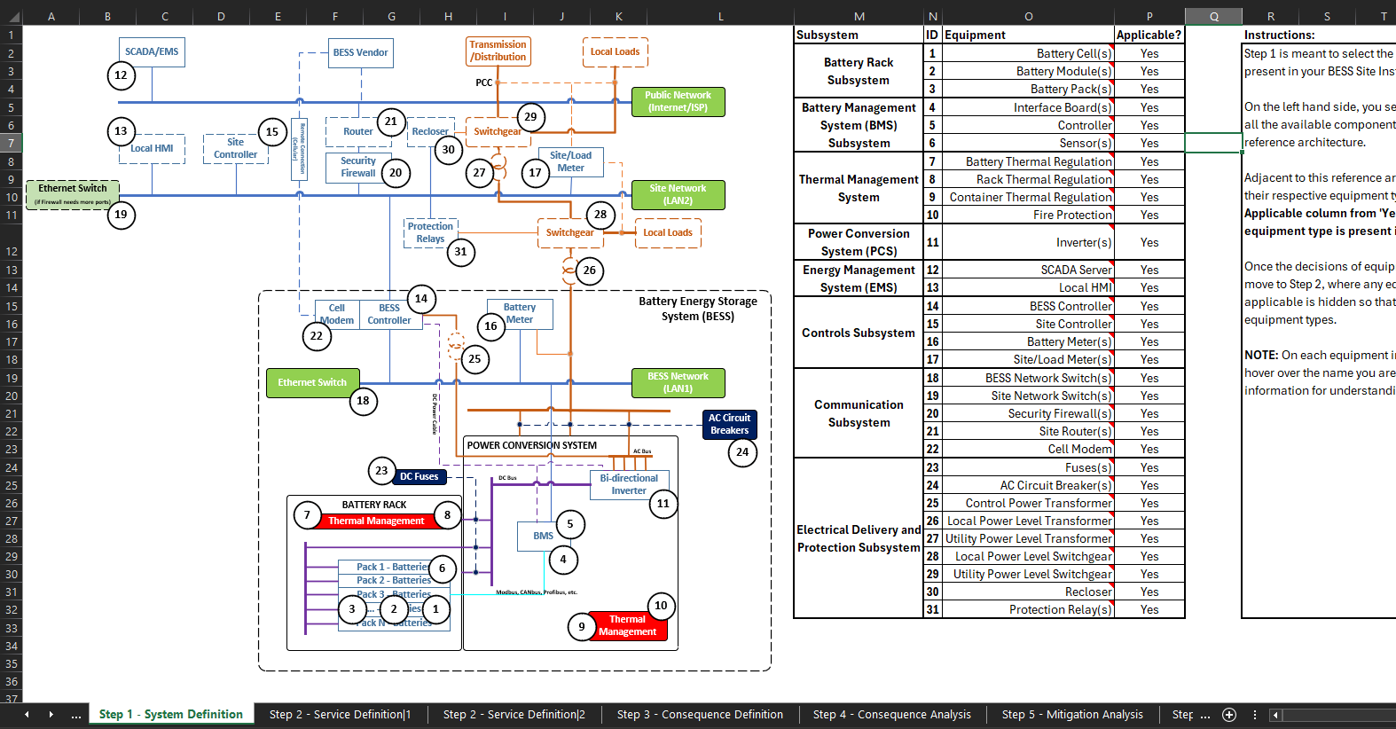
CIE BESS Analysis Tool (CIEBAT)

Slide 68
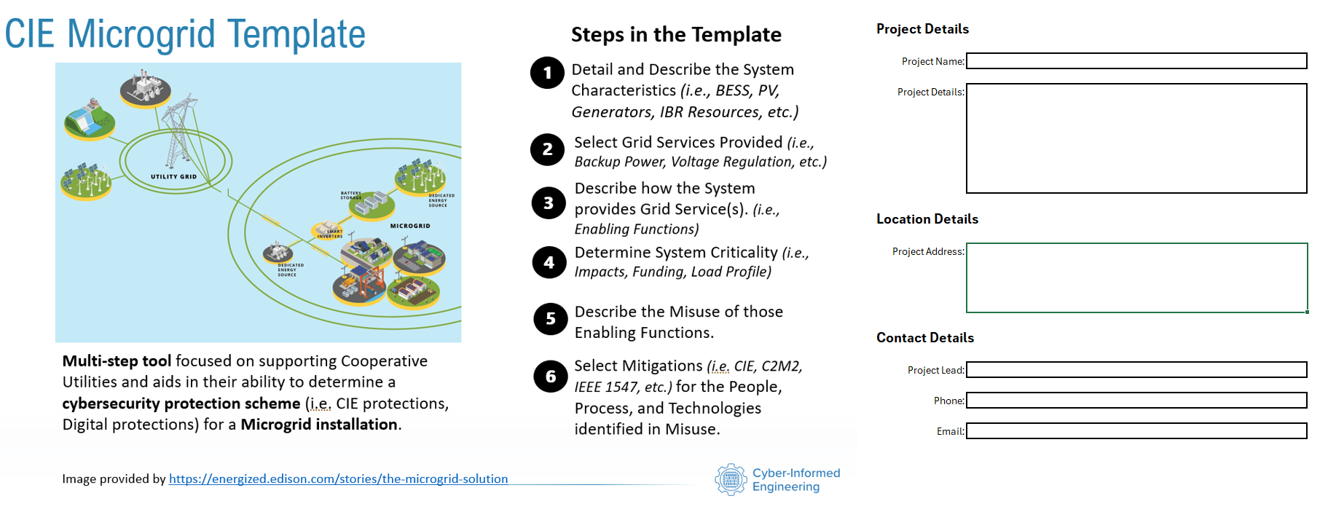
CIE Microgrid Analysis Tool (CIEMAT)

Slide 69
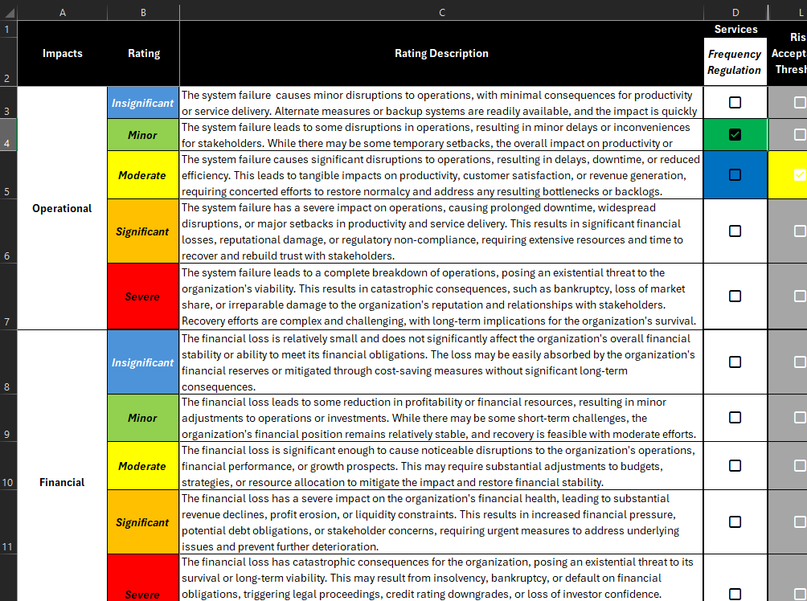
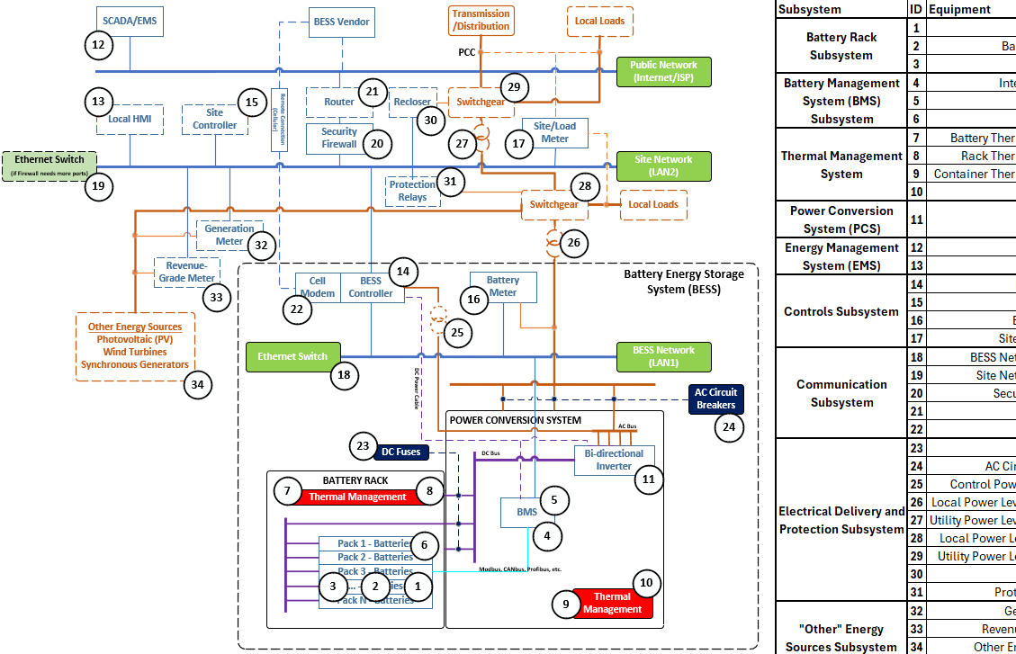
CIE Microgrid Analysis Tool (CIEMAT)

Slide 70

Thank You!
CIE@inl.gov
https://www.energy.gov/ceser/cyber-informed-engineering

